Slide 1
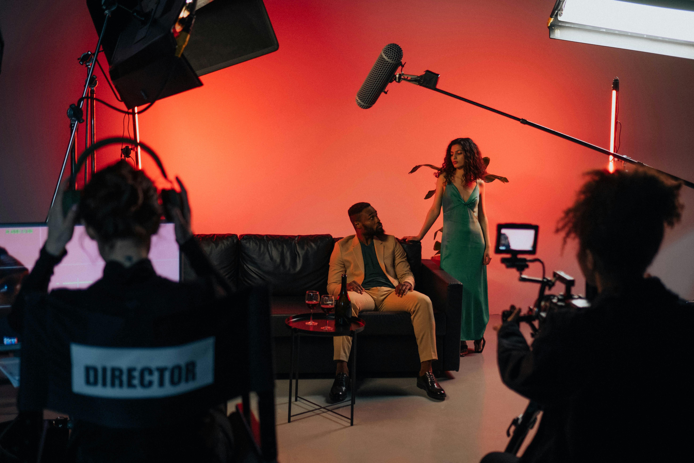

FILM, MEDIA & CREATIVE
WORKSHOP
LMI CONFERENCE
JAN 2025

Slide 2

x

Slide 3
WHERE DO THEY WORK?

Slide 4
POST-PRODUCTION RUNNER
LOGGER
LOCATIONS ASSISTANT
PROPS TRAINEE
EDIT ASSISTANT
CAMERA TRAINEE
GRADING ASSISTANT
FINANCE ASSISTANT
MARKETING ASSISTANT
CASTING ASSISTANT
SOUND ASSISTANT

Slide 5
PRODUCTION ASSISTANT
GRAPHICS TRAINEE
PETTY CASH BUYER
FLOOR RUNNER
GRIP TRAINEE
STUDIO UNIT ASSISTANT
LIGHTING TRAINEE
LOCATION MARSHAL
SCRIPT CLEARANCE ASSISTANT
ACCOUNTS ASSISTANT

Slide 6
HAIR AND MAKE UP TRAINEE
ART DEPT TRAINEE
DEVELOPMENT ASSISTANT
VFX TRAINEE
ENVIRONMENT ARTIST
PRODUCTION TEAM ASSISTANT
ROTO ARTIST
SOUND TRAINEE

Slide 7
COMMISSIONING / DEVELOPMENT
OFFICE

Slide 8
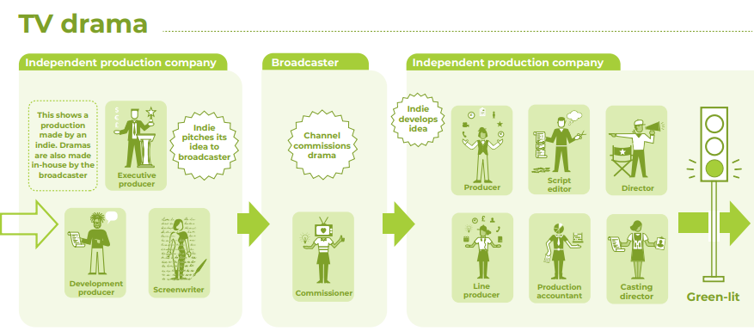
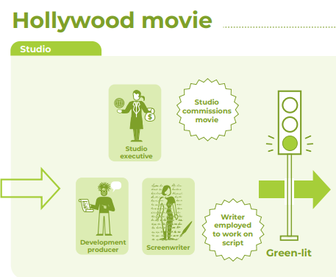
COMMISSIONING / DEVELOPMENT
DEVELOPMENT - Starting with an idea, directors, producers and screenwriters develop a film and raise the money to make it happen.
COMMISIONING - Commissioners in TV drama work for broadcasters, like the BBC, and streaming companies, like Netflix. They decide what dramas get made and when it’s going to be broadcast or released.
Notes:
Hollywood Film – e.g. NBCUniversal in LA commission Jurassic to be made. A production company is then set up specifically for this film and then shot over here.
TV Drama – Pulse Films might pitch Gangs of London to Sky Studios. Then Sky agree and either fund or part fund with other investors. Then Pulse Film make it with oversight from Sky. Sky then programme and distribute using appropriate channels – Pulse Films, Sky Studios.

Slide 9
COMMISSIONING / DEVELOPMENT
Finance assistant
Casting assistant
Production team assistant
Development assistant
Researchers
Marketing assistant*

Slide 10
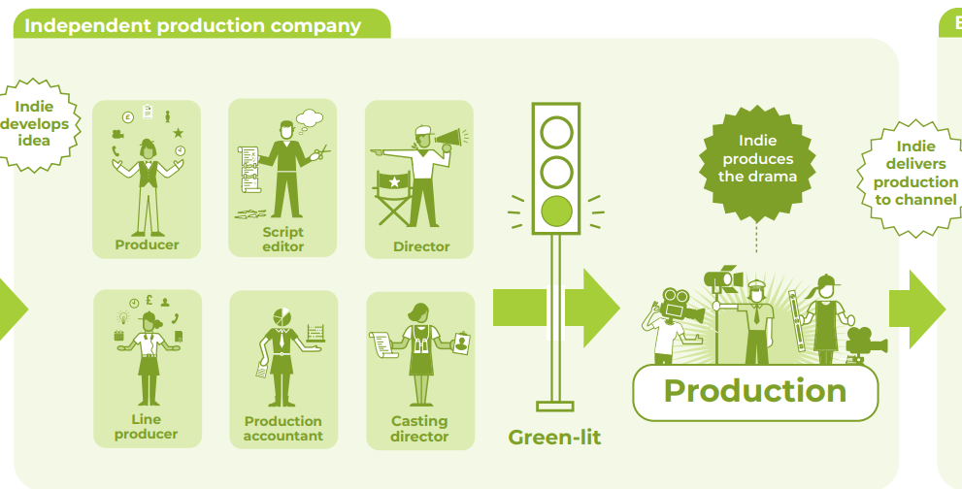
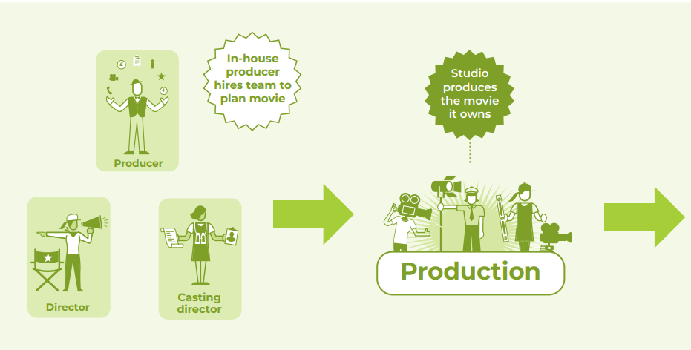
PRODUCTION
Notes:
Production starts
Employ above the line crew
Hire facilities – studio, production office, etc.
Get into production office

Slide 11
PRODUCTION OFFICE

Slide 12
PRODUCTION OFFICE
Production assistant
Draughtsperson*
Accounts assistant / cashier
Production coordinator
Logger
Production secretary
Art dept trainee*
Petty cash buyer*

Slide 13
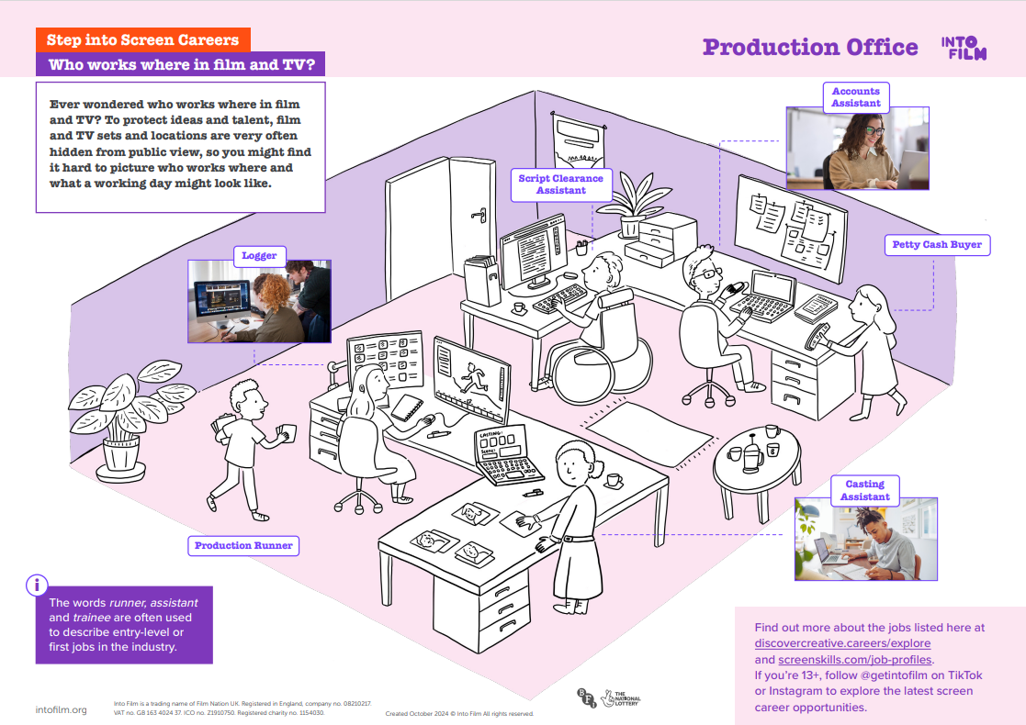

Slide 14
WORKSHOP

Slide 15
WORKSHOP
Props trainee
Graphics trainee*
Petty cash buyer*
Art dept trainee*
Costume trainee
Hair and make up
trainee
Props Master
Riggers, painters, plasterers, carpenters
Construction manager

Slide 16
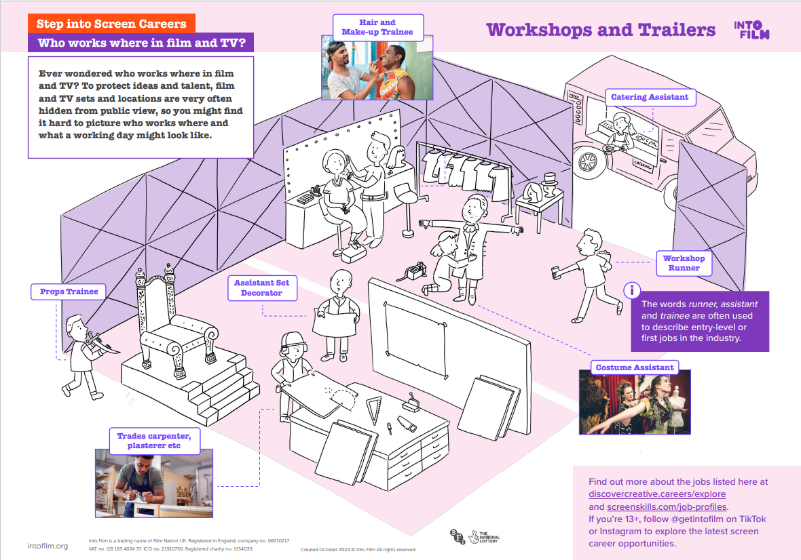

Slide 17
ON SET / ON A STAGE

Slide 18
ON SET / ON STAGE
Camera trainee
Locations assistant*
Grip trainee
Studio unit assistant
Location marshal
Lighting trainee
Sound trainee
Floor runner
Standby props assistant
Hair and makeup artists*
VFX trainee*

Slide 19
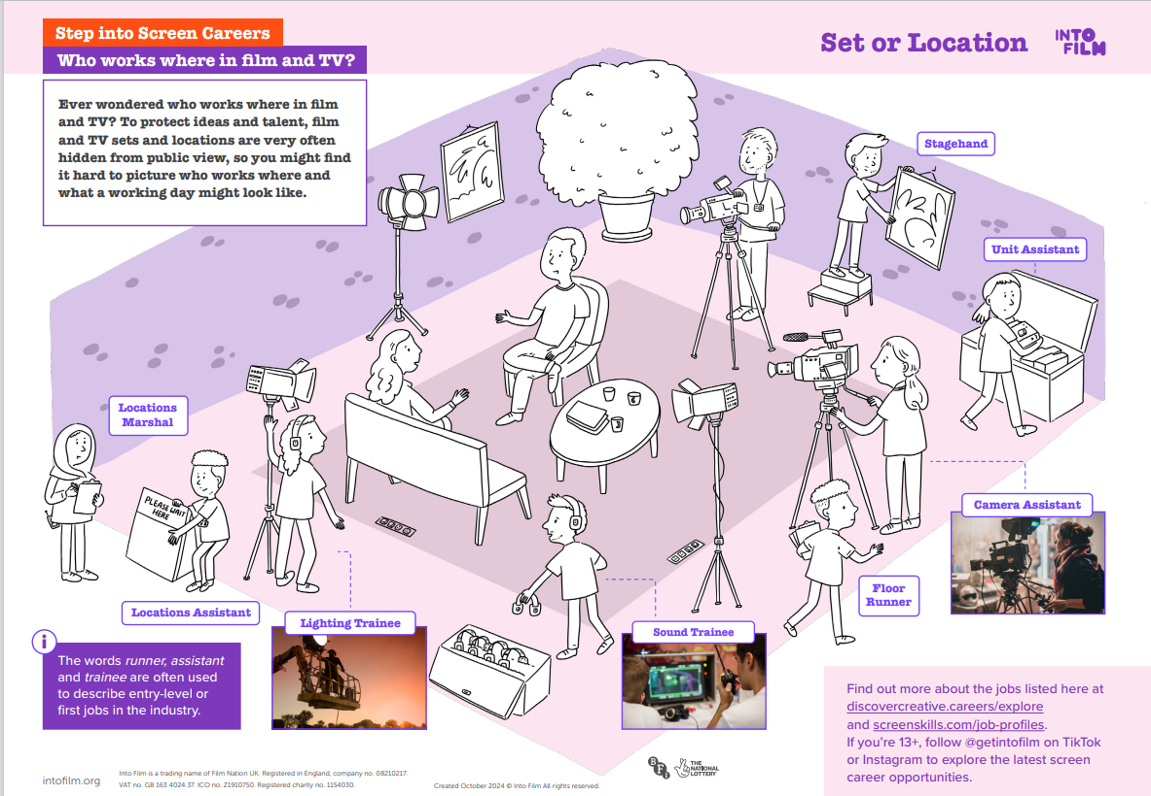

Slide 20













SUPPLY CHAIN
Notes:
Lighting and rigging
Camera
Costumes
Props
Greens
Action Vehicles
Sustainability
Post-production and Pre-vis/ VFX

Slide 21
POST-PRODUCTION /
VFX HOUSE

Slide 22
POST-PRODUCTION / VFX HOUSE
Post-production runner
Edit assistant
VFX trainee*
Grading assistant
Environment artist
Sound assistant
Roto artist

Slide 23
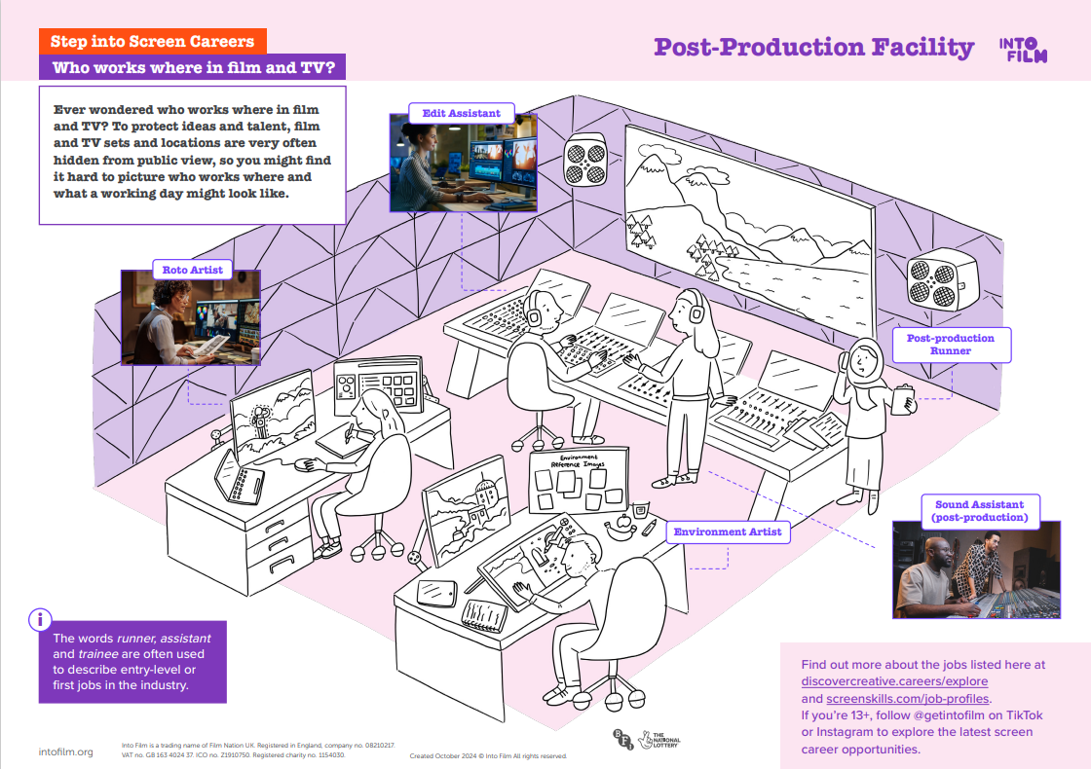

Slide 24
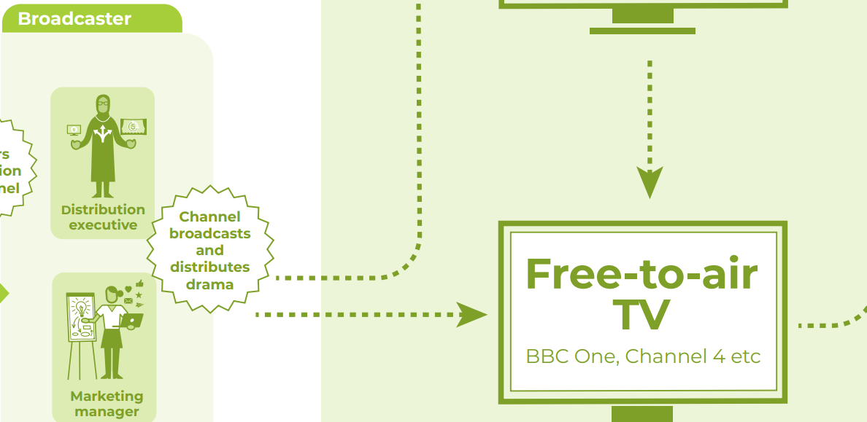

MARKETING / DISTRIBUTION

Slide 25
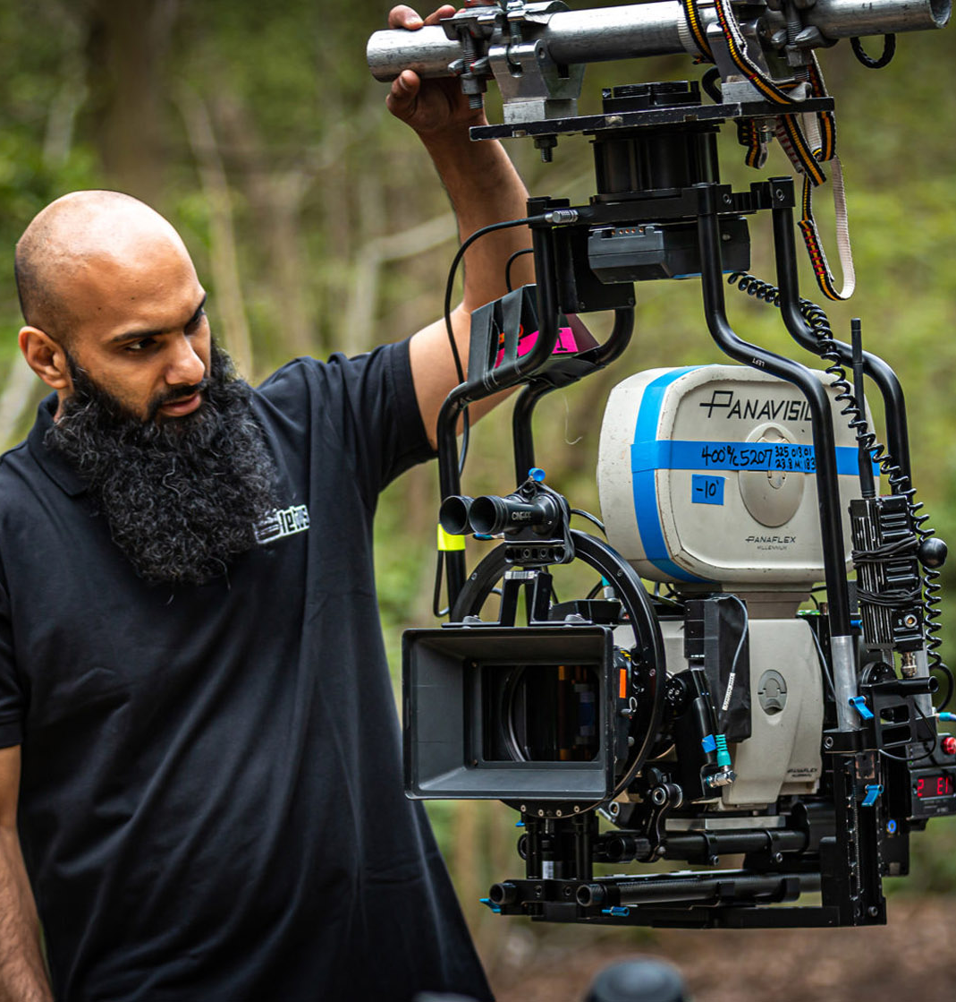
OUR MOST IN-DEMAND ROLES

Slide 26
SKILLS SHORTAGES - UK CREATIVE INDUSTRIES
Production
Location marshal
Accountant
Production secretary
Production Manager
Production Coordinator
Production Assistant
Art Department/ Construction
Costume designers
Prop makers
Hair and make-up artist
Carpenters
Painters
Plasterers
Riggers
Fashion and Textiles
Sewing machinist
Pattern cutter
Craft
Marionette making
Violin bow making
Animation
2D animator
Production manager
2D designer
Background designer
Storyboard artist
Games
3D programmer
Animator
Artist
Back-end programmer
Game designer
Network programmer
Technical artist directors
Technical artist
UI designer
Post-production & VFX
Editor
Edit assistant
VFX Effects
VFX – Rigging
Sound effects
Facial modeller
Real-time engine coder
Colourist
Dubbing mixer
Distribution & Marketing
Financial analysts
Rights and sales analysts
Pay Per Click Executive
Data experts
Technical & Electrical
First and second assistant camera
Camera operator
Lighting technician
Grip
Facilities
Caterers
Venue managers
Security staff

Slide 27





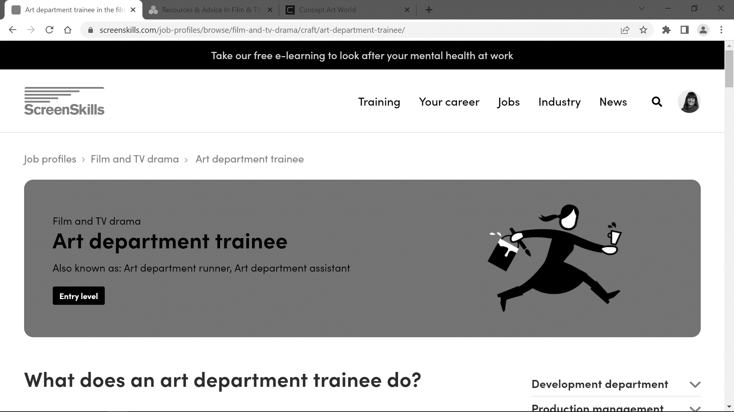
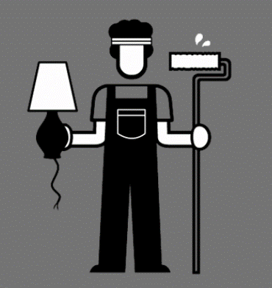


FINE ART
VISUAL ARTS
GRAPHIC DESIGN
DESIGN AND TECHNOLOGY
TEXTILES
Storyboard Artist
Concept Artist
Hair and Make Up Trainee
Costume Trainee
Art Department Trainee
Set Decorator
Texture Artist
Scene Hand

Slide 28










ENGLISH
BUSINESS
COMPUTER SCIENCE
HISTORY
GEOGRAPHY
MATHS
Cashier
Marketing Assistant
VFX Runner
Games Tester
Archivist
Script Editor
Assistant Technical Director
Trainee Broadcast Engineer
Environment Artist
Locations Trainee

Slide 29










PHOTOGRAPHY
MUSIC
FILM/MEDIA
PERFORMING ARTS
Grip Trainee
Lighting Trainee
Logger
Production Assistant
Casting Assistant
Camera Trainee
Sound Assistant
Post-Production Runner
Animation Edit Assistant
Floor Runner

Slide 30






SKILLS REQUIRED
Communication: interpreting other’s requirements and communicating requirements to departments and colleagues
Team-working: collaboration within own and with other departments
Set etiquette: the roles and responsibilities within production teams and the etiquette to follow
Problem-solving: contingency planning and resolving issues with locations so that productions remain on schedule
Planning: assisting with planning practical requirements for transport, catering, cast and crew to meet production needs
Financial skills: budget monitoring
Specialist skills: Art dept, costume, hair and makeup, editing, etc.

Slide 31





ATTRIBUTES
Resilience and enthusiasm: adapt positively to changing work, ensuring deadlines continue to be met. Proactive and explores new ideas which will enhance and deliver the best results for the production.
Productivity: organises work effectively and achieves required results within deadlines. Demonstrates the drive and energy to get things done under pressure and asks for help when necessary.
Ethics and integrity: honest in all actions and interactions. Respectful and inclusive of others and meets the ethical requirements of their profession.
Flexibility: willing to both listen and learn and to accept changing priorities and working requirements and has the flexibility to maintain high standards in a changing production environment.
Professional development: develop an ethos to learn and seek out learning and networking opportunities, identifying those that will be most beneficial.

Slide 32




QUALIFICATIONS
Degree or not to degree? That’s the question
Specialist training – software, technical roles
Look for other training – internships, traineeships, talent programmes, skills bootcamps
Health and Safety – first aid
Free online training – ScreenSkills, Albert
ALSO – get creating – get involved in film camps, theatre, film festivals and competitions – any experience with PEOPLE!
Notes:
Subject alignment

Slide 33
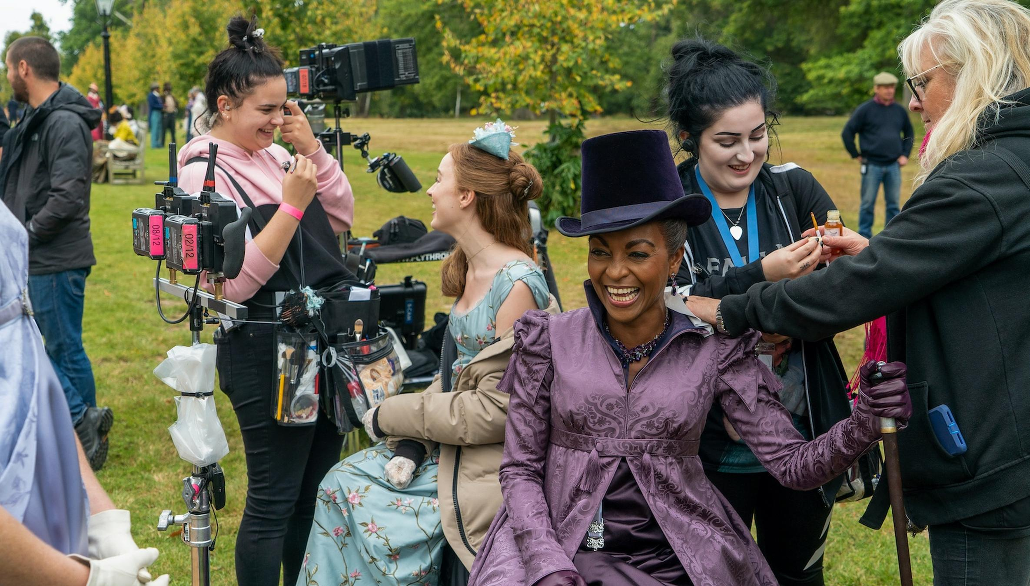
CVs

Slide 34




CVs
The basics: What needs to go in a one-page CV?
Contact details: name, region, phone number, email, driving license status
Statement: Describing you and the role you are looking for
Relevant work experience and tailoring to the role
Other work experience with relevant/transferable skills – retail, hospitality, events, etc
Industry training and skills – details of courses and relevant qualifications
Also include:
Education: Your most recent qualifications
Achievements: have you been part of a production or team or received an award?
Other experience: personal projects, voluntary work
GDPR statement
Notes:
Subject alignment

Slide 35
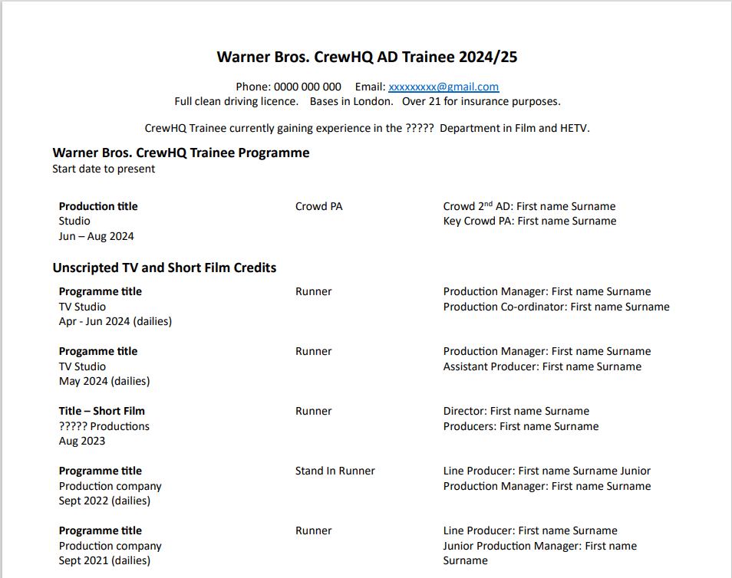
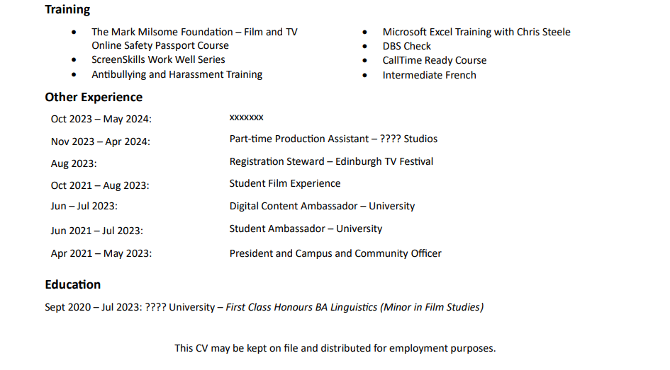
What should a CV in film and TV look like?

Slide 36
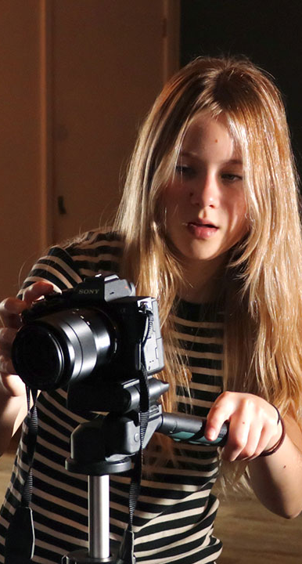
What if your students don’t have any industry experience?
If they don’t have any relevant experience, it’s a good idea to evidence their transferrable skills or their passion for working in film and TV:
Volunteering, extracurricular activities, and part-time work
Workshops or training
Masterclasses or relevant events attended
Personal projects, leadership roles, group work related to the industry
Certificates and courses
Achievements and awards
Education, highlighting any relevant courses or units
Hobbies and interests

Slide 37








Building experience for under 18s
Notes:
BBC – Offer taster days for Year 12/13s
Channel 4 – online work experience
BFI Film Academy – filmmaking workshops in the school holidays for 16-19 year olds
Springpod – online work experience
Speakers for Schools are working on experience
Into Film
National Saturday Club – Herts based film club at Uni of Herts
Brilliant Film Academy – paid Saturday morning film clubs

Slide 38
ENTRY ROUTES INTO THE INDUSTRY
Sky Studios Elstree Future Talent Programme
Elstree Screen Arts Craft Skills Traineeship
Universal’s Below the Line Traineeship ran through Film London
NBCU Internship
Amazon Prime Video Craft Academy
Lime Pictures Internships and Placements
Endemol Shine Internships and Work Experience
Framestore Internship
BBC – Varied
ITV – Varied
Channel 4 – Varied
Sky – Tech, Business, post-production
Warner Bros. – apprenticeships in services and trades
Pinewood – Facilities
NextGen Skills Academy – Animation and VFX
Bauer Academy – Content, journalism and many more
MediaCom – Marketing & Advertising
Internships/ traineeships
Placements / experience
Apprenticeships
Breakout – Creative UK and Netflix
Channel 4 Talent Schemes
BBC Writers room
Warner Bros. CrewHQ Trainee Programme
ScreenSkills Trainee Finder
BBC Paid Work Placement
Channel 4 Production Training Scheme
Disney Trainee Scheme
Young Film Academy Work Experience
Film Buddy Work Placements
Writing /Dev schemes
NB – if you complete a level 3 media qualification you will not be able to apply for a level 3 apprenticeship in the same field.

Slide 39



Slide 40



RESOURCES

Slide 41
ANY QUESTIONS?
Warner Bros. Crew HQ
Sky Studios Elstree -
Future Talent Programme

