Slide 1
INTRODUCING… HEALTH & SOCIAL CARE
LMI CONFERENCE
JAN 2025

Slide 2
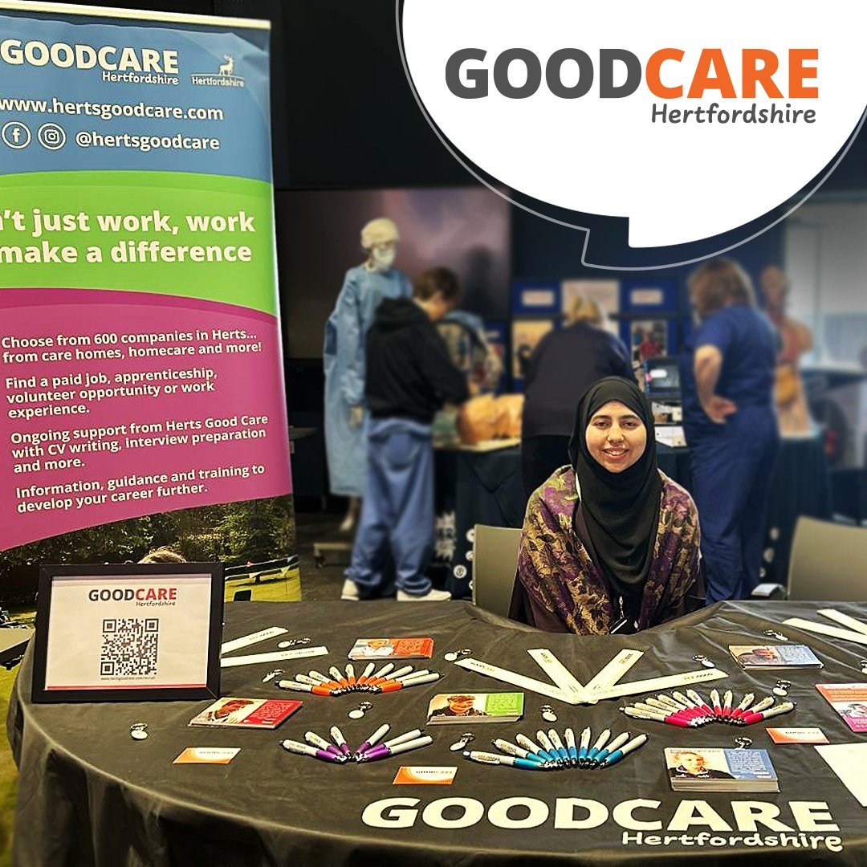
Herts Good Care
Herts Good Care is a free recruitment service for over 650 Adult Social Care providers in Hertfordshire, supporting to fill vacancies with the right people based on values, attitudes and willingness to learn.
We support over 30 people into jobs every month
We are part of Hertfordshire Care Providers Association (HCPA) and we deliver a lot of the training and qualifications that you may complete once you get your job in care

Slide 3
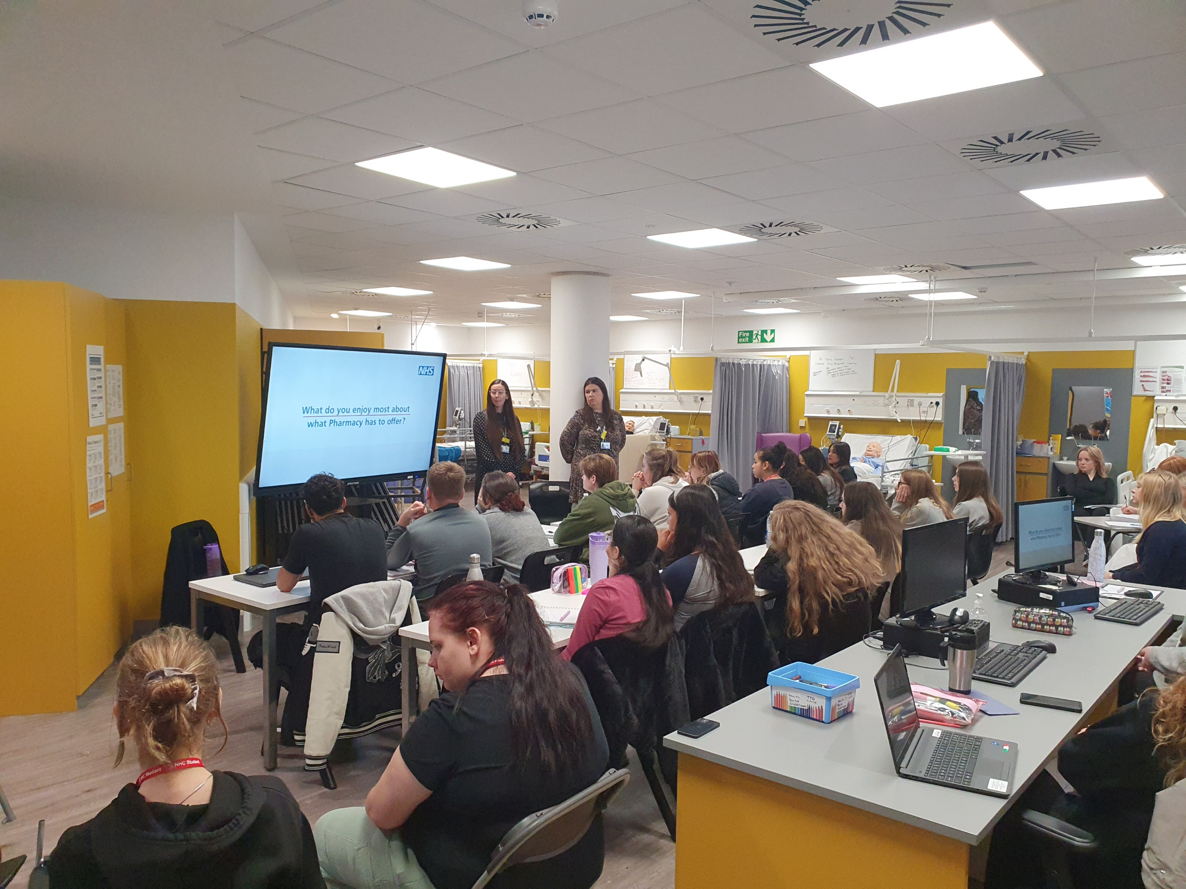
Hertfordshire and west Essex Health and Care Academy
The Health and Care Academy sits within our Hertfordshire and west Essex Integrated Care System (ICS) which is a collaboration of health and care organisations across Hertfordshire and west Essex. These include acute and community services i.e., hospitals, community care i.e.. pharmacy, primary care, social care including care homes, mental health services as well as urgent and emergency services such as ambulance and HUC. We also work with our local councils, charities and external care providers
The academy is a people and website resource to inspire and inform students about the 350+ careers in health and care.
We offer work experience, career event support, pathway information and opportunities like apprenticeships
Did you know…
The National Health Service (NHS) was founded in 1948 and has grown into the world’s largest publicly funded health service.
NHS England is the UK’s largest employer (June 2024)
The NHS employs over 1.5 million people across the UK, from doctors and nurses to cleaners and receptionists.
On average, 45,000 people each day visit major hospital A&E departments in England

Slide 4
ARE THESE STATEMENTS TRUE OR FALSE?
I need experience to work in Adult care
Only women can be midwives
Working in Adult Care doesn’t lead anywhere
If I start as an administrator I’ll always work in admin
Working in Adult Social Care is all about personal care

Slide 5
Entry-level Adult Social Care Positions
Care Assistant/ Support Worker
Activities/ Engagement Assistant
Housekeeping
Kitchen staff

Slide 6
Work Experience
Work experience is a fantastic way of gaining insight into a career especially what a day in the life is like for that job. It can be a valuable way for students to develop confidence and experience caring for people.
We have a range of work experience placements across health and care in Herts and west Essex
Students can apply via the academy website (QR Code) the apply button will redirect students to our work experience portal which is provided by Active Manage. Students will have to complete all of the information requested including any alternative dates in case your preferred dates cannot be offered
Did you know
Our placements are for students aged 14+ / 16+
In the last two academic years we have hosted 367 placements across Herts and west Essex
The most popular placement applied for is ‘Insight into Theatres’

Slide 7
Skills and qualities in Adult Social Care
Qualifications:
Level 1 in Health and Social Care (Induction into Care) ​
Entry Level Frontline roles ​
Level 2 in Care​
Care Assistants and Support Workers ​
Level 3 in Adult Care​
Activities/Engagement Lead, Senior, Team Leader, Field Care Supervisors, Care Coordinators ​
Level 4 in Adult Care​
Deputy Managers, Managers​
Level 5 in Leadership in Health and Social Care​
Registered Managers
How do these relate to curriculum subjects I know?
Health and Social Care
Personality;
Caring,
Empathetic
Compassionate
Notes:
There is not a definitive way on accessing apprenticeships or graduate roles. Below is a list of roles and the qualifications that are most associated with them

Slide 8
Skills and qualities in Health Care
What qualifications do I need?
Grade 4 (minimum) in English and Maths if this is not possible we can help with functional skills
Further Education such as A-Levels or health and care courses, business, science at college
University Education such as diplomas, degrees, bachelors, masters
Work experience, site visits (when permitted), external programmes like Duke of Edinburgh, Princes Trust and St Johns Ambulance, Volunteering, Academy career events such as expos, webinars, career conversation, career videos, social media such as twitter, you tube.
What skills and qualities does the industry require?
The 6 c’s
How do these relate to curriculum subjects I know?
It’s not all about grades and qualifications working
in the NHS, people and personal skills are important too.

Slide 9
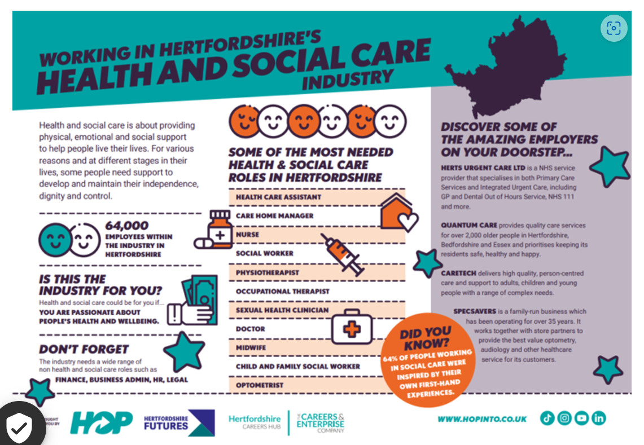
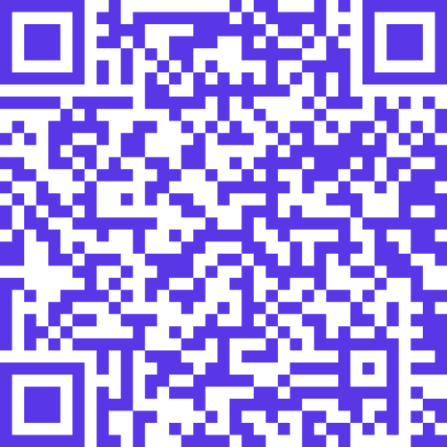

Slide 10
ANY QUESTIONS?
Herts Good Care:
Name: Sara Weir
Email: saraweir@hcpa.co.uk
Telephone: 01707 536020 extension 2
Website: www.hertsgoodcare.com
Health and Care Academy:
Name: Nicola (Niki) Galvin
Email: Nicola.Galvin@nhs.net
Website: www.academy.healthierfuture.org.uk

