Slide 1






Understanding and digesting relevant local LMI info workshop deep dive more detailed session
Steve Trotter -Careers Hub Operations Lead
Hertfordshire LEP
Caroline Cartwright-Hertfordshire LEP Skills Manager and lead for Hertfordshire Opportunities Portal (HOP)
INSERT LOGO

Slide 2
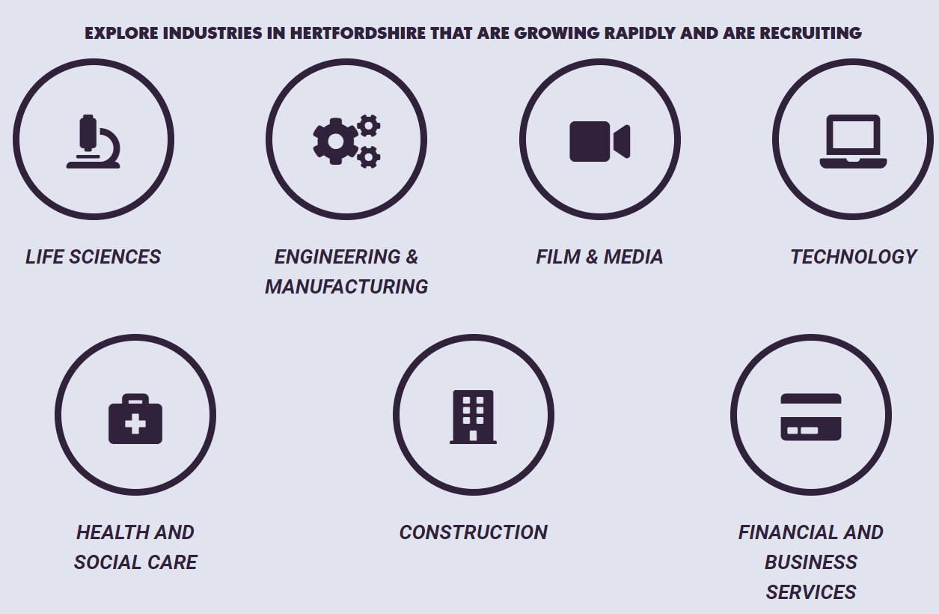
Making use of LMI has never been more important
Labour Market Information (LMI) helps to demystify the jobs market. It helps to take the confusion out of career planning, job hunting, career progression, and changing career. When people have accurate and up-to-date information, they are better equipped to make an informed choice and to plan appropriately
LMI is becoming an increasingly valuable tool and helps to enhance young people’s futures while driving economic growth. If students understand which jobs are widely available and most in demand then they can lay the foundations for their future career based on a fundamental reality.

Slide 3
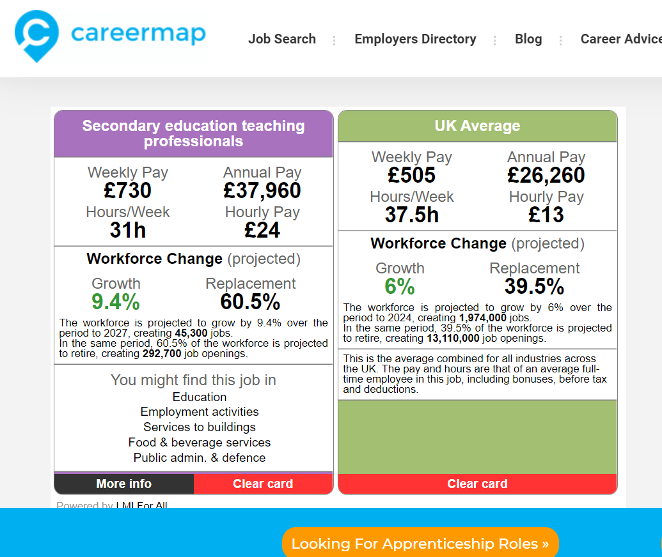
Making use of LMI has never been more important
Labour market information is particularly useful for schools, colleges and universities. This can help students to better understand the labour market, career options and the demands of the local economy. Teachers can use these insights to plan curriculums which meet student career requirements to enhance future employability for young people.
LMI enables students to consider all aspects of employment with relations to the economy and how it operates. Careermap recently partnered with Education and Employers to release a study which highlighted the disconnection between young people’s career goals and the jobs available in the UK. It was reported that young people who had access to labour market information made career goals which were better connected to the UK job market.
LMI is a group of information which relates to industries and sectors. It includes the number of jobs available, salaries, projected industry growth, educational levels required for the occupation, number of job openings and workforce demographics. The Careerometer widget is an extremely useful tool for LMI.
https://careermap.co.uk/careerometer/

Slide 4

Making use of LMI has never been more important
LMI can be used by students for a clearer understanding of trends, structure and economic demand. It also provides a forecast for the future of specific industries based on current and previous trends and demographics. This information is invaluable for young people and can help them find a career which is right for them in a competitive job market. When used to its full potential LMI can benefit employers, students and the economy.
LMI also provides students with time for reflection when choosing their next steps after school or college. For certain occupations, going to university may be the only option to break into the industry, whereas for others, an apprenticeship may provide equal opportunities. This enables young people to fully consider their options and to make a decision based on what is right for them, connected with their career aspirations.

Slide 5

OBJECTIVES OF THIS WORKSHOP
Understand Gatsby Benchmark 2 and how to achieve the benchmark
Understand and digest relevant local labour market information
Know how to access the skills and employer dashboard and have an awareness of the local skills strategies
Know where to access local labour market information and resources
Be informed on how to share this with students, parents and teachers

Slide 6



Agenda
Time | Agenda item | Info | Lead
3.30pm | Introductions & overview of Gatsby Benchmark 2 | Introductions, run through the breakdown of Gatsby Benchmark 2 | Steve Trotter- Careers Hub Operations Lead
3.40pm-4.10pm | Overview of local picture- Labour Market Information and local skills strategies | Overview and current picture of local labour market information and skills strategies Including Priority Sectors Skills strategies Skills Skills Gaps Skills and Employer Dashboard Destinations data and other evidence Growth | Caroline Cartwright-Skills Manager and lead for Hertfordshire Opportunities Portal (HOP)
4.10pm-4.30pm | Resources to help | HOP HOP lesson plans HOP Growth Sector videos LMI Video LMI Posters LMI Infographics Careers Map Widget | Caroline & Steve
4.30pm-4.55pm | Discussions/Reflections | How could your school/college best use LMI? How can/do you share this with: students, teachers and parents? Share best practice –Plus what is missing? | Steve Trotter with input from Careers Leaders
4.55pm-5pm | Future event info and close
Wed 10th Nov
Agenda

Slide 7
Agenda
Time | Agenda item | Info | Lead
3.45pm-3.55pm | Introductions & overview of Gatsby Benchmark 2 | Introductions, run through the breakdown of Gatsby Benchmark 2 | Steve Trotter- Careers Hub Operations Lead
3.55-4.20pm | Overview of local picture- Labour Market Information and local skills strategies | Overview and current picture of local labour market information and skills strategies Including Priority Sectors Skills strategies Skills Skills Gaps Skills and Employer Dashboard Destinations data and other evidence Growth | Caroline Cartwright-Skills Manager and lead for Hertfordshire Opportunities Portal (HOP)
4.20pm-4.30pm | Resources to help | HOP HOP lesson plans HOP Growth Sector videos LMI Video LMI Posters LMI Infographics Careers Map Widget | Caroline & Steve
4.30pm-4.45pm | Discussions/Reflections | How could your school/college best use LMI? How can/do you share this with: students, teachers and parents? Share best practice –Plus what is missing? | Steve Trotter with input from Careers Leaders
4.45pm | Future event info and close
Thurs 11th Nov
Agenda

Slide 8
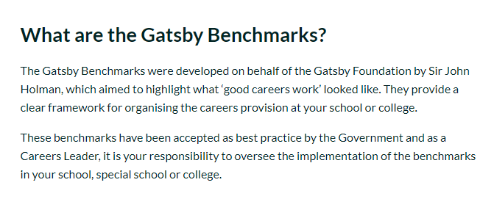
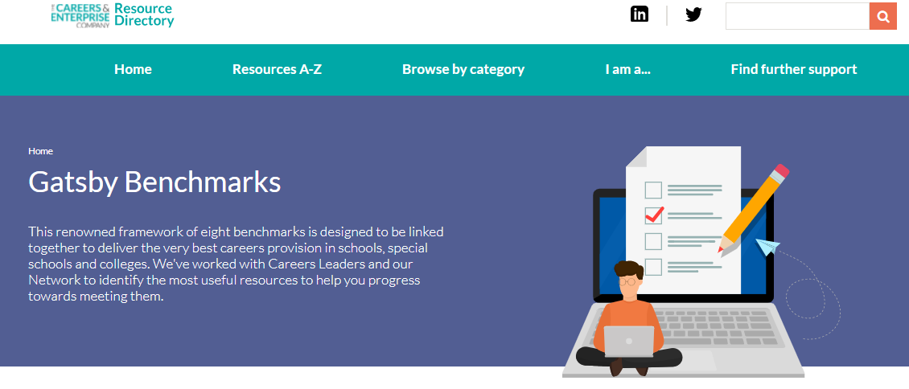
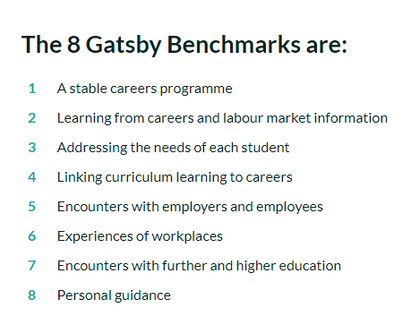
Gatsby Benchmarks
For more information on the Gatsby Benchmarks visit The Careers and Enterprise Company resource directory by clicking the below page:

Slide 9
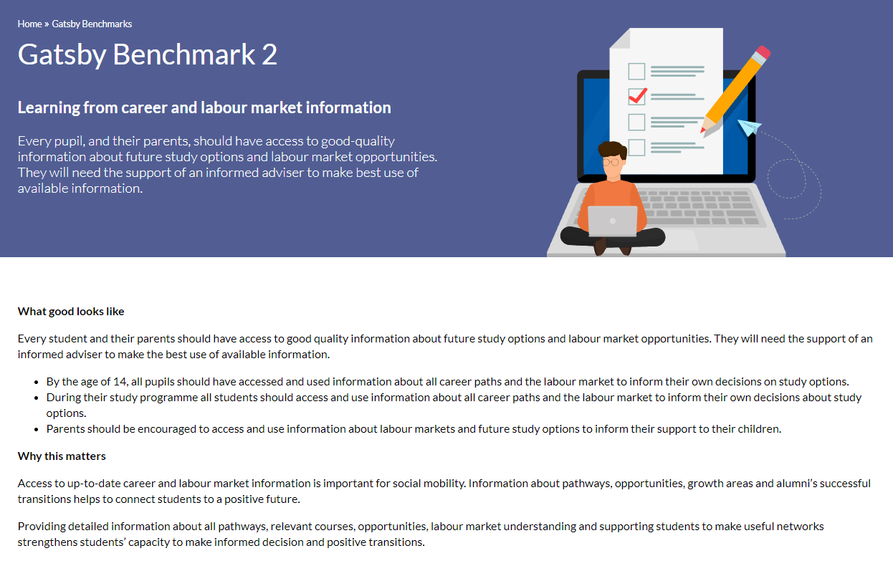
GB2

Slide 10
GATSBY BENCHMARK 2
Gatsby Benchmark 2 –
Learning from career and labour market information
Every student, and their parents, should have access to good quality information about future study options and
labour market opportunities. They will need the support of an informed adviser to make best use of available
information.
Requirements:
• By the age of 14, all pupils should have accessed and used information about career paths and the labour market to inform their own decisions on study options.
• Parents should be encouraged to access and use information about labour markets and future study options to inform their support to their children
IAG 121 appointments with targeted support for vulnerable groups including SEND/in Care/Pupil Premium/Free school meals
Labour market video, posters/infographics on school website/in newsletter, shared with parents via twitter etc.
Talks at parents evenings, academic review days on local labour market/post 16/18 options
HOP lesson plans, HOP growth sector videos, HOP job profiles, HOP virtual employer encounters
https://careermap.co.uk/careerometer/ or http://www.lmiforall.org.uk/explore_lmi/
Will showcase these resources a bit later

Slide 11

Hertfordshire Skills and Employment Strategies and Plans

Slide 12
The Hertfordshire Skills and Employment Landscape
The work of the LEP Skills Managers
Lead and co-ordinate the work of the Skills Advisory Panel
Work with analysts to provide the evidence-base which details Hertfordshire’s skills supply and demand, skills gaps and opportunities
Work with skills, careers and employment partners (schools, FE, HE, local authorities, business organisations, DWP, ESFA) to articulate Hertfordshire’s skills and employment needs and develop our strategy and action plans
Write and publish our Local Skills Report and work with Hertfordshire County Council and the DWP to develop and work towards the actions in our Hertfordshire Skills and Employment Strategy (2021-2024)

Slide 13
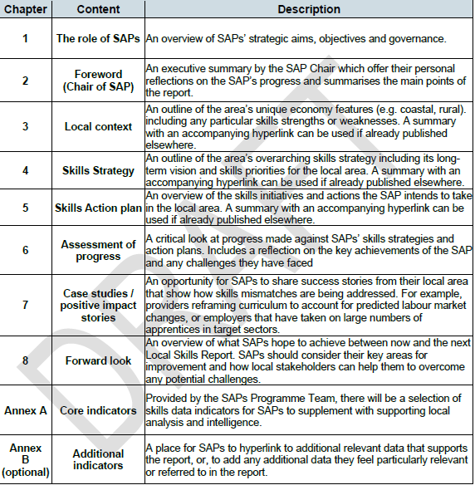
The Skills Advisory Panel and Local Skills Report
Skills Advisory Panels (SAP) were introduced across all LEP areas in 2018 by the DfE
To enable each region to provide strategic leadership on skills and help to address workforce challenges
Our Hertfordshire Panel consists of a mix of around 20 representatives including education, employers, local government, training providers
The SAP work collaboratively to ensure that skills programmes delivered by Hertfordshire’s education, skills and apprenticeship providers help to meet local employers’ skills needs.
Each region develops an annual local skills report providing a detailed insight into local skills needs across the county
Read our Hertfordshire Local Skills Report - https://www.hertfordshirelep.com/media/maflpk3y/hertfordshire-local-skills-report-2021.pdf

Slide 14
Key demographics
At face value – our key metrics seem strong
Hertfordshire has a highly skilled workforce, with 42.4% of working age residents (aged 16-64) educated to at least NVQ level 4.
Hertfordshire has a strong performance in school qualifications. In 2018. 53.1% of pupils in Hertfordshire achieved between grades 9-5 compared with 40.2% in England. A level results are also strong in Hertfordshire with 23.9% of pupils achieving AAB or better at A level in the academic year 2017/18 compared to 19.4% of pupils in the East of England.
Hertfordshire residents earn 16% more than the national average
However, there are levels of inequality
For example, Broxbourne has the lowest percentage of working age residents with a NVQ Level 4 or above and 15.8% of the work population in this district have no qualifications which is significantly higher than the national average.
Also, Hertfordshire is a net exporter of highly skilled employees and a net importer of low-skilled employees. Workplace earnings are 7% less than resident based earnings suggesting that residents travel out of the county for higher salaries.
The net out-commuting is mainly in the highest three skilled categories of occupation: Managers, Directors and Senior Officials and Associate Professional and Technical Occupations. By contrast the net in-commuting is positive for lower skilled occupations.
Source: Hertfordshire Skills and Labour Market Review 2020.

Slide 15


Employer skills needs
Source: Hertfordshire Employment, Skills and Enterprise Review, Winning Moves, November 2020
60% of employers say they have one or more skills gaps in their organisation – particularly in digital, sales and marketing, and job specific skills across manufacturing, construction, health, education and professional services
86% of employers likely to take action to upskill staff in the next 12 months
70% likely to engage with external training providers to upskill their staff in the next 12 months
One in 5 employers reported that, in the last twelve months, they had a hard to fill vacancy – most common cited reason was perceived applicant quality, sub-optimal skills, attitude or motivation for the job
Employers predicted that in the next three to five years they would need greater numbers of staff with digital and technical/practical skills
Apprenticeships – 47% of employers were considering taking an apprentice in the near future but there are widespread reservations to overcome i.e. candidate quality, reassuring employers who have had a poor previous experience
17% off employers said they would be likely to support employees to undertake a higher qualification in the next three years – however cost is a significant barrier
Source: Hertfordshire Employment, Skills and Enterprise Review, Winning Moves, November 2020

Slide 16



Future Skills needs
Digital – automation, digitalisation, artificial intelligence, big data, internet of things
Achieving Net Zero – scientists and engineering skills in renewable energy, installation and system design, machine learning to prediction modelling
Sustainable Construction – digital design, offsite manufacturing, site management and integration, onsite placement and assembly.

Slide 17


The aim of the strategy is to ensure the county’s skill provision addresses the local skills challenges and also the opportunities and is meeting the employment needs of the future, whilst supporting all our residents to reach their potential
Notes:
What is the strategy about?:
Hertfordshire employers report a skills gap, they have done to varying degrees since we started this work
We know there are people who struggle to gain and sustain employment – barriers to employment
Now have the additional challenge of a significant unemployment rate, with young people likely to bear the brunt of this
There are also changes in the job sectors – an increased demand in some sectors, such as logistics and distribution, whilst many others have seen significant contractions in demand e.g. high-street retail
But there are opportunities: there are priority and growth sectors that of course need a skilled workforce and we need to encourage our residents to prepare for this. There are also the opportunities of Hertfordshire’s business assets together with the proximity to London and other key economic areas e.g. Research Triangle of London- Cambridge- Oxford, recognised as an economic area renowned as an engine of growth. In addition, government has ambitious plan to grow the economic and cultural potential of the Oxford-Cambridge Arc, to transform it into one of the world’s premier growth corridors and a world-leader in sustainability.

Slide 18
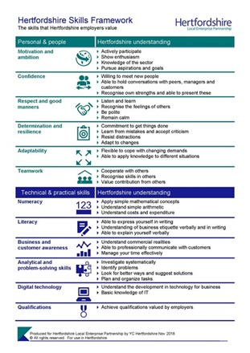



The Hertfordshire Skills and Employment Strategy, in place since 2015, has been successful in helping to increase and develop the capacity of the county’s existing and future workforce as well as securing significant funding for Hertfordshire to support this agenda.
Skills and Employment Dashboard
Notes:
Before I talk about the strategy – a glance back.
The strategy document includes details of our successes:
helped to secure circa £29m of European Social Funding (ESF) for Hertfordshire to deliver skills and employment initiatives
Hertfordshire County Council Adult and Family Learning Service secured £5.5m from The Big Lottery/ESF to run the Building Better Opportunities programme in partnership with a number of voluntary and third sector partners. A further two years of funding of circa £3.4m was secured in 2019, and in 2021 a further £2.8m has been secured. The project provides intensive, long-term and individualised coaching to work and employment with adults with complex barriers to learning
Hertfordshire County Council Services for Young People successfully bid for £1m European Social Funding to support 15-24 year olds Not in Education, Employment or Training (NEET) or at risk of becoming NEET, including those leaving care with a focus on mental health and wellbeing support, into the Labour Market
The Hertfordshire Local Enterprise Partnership continue to provide capital funding via its Skills Capital and Skills Estate and Equipment Funding Programme in order to support local providers to meet the needs of local employers, circa £27m has been allocated
The Hertfordshire Opportunities Portal, HOP, has been developed and launched, enabling residents to access the resources they need to make informed career decisions as well as connecting employers with future skills pipelines
The Hertfordshire Skills Framework, has been developed, published and promoted, setting out the key employability skills and attributes sought by Hertfordshire employers
The Careers and Enterprise Company (CEC) Enterprise Adviser Network and Careers Hubs have been established, achieving all targets and enabling Hertfordshire schools to continue to outperform other areas of the country based on Gatsby Benchmarks; a framework for good career guidance developed to support schools in providing students with the best possible careers education, information, advice, and guidance
The Hertfordshire Skills Advisory Panel has been established and a Local Skills Report has been published providing a detailed insight into local skills and employment needs across the county
The Skills & Employment Dashboard has been developed and launched providing an interactive resource to enable stakeholders to better understand the county’s labour market and to support data-driven decision making relating to local skills provision
The Department for Work and Pensions led mapping of provision across Hertfordshire for initiatives that support vulnerable adults into employment to ensure a joined-up approach is now at a business as usual status through the Complex Needs Toolkit

Slide 19

Hertfordshire Skills & Employment Strategy 21-24 Key Themes

Slide 20

Unlocking emerging talent, support for young people aged 16 – 24 years
A partnership approach supporting young people aged 16 to 24 years in the transition from education to employment through access to impartial advice and guidance; encouraging informed career decisions.
Our overarching ambition is for young people to be inspired and prepared to become the county’s workforce with the skills to deliver Hertfordshire’s future prosperity
Notes:
Go through the five themes: more details in the strategy document.
Theme 1 being led by HCC children’s services

Slide 21

Adult learning and employment, working towards full employment, promoting lifelong learning and retraining opportunities
Supporting adults with barriers to employment and learning, increasing the available workforce and promoting a culture of lifelong learning. Ensuring measures are in place to support adults to retrain and upskill for advanced and higher technical skilled jobs as well as retraining for workers from industries that are contracting
Notes:
Theme 2 being led by HAFLS working with the DWP

Slide 22

Skills to grow small and medium size businesses, enabling employers to build their future workforce
Providing targeted support to small and medium size businesses (SMEs) to develop their workforce and improve the matching of skills to business needs in order to sustain economic growth. Enabling employers to build their future workforce through work-based learning programmes including Apprenticeships, Traineeships, T Levels and technical qualifications.
Notes:
Led by Herts LEP
SME - less than 250 people

Slide 23

Priority and growth sectors, harnessing the opportunities and investing in skills of the future
Investing in skills of the future including those of our economic growth sectors: life sciences, advanced engineering and manufacturing, creative, smart construction, agri-tech and our knowledge and digital based assets. Supporting those major employment sectors most affected by the pandemic such as our health and social care sector as well our visitor economy including hospitality, high-street retail, leisure, travel and the arts in alignment with national support programmes
Notes:
Led by Herts LEP

Slide 24

Placemaking, seizing the opportunities of Hertfordshire’s business assets together with the proximity to London and other key economic areas
Hertfordshire is at the core of the UK’s science, research and innovation hub and sits at the heart of the UK’s Golden Research Triangle of London- Cambridge- Oxford, an economic area renowned as an engine of growth. Government has ambitious plan to unleash the economic and cultural potential of the Oxford-Cambridge Arc, to transform it into one of the world’s premier growth corridors and a world-leader in sustainability.
Our overarching ambition is to explore the opportunities of a place-based approach, levelling up outcomes in skills and employment and ensuring our residents are aware of the employment opportunities in Hertfordshire
Notes:
Led by Herts LEP

Slide 25
As stakeholders in careers education
Organisations across Hertfordshire continue to be encouraged to refer to this strategy and reflect it in their own plans knowing that collectively we will be working towards the same strategic aims.
Notes:
We are asking all stakeholders who have a part to play in the skills and the employment agenda in Hertfordshire to be aware if the strategy:
help raise the profile of this partnership approach
utilise it to support any funding bids
When you’re developing your own plans and strategies around skills and employment please refer to this strategy and reflect it, knowing that collectively we will be working towards the same strategic aims.
That’s the end of the presentation about the strategy, if you have any questions please do ask.
Thank you.

Slide 26
Hertfordshire Skills and Employment Strategy 2021-24
Hertfordshire Opportunities Portal (HOP) (hopinto.co.uk)
Hertfordshire Skills and Employment Dashboard | Hertfordshire LEP

Slide 27
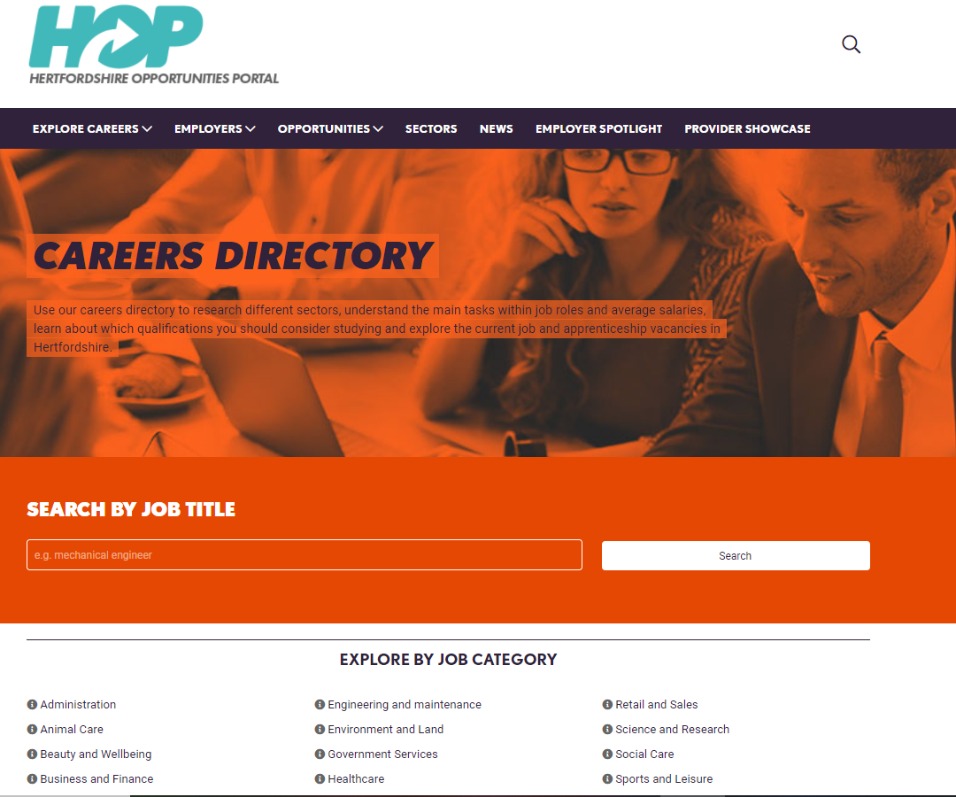
HOP
Resources for Labour Market Information
https://www.hopinto.co.uk/

Slide 28
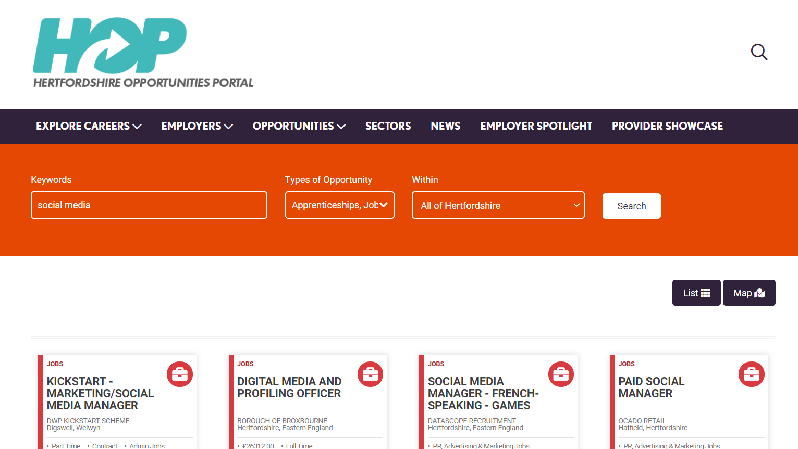
HOP

Slide 29
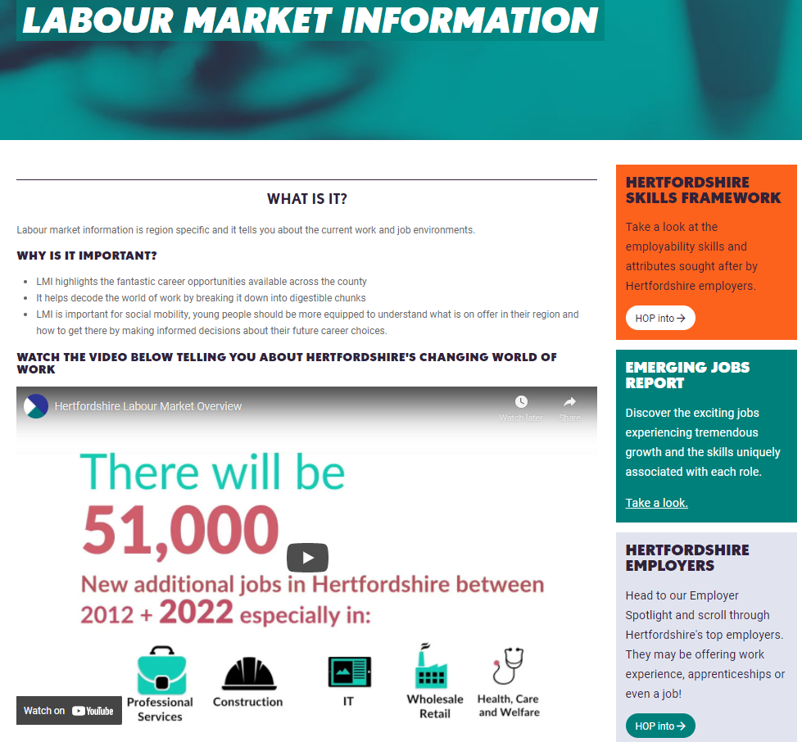

https://www.youtube.com/watch?v=qxEnwYjtk5w
HOP LMI Video https://youtu.be/qxEnwYjtk5w

Slide 30

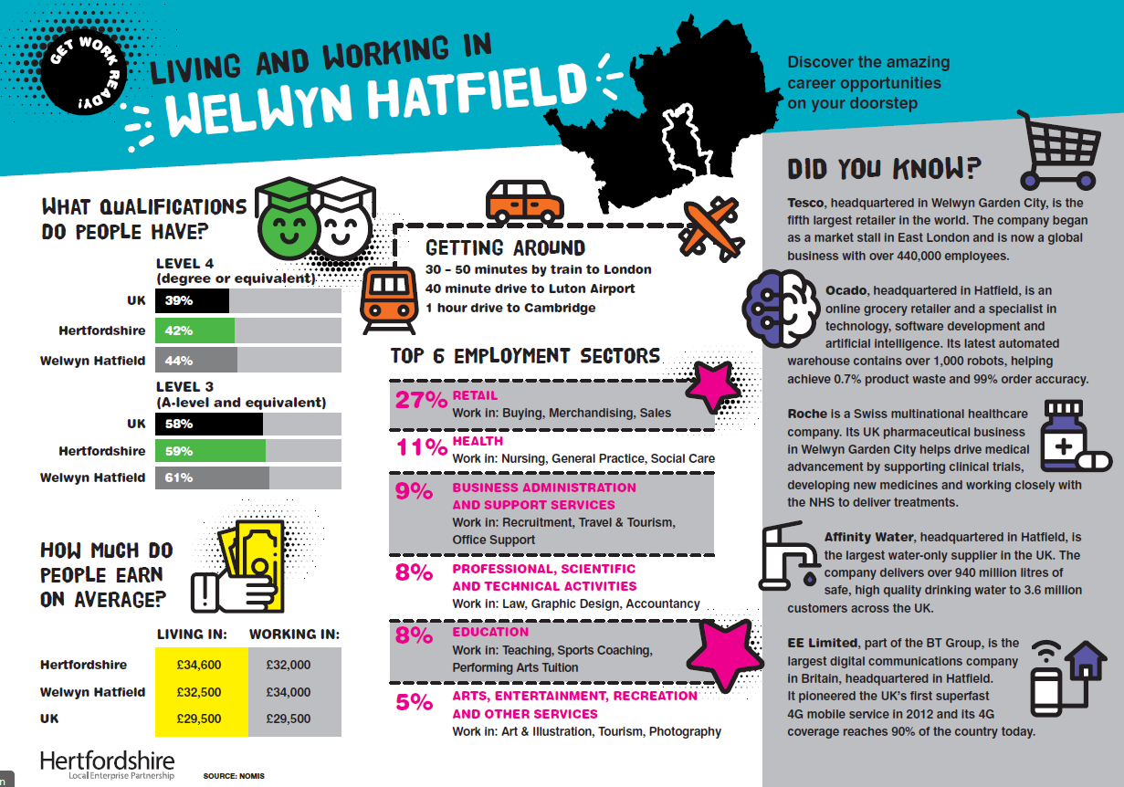
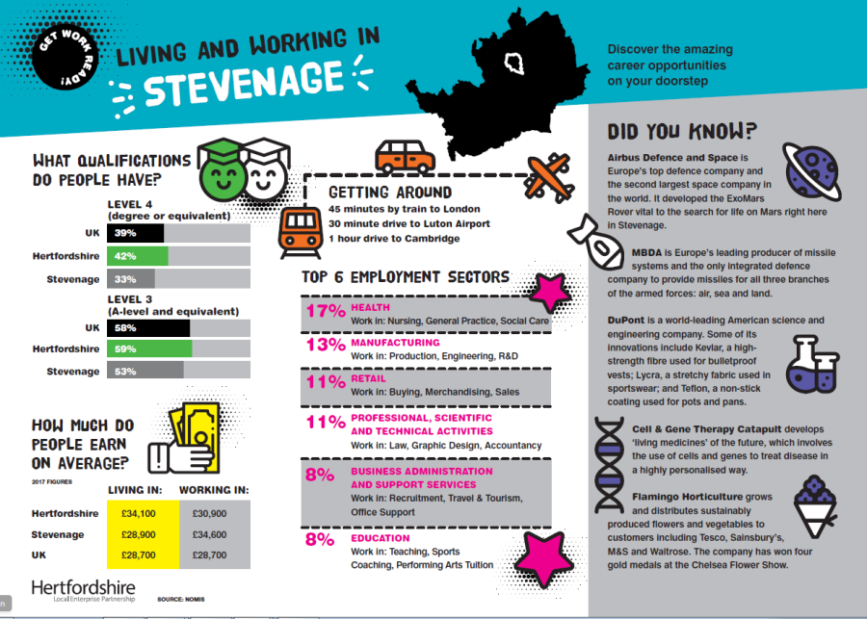
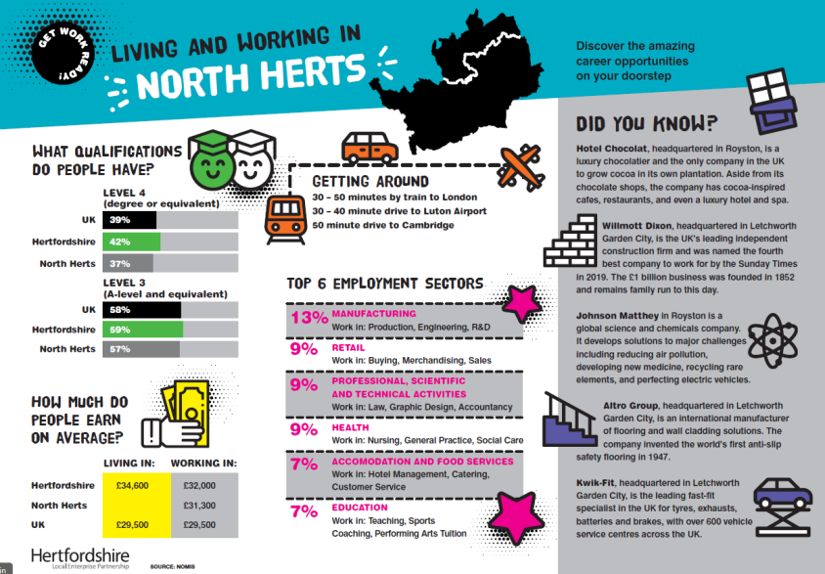
Helping to Achieve Benchmark 2 –
LOCAL LABOUR MARKET infographics
Created for schools to provide picture of district employment stats..
All 10 Hertfordshire district posters available at HOP website…
https://www.hopinto.co.uk/questions/labour-market-information/
Could be used on website (GB1 and GB2) or as part of a PSHE programme (GB4)
Hertfordshire LMI Infographic video:
https://youtu.be/qxEnwYjtk5w
https://www.youtube.com/watch?v=qxEnwYjtk5w
HOP LMI section https://www.hopinto.co.uk/questions/labour-market-information/

Slide 31
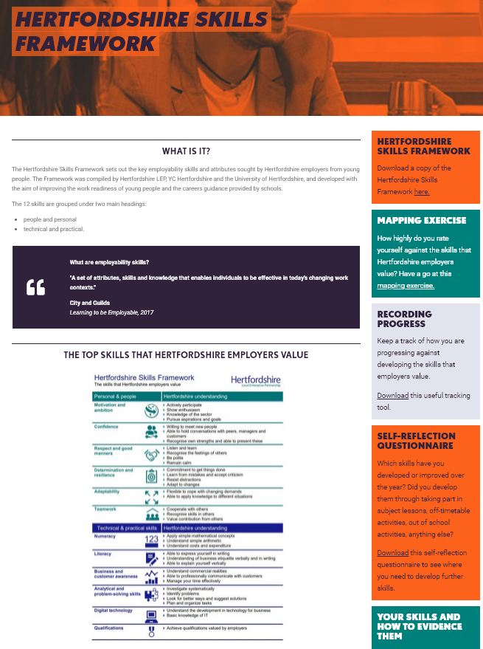
Helping to Achieve Benchmark 2 –
Hertfordshire Skills Framework
https://www.hopinto.co.uk/questions/labour-market-information/
https://www.youtube.com/watch?v=qxEnwYjtk5w
https://www.hopinto.co.uk/explore-careers/resources/hertfordshire-skills-framework/

Slide 32

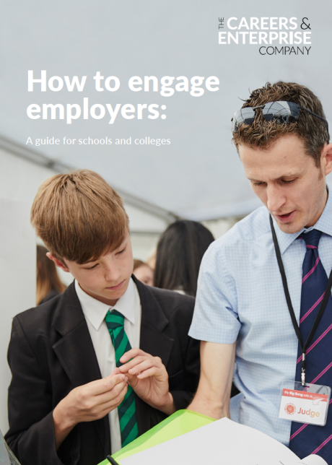
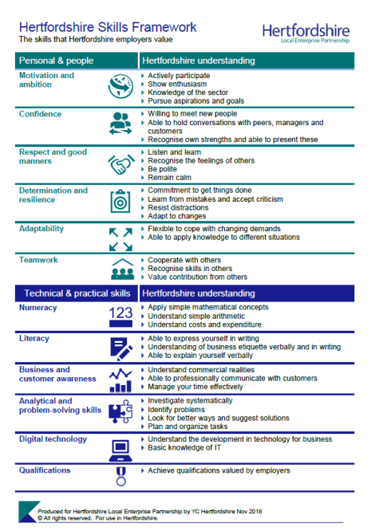
HERTFORDSHIRE SKILLS FRAMEWORK
Resources
Good practice use of Hertfordshire Skills Framework
    Used in 6th form handbooks
    Year 10 pre Work Experience Lesson
    Evaluation/benchmarking tool for students

Slide 33
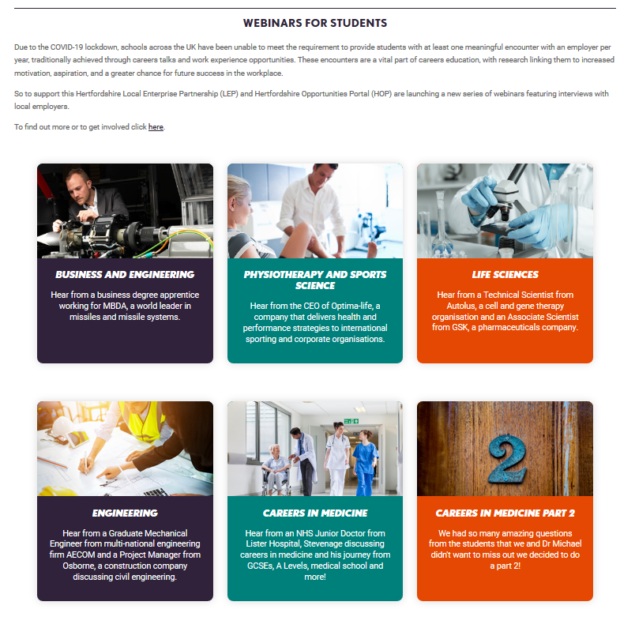


Returning on Thursdays 4.30pm from October
https://www.hopinto.co.uk/explore-careers/webinars/virtual-employer-encounters/
Notes:
Thursdays – 4:30pm

Slide 34




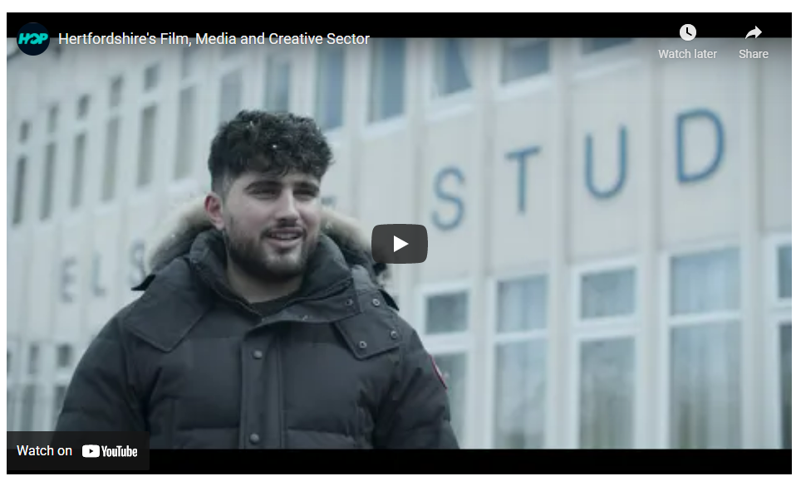
HOP Growth Sector Videos
7 videos around 10 mins each highlighting priority sectors
Hear from Hertfordshire young people who have gone into and are thriving in the growth sectors. These sectors have huge growth planned and are actively recruiting young people.
In the videos they detail how they got into the sector, their pathway taken and hints on tips on how to get there:
https://www.hopinto.co.uk/sectors/

Slide 35


HOP Lesson Plans
https://www.hopinto.co.uk/explore-careers/resources-for-schools/
Designed to support teachers, careers leaders or any other providers who support young people to use HOP to deliver careers activities
Lessons plans include:
Our world of work – labour market information
Hertfordshire’s growing employment sectors
#hopinto the right career for you
My dream work experience
Further education and higher education options
Get…ready…work – Hertfordshire Skills Framework
Student activity sheets and PowerPoint presentations are also available. Does your school have a link to HOP on your careers section of your website? https://www.hopinto.co.uk/
Notes:
HOW CAN HOP HELP TEACHERS IN SECONDARY SCHOOLS?
School and education providers in Hertfordshire are required to fulfil their statutory duty to deliver high quality and impartial careers education, information, advice and guidance. With teachers and careers advisers involved in supporting students to make informed decisions on their post-16 and post-18 career pathways, HOP is the go-to portal for students in Hertfordshire.
We have devised some lesson guides to help teachers meet the identified 8 Gatsby benchmarks that are the core dimensions of good careers and enterprise provision in schools. They have been designed to be delivered by teachers that do not have careers guidance experience, and can be used in careers and pastoral lessons, or by the student/teacher as an ongoing planning exercise focusing on career development.
WHY SHOULD TEACHERS IN HERTFORDSHIRE SECONDARY SCHOOLS USE HOP?
The resources provides young people access to the information they need to make informed decisions on qualification choices and career path options, including guidance about accessing Further Education and Higher Education, work experience and job opportunities, and much more!
In order for students to research their career options fully, they need to have an understanding of what a local labour market is, why it useful to access information relating to the local labour market and where they can access such information. Powered by the Hertfordshire Local Enterprise Partnership, the portal aims to inform young people of the choices and options available to them. The difference with HOP is that it is local - it tells you about what is going on in Hertfordshire with regard to careers, work experience, jobs and apprenticeships and how students and schools can connect with employers in the local area. HOP is here to help students navigate their way through to the world of work!

Slide 36

lmi tells us
Which are the big employers in different geographical areas
Which industries/sectors have jobs on offer
Which jobs are growing or declining
What the jobs of the future might look like
What qualifications or skills employers are looking for and which are in short supply
Hertfordshire Opportunities Portal
hopinto.co.uk

Slide 37
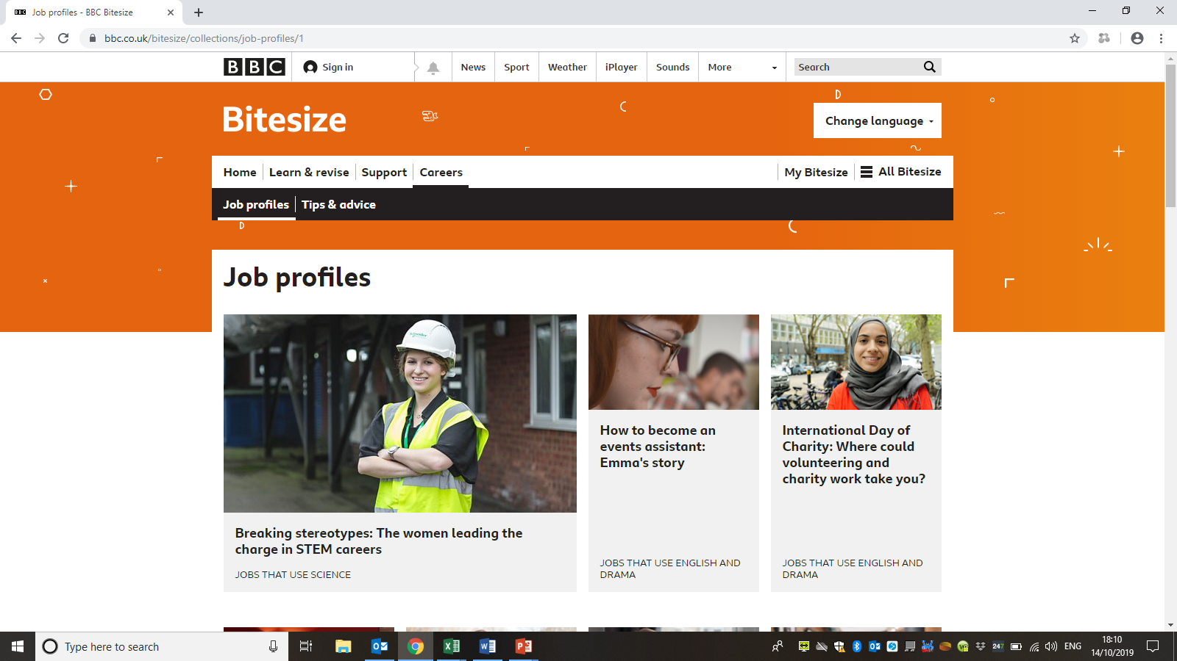
Other resources BBC BITESIZE
Careers inspiration and advice from BBC Bitesize
Explore BBC Bitesize’s brand new collection of free, online careers resources offering a wealth of inspiration and advice for your students. Designed to support you in meeting the Gatsby Benchmarks, these new resources offer a rich collection of case studies across a wide range of sectors, linking curriculum subjects and the world of work. Including:
Careers A-Z – Find Your Perfect Job
Where Could Your Favourite Subject Take You
Applying For Jobs

Slide 38
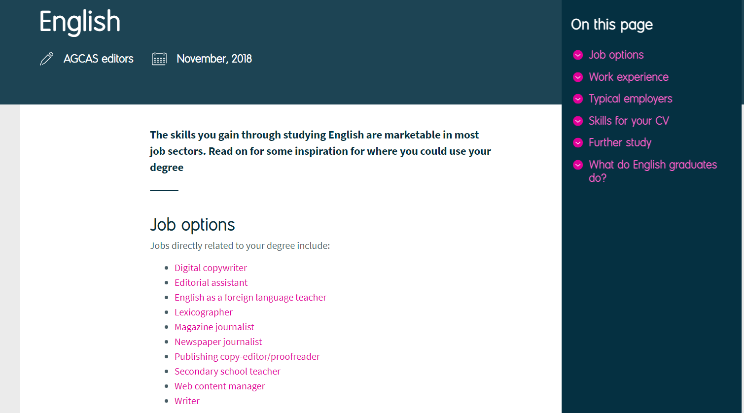
Prospects.ac.uk – Where can English Take You? Available For All Subject Areas

Slide 39


Where can an English Language or Literature A-level take you?
Editorial Assistant
This area of work is open to all graduates. most entrants at editorial level are graduates.
Postgraduate courses that include placements and contact with people in publishing provide a good introduction to professional skills and networking.
What do I need to
do to get
into this career…
Editorial assistants perform a range of administrative and editorial tasks necessary to the production of publications.
You'll often be involved in projects from conception to completion, from receiving copy from authors through to the handover to production staff.
Career information
Starting salaries are likely to be in the region of £15,000 to £23,000.
Average salaries in publishing are around £26,500-£40,000, with higher salaries possible in larger publishing houses.
Average
salary

Slide 40
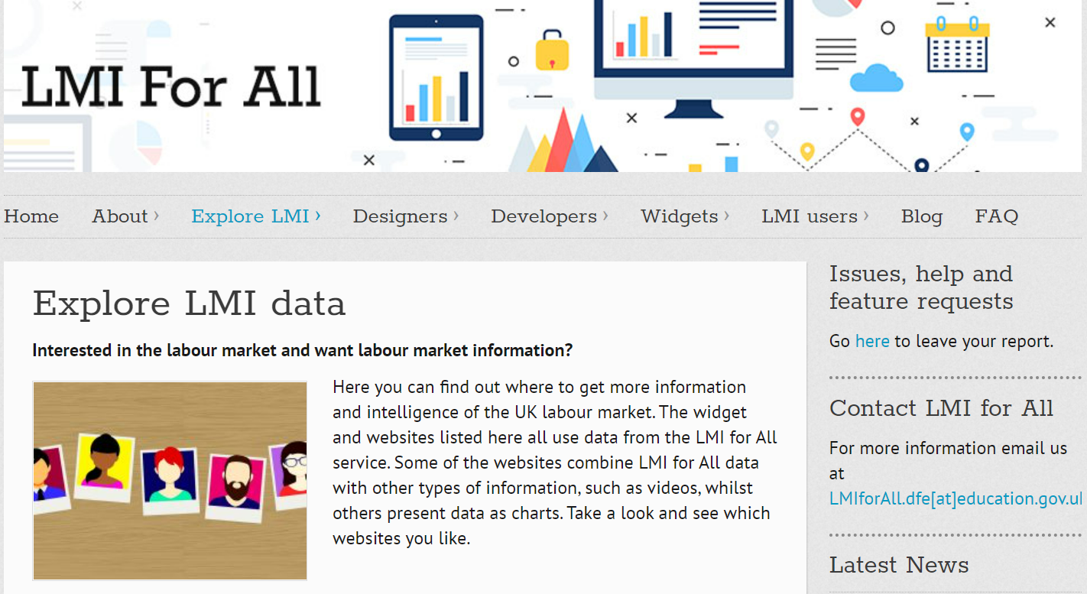
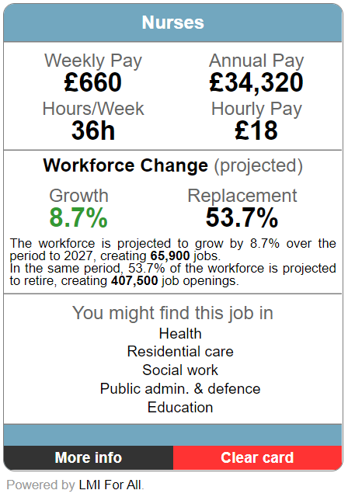
What do I eed to
do to get
into this career…
Career information
Careersometer/LMI for all widget is a useful interactive tool for young people with some schools embedding it into their careers website for students
http://www.lmiforall.org.uk/explore_lmi/
Average
salary

Slide 41
HOW LMI RESOURCES CAN BE USED
Embed into a PHSE Lesson
Embed into a Tutor Time lesson
As help to prepare student for their work experience placements – researching the company and careers sector
Put on your school website
Use within an assembly focussing on careers
Put in a newsletter
Use as part of a school trip – to learn about all the careers involved on that student’s day outside of the classroom

Slide 42
SHARING LMI WITH PARENTS
show videos on loop at parents evenings
Include information in newsletters
EXPLICITLY include on your website
School social media accounts share the resources-Stanborough school has an inspiration twitter account

Slide 43

Reflections
How do you/could your school/college best use LMI?
How can/do you share this with: students, teachers and parents?
What is missing?

Slide 44
Future Events
We have some district network sessions in December:
Monday 6th Welwyn/Hatfield/Stevenage/North Herts @Computacenter 2.30-4pm
Tuesday 7th Watford/Three Rivers/Hertsmere on MS Teams 2.45-4pm
Wednesday 8th St. Albans & Dacorum on MS Teams 2.45-4pm
Thursday 9th East Herts & Broxbourne at Weston Homes Takely nr Stanstead 2.30-4pm
Gatsby Benchmark 4 Careers in the Curriculum Workshop
Wednesday 12th January 2pm-3.30pm over Zoom
We hope you can join us

