Slide 1
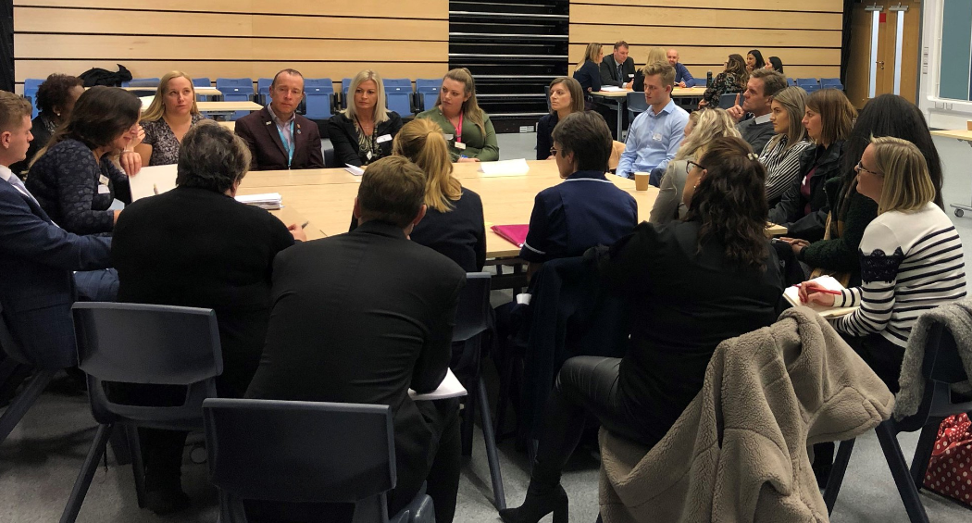
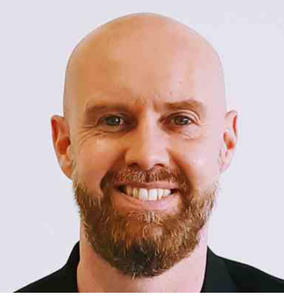
Enterprise Adviser Induction
Steve Trotter
Careers Hub Operations Lead Hertfordshire

Slide 2
Welcome new Enterprise Advisers (EAs)

Slide 3
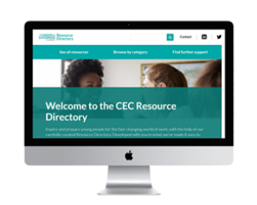
Agenda
Today will cover:
Who The Careers & Enterprise Company are
The roles of the Enterprise Adviser & Careers Leader
The eight Gatsby Benchmarks
Performance
HOP, Local Labour Market Information and LEP priorities
Problem-solving, resources and key dates

Slide 4
Our missions:
To inspire and support young people in the transition to the fast-changing world of work
Strengthen the links between education and employment
Raise the profile and quality of Careers Education in schools and colleges by backing the 8 Gatsby Benchmarks
Raise aspirations among young people in Hertfordshire and help every young person find their best next step

Slide 5
Our Vision:
Help provide modern high quality, 21st Century careers education for all young people in Hertfordshire
Support schools and colleges as much as possible to deliver brilliant careers education
We want to support employers to engage with education with purpose and for the long-term
We want to involve every young person in careers education regardless of their starting point or circumstances

Slide 6
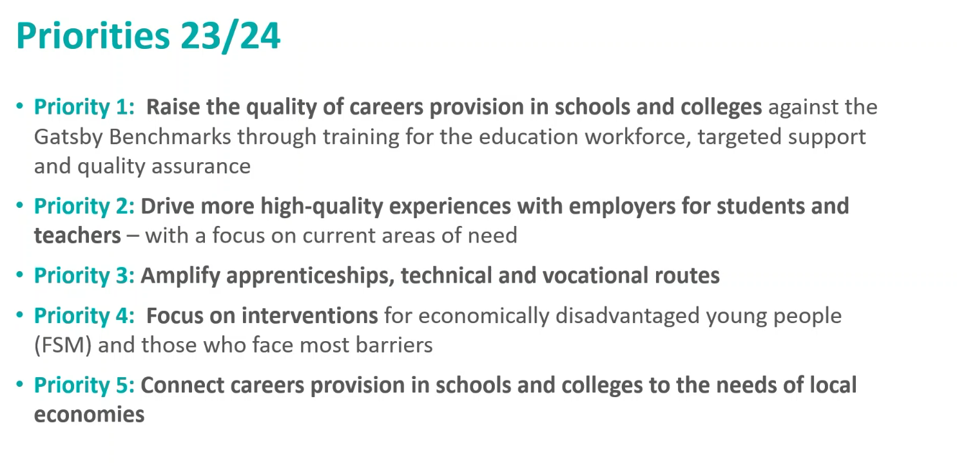
Our priorities and coordinated actions:
To help every young person find their best next step
Modern high quality, 21st Century careers education for everyone; everywhere
Encourage schools to start using the future skills questionnaire on Compass Plus

Slide 7
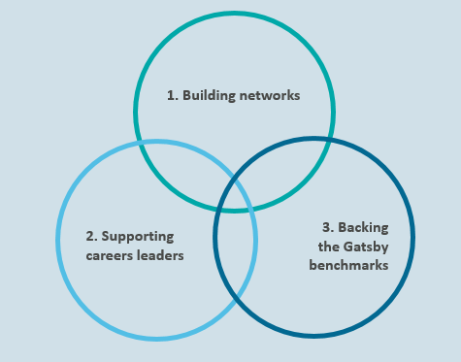
Our role:

Slide 8
Please click the video thumbnail or link below:
https://youtu.be/B0RUJI-g0uw?si=b-yFxMXSPIN97ql1

Slide 9
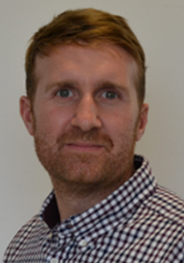
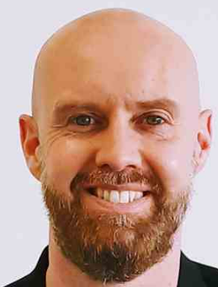
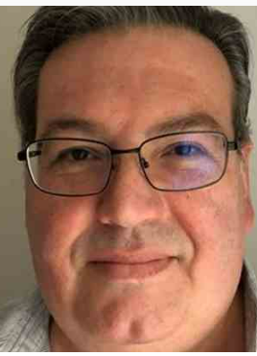
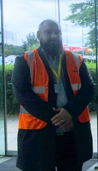
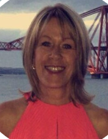
Herts Careers Hub Team Structure:
Gareth Dace- Careers Hub Strategic Lead-Hertfordshire LEP
Steve Trotter- Careers Hub Operations Lead-Hertfordshire LEP, plus EC to Welwyn & Hatfield schools
Chris Dowton- Enterprise Co-Ordinator Hertfordshire LEP, Broxbourne & East Herts
NEW Enterprise Co-Ordinator tbc- HCC, Stevenage and North Herts schools
Shea Costello-Enterprise Co-Ordinator-HCC, Watford, Three Rivers & Hertsmere schools
Lesley Leggett- Enterprise Co-Ordinator-HCC, St. Albans & Dacorum schools
Jacquie Gascoigne- Enterprise Co-Ordinator-HCC, SEND schools

Slide 10
What is an Enterprise Adviser? Please click short video for more info
Develop your skills in communication and strategy development
Support your local school or college to deliver world class careers guidance to their students.
Build strong working relationships with your local school or college and provide insight into your organisation/industry
Join a national and local network to develop your own skills.
Give back to your local community.
Better understand the education sector and the challenges faced

Slide 11
Why volunteer as an EA?
https://youtu.be/pluN1FJL7Vk?si=AoDRhYQl4PG3PgTa

Slide 12
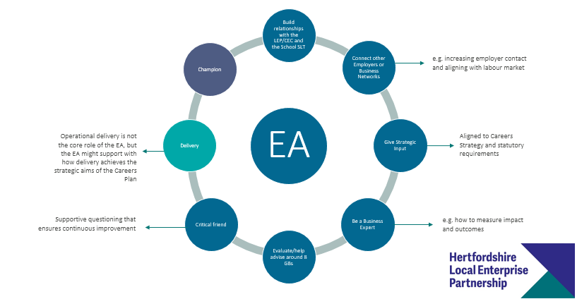
What does an EA do?

Slide 13
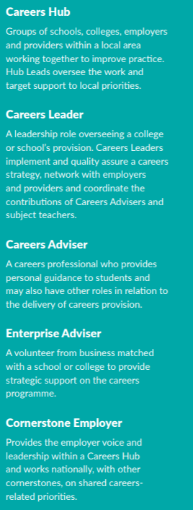
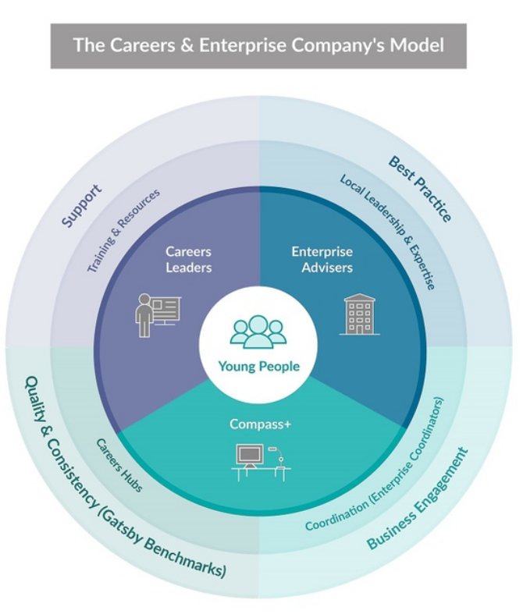
Structure of what we do:

Slide 14
Structure of what we do:

Slide 15
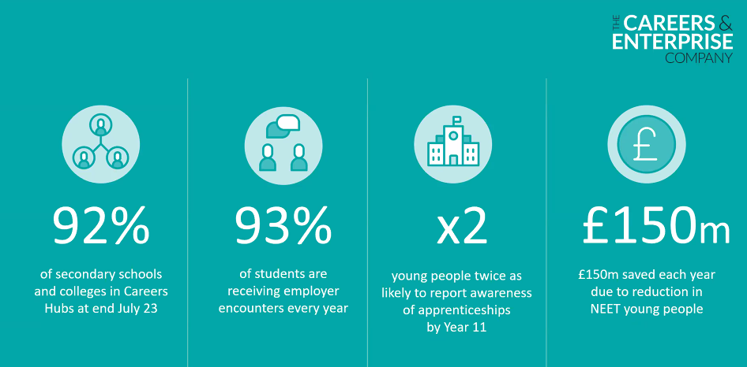
What we do:

Slide 16
Key deliverables
Compass Plus & Future Skills Questionnaire Training Tues 21st November for your Careers Leaders and Careers Admin Smile Building Tesco WGC
As many schools using Compass Plus and the Future Skills Questionnaire as possible
Hosting Teacher Encounters
Careers Leader Training
Work Experience
Getting Teachers out to visit employers and gather real world scenarios and bring the curriculum to life in the classroom
Careers Leader short courses and full FREE Level 6 Training (Has your Careers Leader signed up to this?)
We are working on a bid to help get more meaningful experiences of the workplace in Herts, and also research new models
We want to boost more varied types of placements can your EAs help?

Slide 17
New Enterprise Adviser structure
Over the last 7 years we have matched EA(s) to one school or college (1-2-1 support)
The Careers and Enterprise and Hertfordshire Careers Hub are happy for that to continue, but also move towards a more flexible approach where EAs can work with more than one school or in certain ways and match skills and needs e.g.
An EA may be more strategic and help a school working on their Careers Strategy, whilst also still supporting their current school (Targeted Support)
An EA who has capacity to be operational can help multiple schools in an ad hoc way for example support two schools with a provider access talk on apprenticeships and some other schools with mock interviews etc. (Agile EA)
We are also moving towards more local networking sessions supported by an employer, training providers/local college and in term time Careers Leaders as well as EAs

Slide 18
New Cornerstone Employer and Employer Journey

Slide 19
New f2f Networking sessions
Networking events to include Careers Leaders and Enterprise Advisers:
Please drop in when you can and stay as long as you are able to…
East Herts & Broxbourne IMI Thurs 28th Sept 3pm-5pm
Welwyn, Hatfield & Hertsmere Morgan Sindall Wed 11th Oct 3.30pm
Watford Mon 9th Oct 3.45 Warner Bros
Tbc Hemel and Dacorum
Tbc St Albans and Harpenden
Tbc Stevenage and North Herts
Tbc SEND networking session tbc Wed 8th November

Slide 20
Careers Leaders

Slide 21
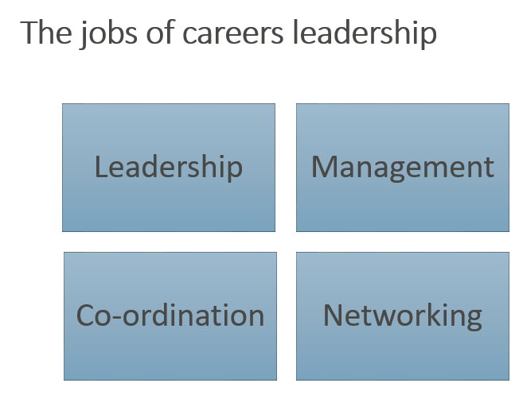
Careers Leader

Slide 26
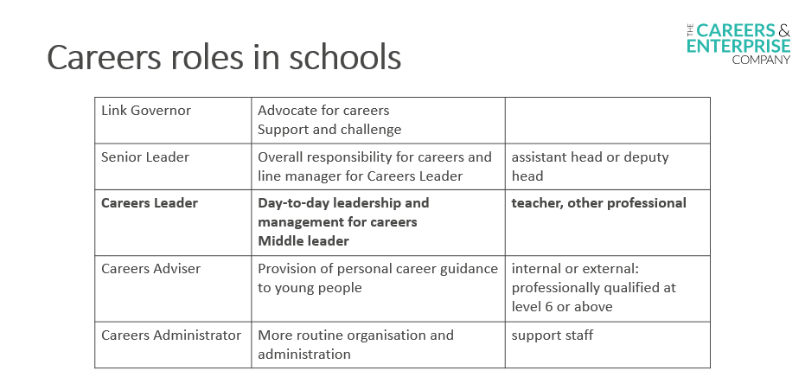

Slide 27
Please take a few minutes to have a comfort break and grab a drink

Slide 29
The 8 Gatsby Benchmarks-Please click video below
https://youtu.be/G-4G4_W5kk8

Slide 31
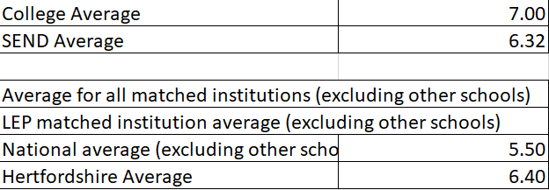
Compass Data July 23 out of 8
Hertfordshire currently averaging 6.40 up from 5.90 Gatsby Benchmarks
4644 schools in England
111 in Hertfordshire including SEND, Colleges and ESC’s

Slide 32
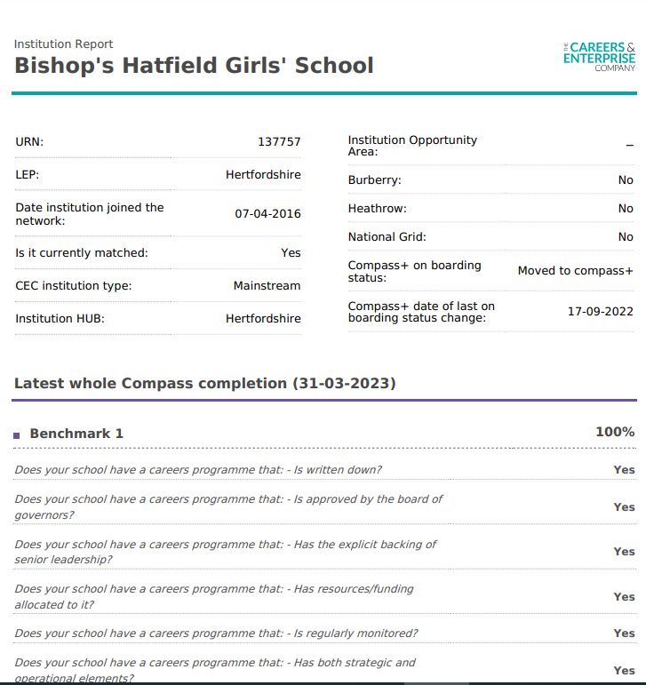
Ask to see your school/college’s compass report:

Slide 33
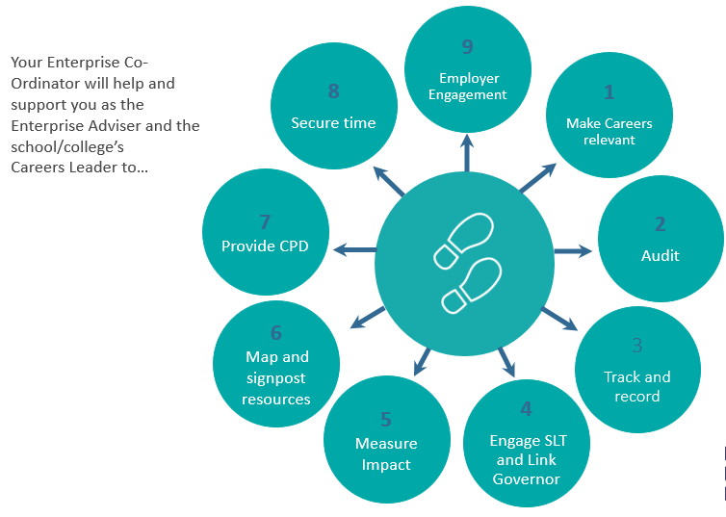
:

Slide 34
:

Slide 35
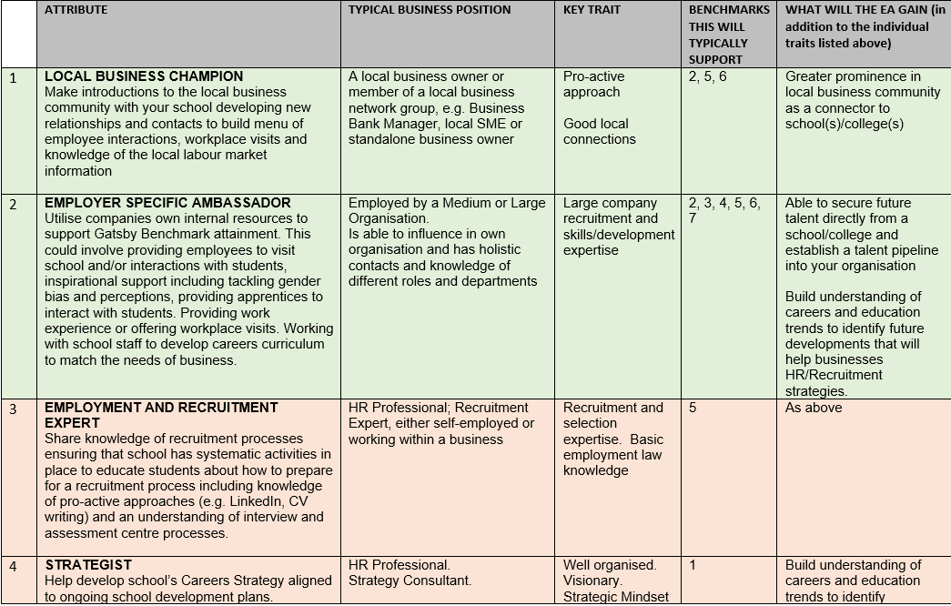
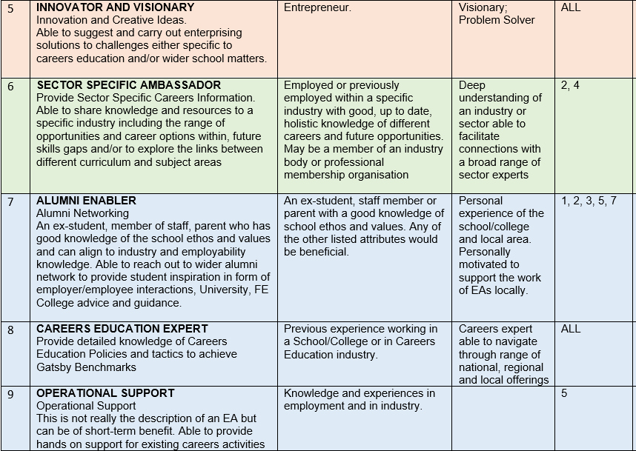
What type of EA do you think you will be?
It is good to work through the careers programme for the year ahead
Look at or complete compass together once per school term
Look at/revisit careers strategic plan-what are the main aims this year?

Slide 36
HOP- Herts Opportunities Portal

Slide 37
New Labour Market Information Video and lesson plan
Herts LMI Video
https://www.hopinto.co.uk/questions/labour-market-information/
Quiz to go with it: https://www.hopinto.co.uk/media/2531/lmi-video-guidelines-and-discussion-points.pdf

Slide 38
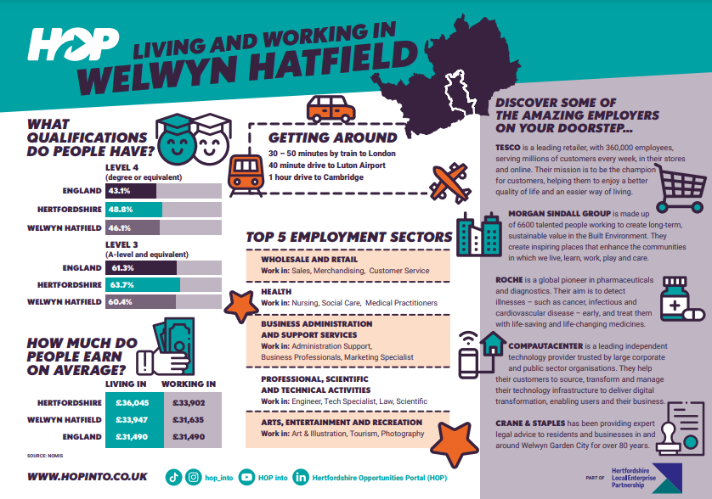
New Labour Market Information posters and growth sector posters on HOP
For Gatsby Benchmark 2 Labour Market Information/National Careers Week we have new Herts labour market information (LMI) posters to use with your students, parents and teachers with hard copies being sent to your Head: https://www.hopinto.co.uk/questions/labour-market-information/

Slide 39
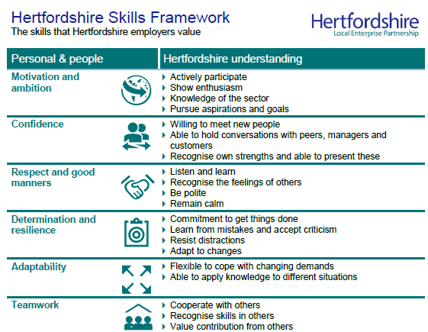
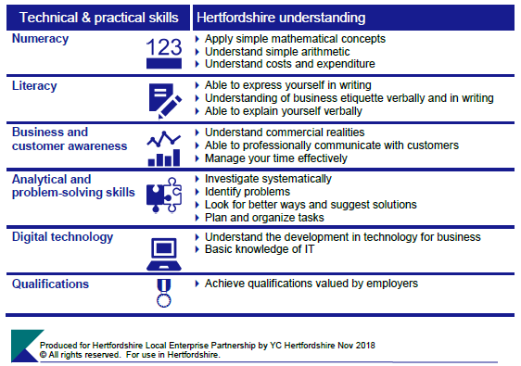
Hertfordshire Skills Framework:

Slide 40
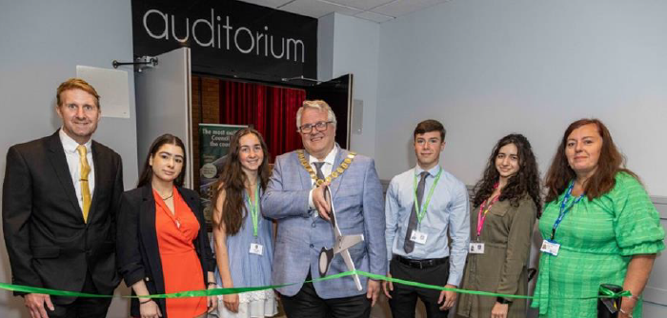
Generation Careers Fair Events- Reach local young talent
MORE GENERATION EVENTS BROUGHT TO YOU BY HOP –
CONNECTING EMPLOYERS TO LOCAL TALENT IN DACORUM, HERTSMERE, WELWYN/HATFIELD BROXBOURNE & STEVENAGE AREAS
Generation Dacorum (Wednesday 27th September - Shendish Manor)
Lesley.Leggett@hertfordshire.gov.uk
Generation Hertsmere (Wednesday 15th November - Double Tree Hilton Borehamwood)
Shea.Costello@hertfordshire.gov.uk
Generation Welwyn & Hatfield (Friday 9th February-Fielder Centre Hatfield)
Gareth.Dace@hertfordshirelep.co.uk
Generation Broxbourne (Wednesday 6th March - Spotlight Theatre Hoddesdon)
Chris.Dowton@hertfordshirelep.co.uk
Organised in association with the local councils and Hertfordshire Careers Hub we have some exciting events to highlight job opportunities open in these areas now and in the near future: these events will give young people an opportunity to meet employers with schools and colleges having slots during the day.
These events also operate a Twilight session from 4-6pm and any local school or college students are welcome to attend to meet with local employers and learn about the many career opportunities available. Parents/Carers are also more than welcome to accompany their child.
Attending one of these events will:
Help young people gain meaningful encounters with employers
Highlight to young people about a variety of local jobs and industries
Informing students about the varied routes into work

Slide 41
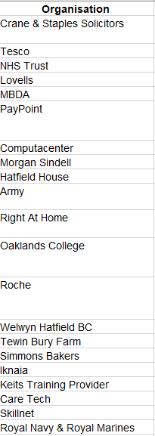
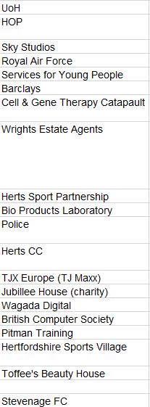
Generation Careers Fair Events
Some of the employers attending
Twilight session for all year groups

Slide 42
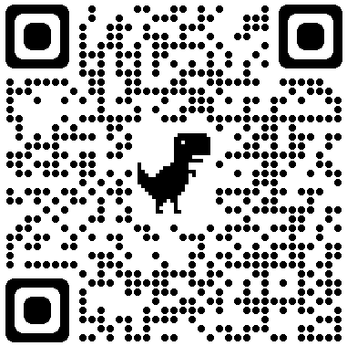
Provider Access Legislation (PAL)
What is the provider access legislation?
The provider access legislation introduced in January 2018 requires all maintained schools and academies to publish a policy statement setting out opportunities for providers of technical education and apprenticeships to access Year 8-13 pupils, and to make sure the statement is followed.
What are the new requirements of the provider access legislation?
The updated provider access legislation specifies schools must provide at least six encounters for all their students:
• Two encounters for pupils during the ‘first key phase’ (Year 8 or 9) that are mandatory for all pupils to attend
• Two encounters for pupils during the ‘second key phase’ (Year 10 or 11) that are mandatory for all pupils to attend
• Two encounters for pupils during the ‘third key phase’ (Year 12 or 13) that are mandatory for the school to put on but optional for students
To promote the quality and consistency of provider encounters, the legislation includes a new set of minimum information that the school must ask the provider to give pupils during each encounter.
When will the updated provider access legislation be enacted?
The updated provider access legislation came into force on 1 January 2023.
What support is available to Careers Leaders to help meet the requirement?
• Several resources will be released in November to support your understanding and implementation of PAL
• Compass+, the online self-evaluation tool will also be updated to enable you to record, track and evidence against the new requirement
• If your school is in a hub, your Enterprise Coordinator is available to help signpost you to relevant information and support conversations about PAL with
your Senior Leadership Team. More info will become available here: https://www.careersandenterprise.co.uk/fe-skills/provider-access-legislation/
If you have any further questions, please do not hesitate to contact: provideraccess@careersandenterprise.co.uk
https://www.hopinto.co.uk/questions/labour-market-information/

Slide 43
Theme weeks NAPW Feb NCW March
National Apprenticeships Week 2024 (NAPW) 7th Feb
National Careers Week 2024 (NCW) 4th March
International Women’s Day 2024
Friday 8th March 2024

Slide 44
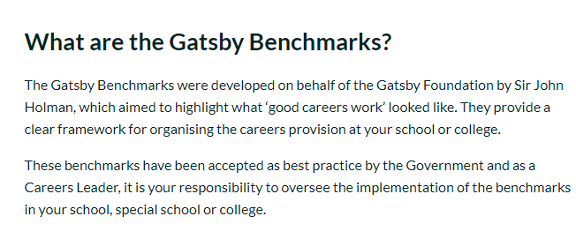
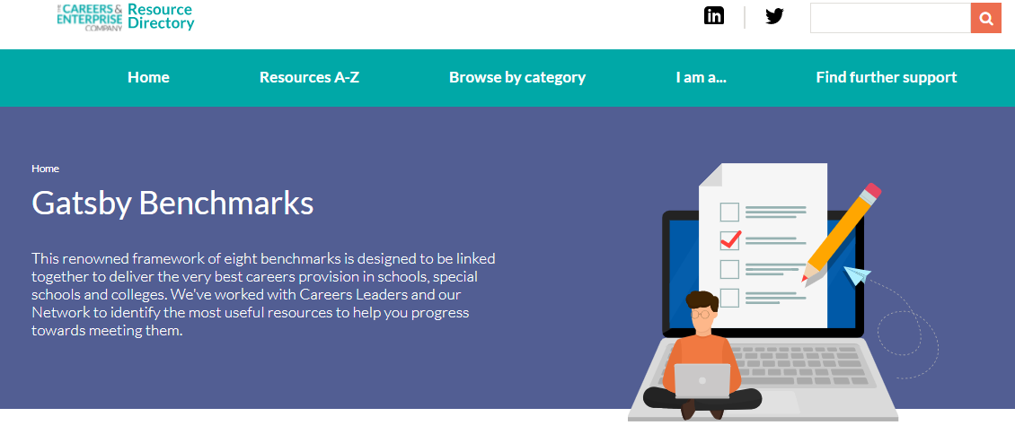
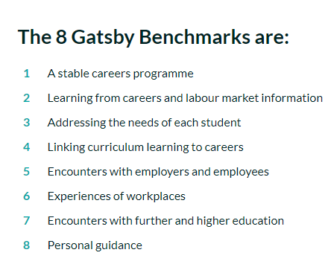
Further research if of interest
For more information on the Gatsby Benchmarks visit The Careers and Enterprise Company resource directory by clicking the below page:
Another useful resource is the Gatsby Benchmark FAQs please click on this thumbnail for more info:

Slide 45
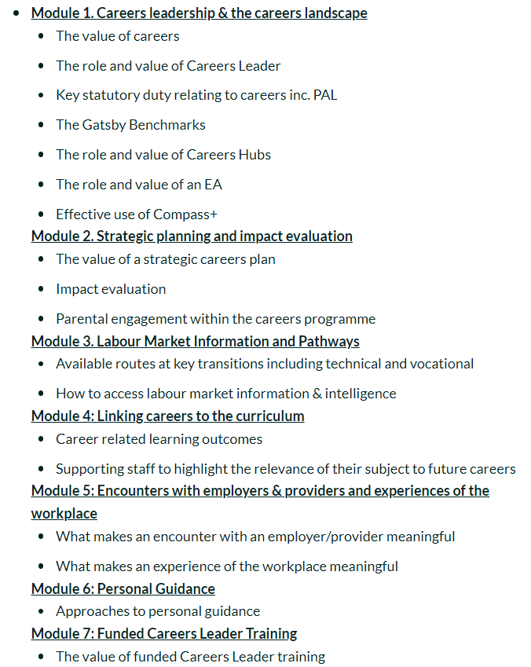
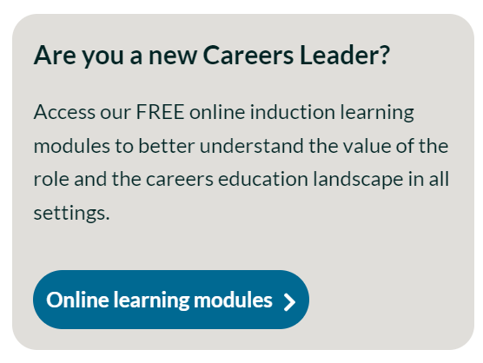
FREE Careers Leader Induction Modules:

Slide 46
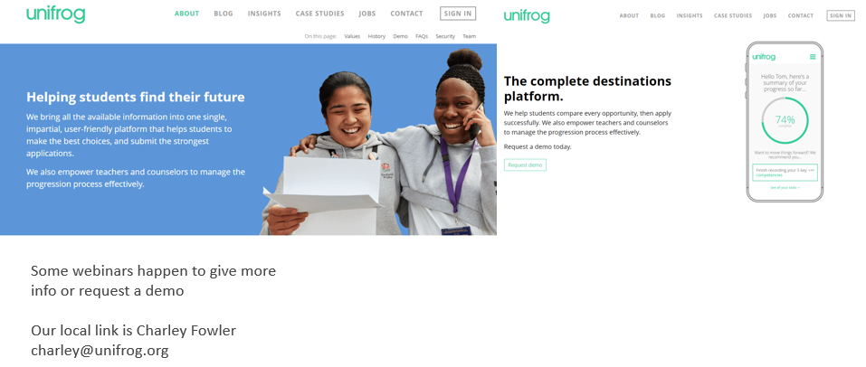
Careers Programs some schools use

Slide 47
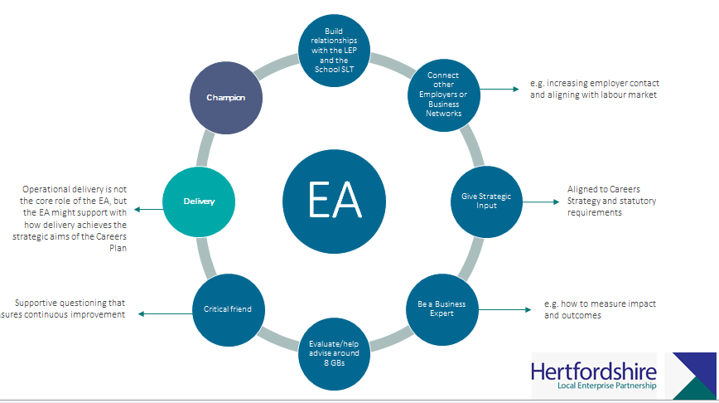
Quick Quiz
Q: What does EC stand for?
A: Enterprise Co-Ordinator
Q: What is Gatsby Benchmark 4?
A: Careers in the curriculum
Q: How many Gatsby Benchmarks in Hertfordshire currently hitting on average out of 8?
A: 6.40/8
Can you name a role of an EA?
Q: Roughly how long does the Compass Audit take?
A: 20-30mins
Q: Can you name a skill from the Hertfordshire Skills
Framework?

Slide 48
Hertfordshire Skills Framework:

Slide 49
Why are Enterprise Advisers so important to our mission
https://youtu.be/ZP1zMLQztVw?si=gk2LZH45yPu0D_Hb

Slide 50
Employer Standards
https://resources.careersandenterprise.co.uk/employer-standards-resource-directory
From late Oct 23 we will need Hertfordshire employers to complete the Employer Standards (like Compass/Gatsby for employers)
All Cornerstones to complete and
Encourage EAs

Slide 51
Next Steps:
Read the safeguarding information provided, EA Roadmap and Compass results for your school/college
Provide a signed MOU and Data Sharing Agreement to your LEP and CEC
Send the LEP any information not yet submitted for your DBS check
Check the CEC website for the resources referenced in your resources list https://resources.careersandenterprise.co.uk/
Plan for your first meeting with your matched school and college
Look on HOP Hertfordshire Opportunities Portal for resources and ideas https://www.hopinto.co.uk/
Invites to events

Slide 52
Good luck and thanks for volunteering ☺

