Slide 1



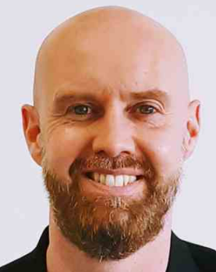
Gatsby Benchmark 1 A stable careers programme & Gatsby Benchmark 3 Addressing the needs of each pupil workshop
16th March 2022
Steve Trotter Careers Hub Operations Lead

Slide 2

Gatsby Benchmark 1 A Stable Career Programme &
Gatsby Benchmark 3 Addressing the needs of each pupil workshop
Wed 16th March 2pm-3.30pm Agenda
Introduction & Welcome | Steve Trotter | 2pm
Introduce concept of Gatsby Benchmark 1 & 3 and hints & tips on how to meet them | Steve Trotter Careers Hub Operations Lead | 2.10-2.30pm
Quality in Careers Standard | Jenny Longstaffe Complete Careers and time for Q&A Careers Leaders who have undertaken the award Sarita Mistry Herts & Essex Judith Crimes Birchwood | 2.30pm-2.55pm 2.55pm-3.05pm
GB1 & 3 hear from Careers Leaders | Input from Careers Leaders sharing best practice on GB1 & 3 Julie Stephenson Presdales Kate Robinson North Herts ESC Sophie Antwi Chancellors | 3.05pm-3.25pm
Resources further guidance & upcoming events | Steve Trotter Careers Hub Operations Lead | 3.25pm-3.30pm

Slide 3


Aims of this session:
CAREERS LEADERS AND EAs WILL GAIN A BETTER UNDERSTANDING OF GATSBY BENCHMARKS 1&3 & HELP ON HOW TO IMPLEMENT THESE BENCHMARKS
CAREERS LEADERS AND EAs WILL FIND OUT HOW THE QUALITY IN CAREERS STANDARD CAN HELP THEM WITH THEIR CAREERS PROGRAMME & GATSBY BENCHMARKS
CAREERS LEADERS AND EAs WILL HEAR BEST PRACTICE FROM CAREERS LEADERS TO HELP INFORM THEIR PRACTICE

Slide 4

Our missions:
To inspire and support young people in the transition to the fast-changing world of work
Strengthen the links between education and employment
Raise the profile & quality of Careers Education in schools and colleges by backing the 8 Gatsby Benchmarks
Raise aspirations among young people and help every young person in Hertfordshire find their best next step

Slide 5
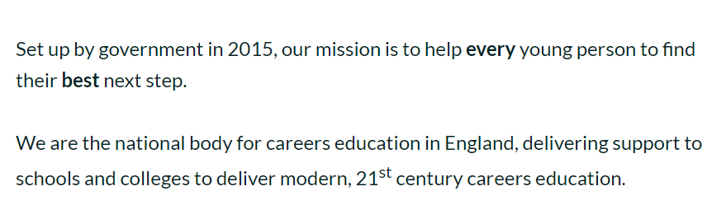
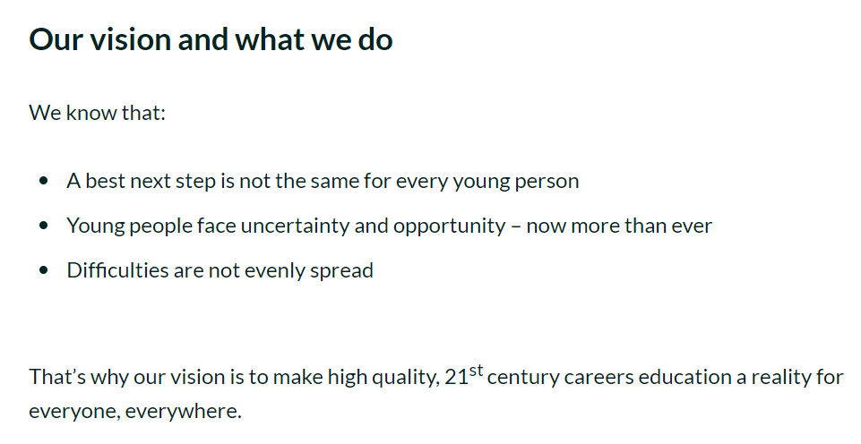
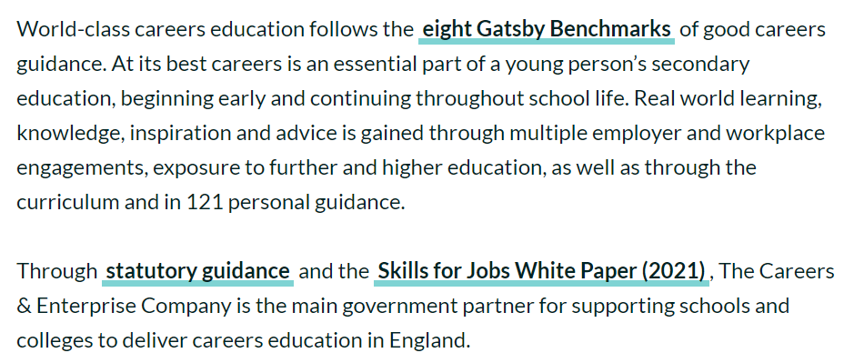
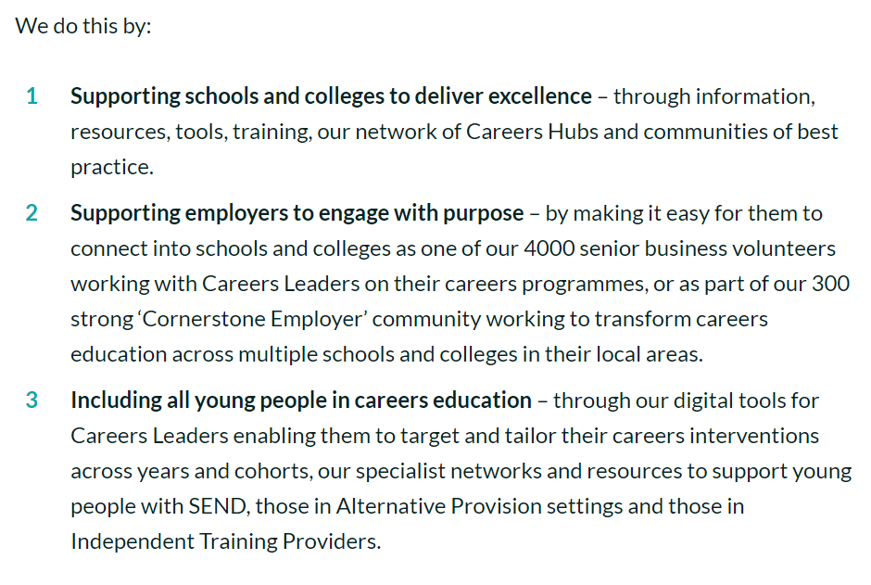

The Careers & Enterprise Company
SHIFT WITH LASER FOCUS ON SHOWCASING IMPACT

Slide 6
The eight Gatsby Benchmarks
The Gatsby Benchmarks define what is considered world-class in careers guidance.
Gatsby Benchmark 1
A stable careers programme
Gatsby Benchmark 5
Encounters with employers and employees
Gatsby Benchmark 2
Learning from career and labour market information
Gatsby Benchmark 6
Experiences of workplaces
Gatsby Benchmark 3
Addressing the needs of each pupil
Gatsby Benchmark 7
Encounters with further and higher education
Gatsby Benchmark 4
Linking curriculum learning to careers
Gatsby Benchmark 8
Personal Careers Guidance
Notes:
Schools and colleges in the Network, and many who are not currently members of the Network, undertake a regular self-assessment against the 8 Gatsby Benchmarks.
This is ideally carried out termly, to enable us to track performance against the benchmarks in comparison to the baseline at the end of the previous academic year

Slide 7
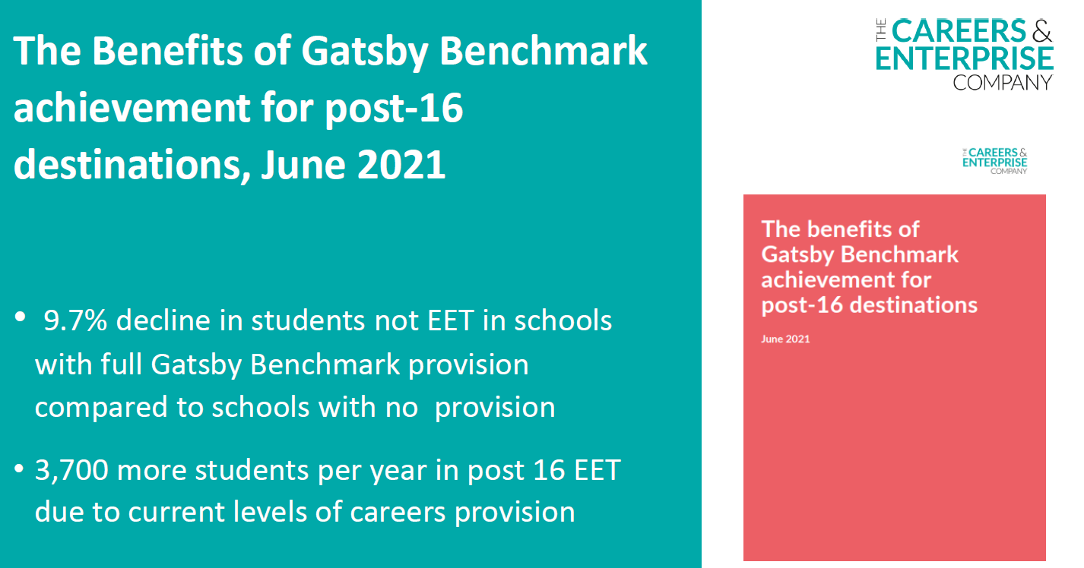
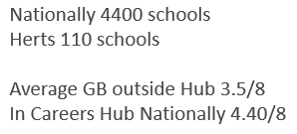
Gatsby Benchmarks
In Herts we are averaging 5.10/8

Slide 9
HUB COMPASS DATA BY CLUSTER – JAN 2022
 | HERTS | ENG | CLUSTER 1 | CLUSTER 2 | CLUSTER 3 | CLUSTER 4
Overall | 5 | 4.41 | 5.03 | 4.12 | 5.18 | 5.54
Schools included | 110 |  | 29 | 24 | 33 | 24
Meeting 3 or more | 83 |  | 24 | 18 | 30 | 21
BM1 FULL ACHIEVE | 55 | 47.4 | 52 | 50 | 48 | 71
BM2 FULL ACHIEVE | 83 | 69.7 | 90 | 66 | 85 | 83
BM3 FULL ACHIEVE | 63 | 41.1 | 55 | 62.5 | 58 | 75
BM 4 FULL ACHIEVE | 77 | 64 | 83 | 79 | 64 | 83
BM5 FULL ACHIEVE | 66 | 62.8 | 76 | 50 | 73 | 58
BM6 FULL ACHIEVE | 59 | 44.6 | 48 | 42 | 73 | 75
BM7 FULL ACHIEVE | 33 | 39.7 | 31 | 21 | 39 | 29
BM8 FULL ACHIEVE | 71 | 70.1 | 69 | 42 | 79 | 88

Slide 10
BENCHMARK 1 – SUB BENCHMARK ANALYSIS
Sub Benchmark | % schools to achieve (based on most recent Compass updates)
Is Written Down | 98%
Approved by Governors | 87%
Backed by SLT | 98%
Resources and funding allocated | 95%
Regularly monitored | 96%
Strategic and Operational elements | 95%
On website | 93%
Info on website….for students | 91%
Info on website…..for teachers | 72%
Info on website……for employers | 74%
Info on website……for parents/carers | 90%
Evaluated every 3 years | 94%
Feedback received from students | 89%
Feedback received from teachers | 82%
Feedback received from employers | 71%
Feedback received from parents/carers | 67%
Has a Careers Leader | 100%

Slide 11
BENCHMARK 3 – SUB BENCHMARK ANALYSIS
Sub Benchmark | % schools to achieve (based on most recent Compass updates)
Raises aspirations | 95%
Challenges typical stereotypes | 90%
Systematically records students experiences | 76%
Pupils can access information about experiences | 64%
Collects and maintains data for up to 3 years…. | 60%
Shares data with Local Authority | 97%
Provides bespoke provision for all students, including those with SEN | 96%

Slide 12
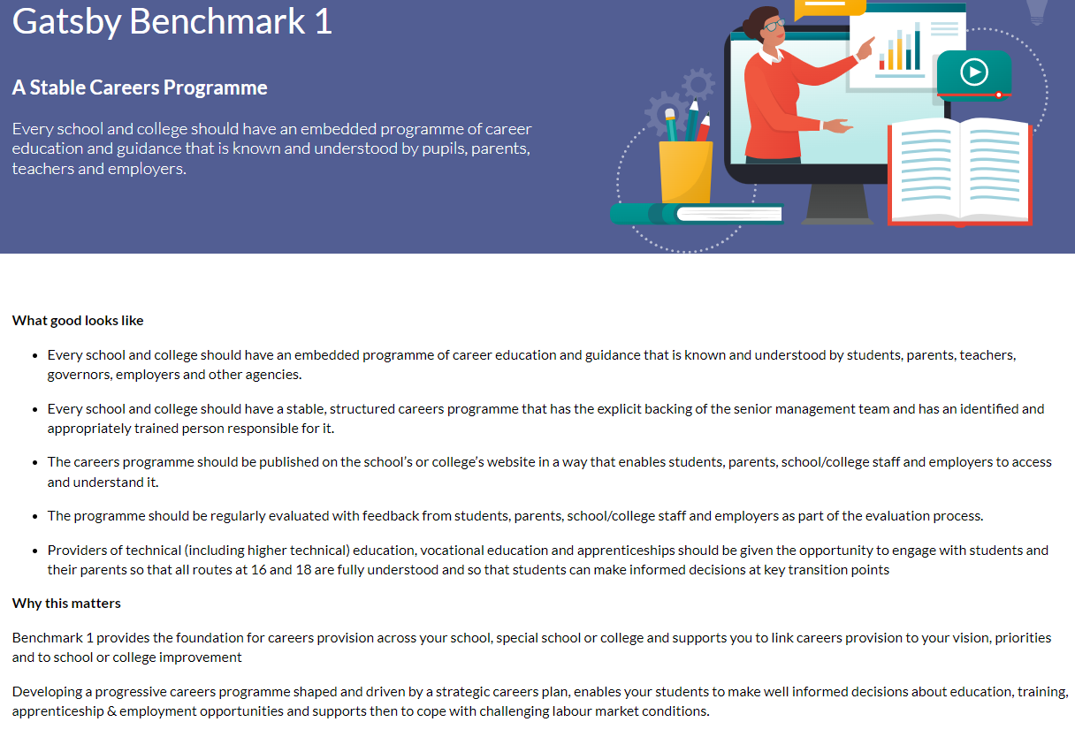
What is looked for to meet the benchmark?

Slide 13
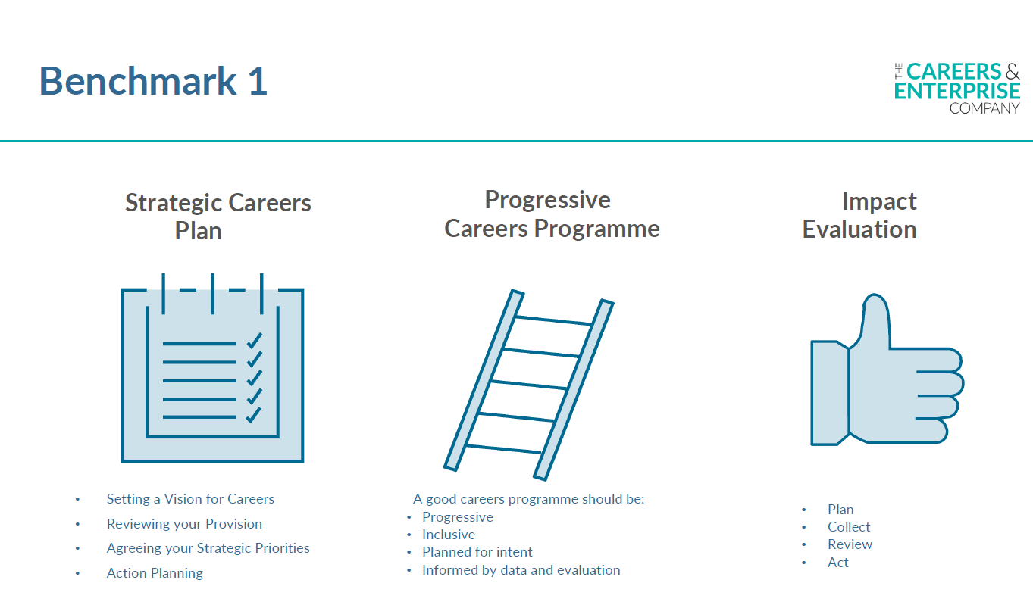

Slide 14
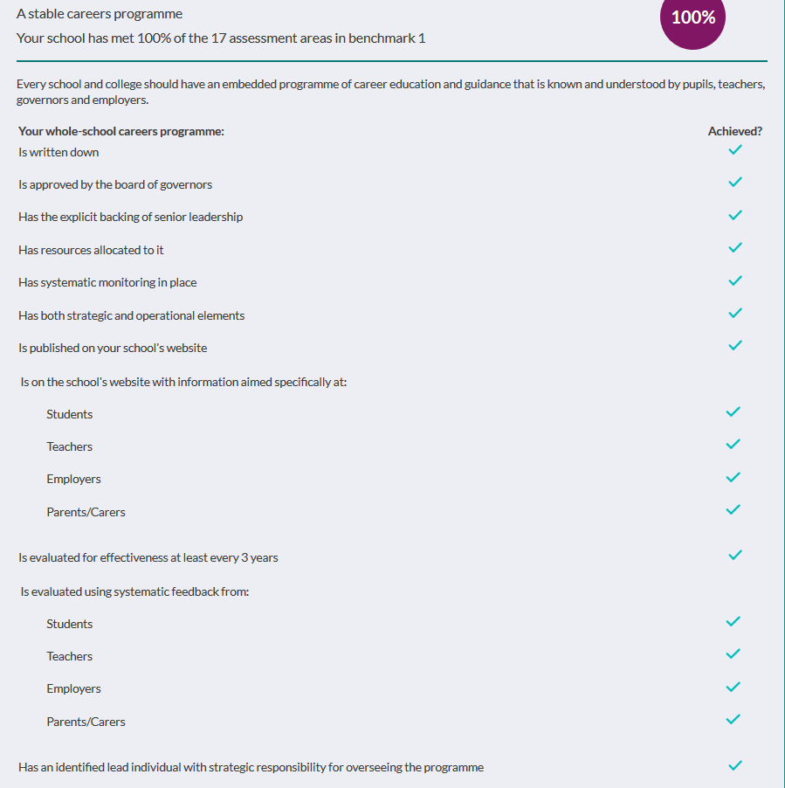


Gatsby Benchmark 1 elements and sub benchmarks
Careers Programme overview on school website with each year group’s activities
Programme and policy shared and approved with SLT/Governors and on website
Intro to careers with a vision statement, careers leader named and contact details present
Careers policy in careers section
Baker Clause/Access statement
Highlight that the programme is for students, parents, teachers and employers to be part of

Slide 15


Key elements to a careers programme GB1
Components:
Careers Education for years 7-13 with overview of activities
Careers within subject areas GB4
Labour Market Information (LMI) GB2
Employer Engagement GB5
Experiences of the world of Work GB6
Encounters with FE/HE/ITP Apprenticeships-Inspiration GB3/GB7
1:1 Personal Guidance with Level 6 Adviser GB8
Features:
Progressive
Each & Every and Student Level Tracking-Compass +/Unifrog
Informed by Stakeholder voice
Known and Understood-by Careers Leader/SLT/Teachers/Parents/Students/Governors
Informed by Evaluation
Benchmarks as a Self-Assessment Framework-Compass
Notes:
Learning outcomes for Careers Education Provision can DRIVE all other elements to a stable careers programme to ensure a planned progressive careers programme, which meets the needs of each and every student
Worth a focus on Careers Education
1 in 6 schools stopped a taught element of careers education once it became non-statutory
Links to BM4: Career learning outcomes are delivered as a discrete curriculum, e.g. careers education or as part of PSHE CPD consideration for delivery team and tutors, etc.
This is about outcomes –what do students need to know, understand and be able to do
Discussion 1: How does your school/college deliver Careers Education. What drives it?
We are going to look at two examples of tools who offer progressive frameworks for skills development and for careers education with learning outcomes and suggested activities, which contribute to ensuring any taught element is:
Progressive
For Each & Every
Supports Benchmark progress

Slide 16
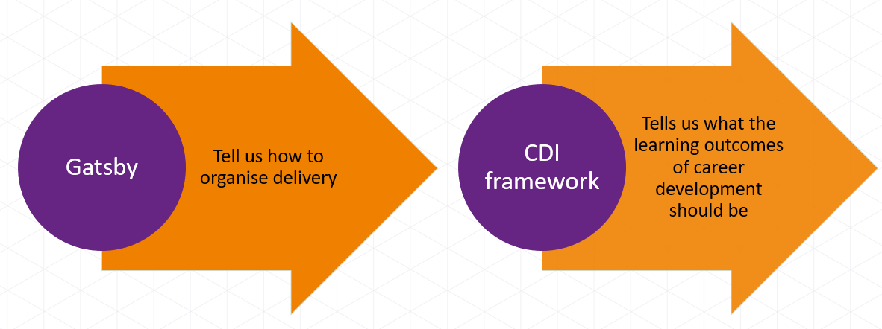
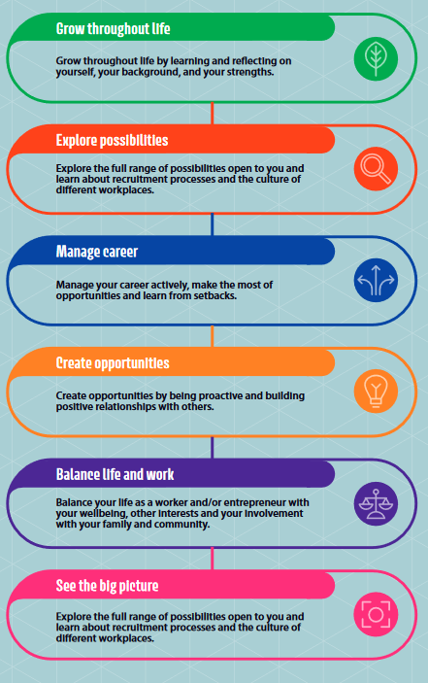
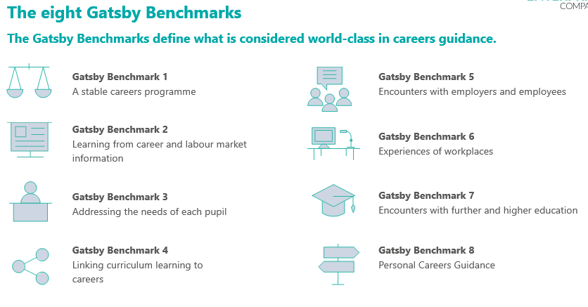
Gatsby Benchmarks/New CDI Framework

Slide 17
A stable (and progressive) careers programme
Year Group | Careers Education Activity | Term/Date | Gatsby Benchmark(s) | CDI Framework Pillar(s)
7 | Intro to the careers programme Careers talks NCW Register on careers programme e.g. Unifrog | Aut Spring Sum | 1 5 2, 3,
8 | GB4 Careers in the Curriculum lessons for NCW Enterprise competition with Company/EA | Spring Sum | 4 5
9 | Careers carousel with employers from different sectors | Spring | 2, 3, 5
9 | GCSE Options info Work shadowing | Spring Sum | 3 2, 5, 6
10 | Work Experience/Virtual Work Experience | Sum | 2, 5, 6
11 | Careers Fair/Virtual Careers Fair including employers/FE/HE, apprenticeships and ITPs | Aut | 2,3,5,7
All | Careers Guidance appointments | Aut/Spring/Sum | 2, 3, 7, 8
11 | Transition events and college tasters | Aut/Spring/Sum | 3, 7
12 | Careers talks different sectors, apprenticeships, Unis | Aut/Spring/Sum | 2, 3, 5, 7
12 | Work Experience | Sum | 2, 5, 6
13 | Extra support group for students looking at apprenticeship/degree apprenticeship routes | Aut/Spring/Sum | 2, 3, 5, 7, 8
Careers Programme overview on school website
Mapped to the Gatsby Benchmarks
Update for next academic year
Move towards blended f2f/virtual
Next logical step to map to new CDI Framework

Slide 18
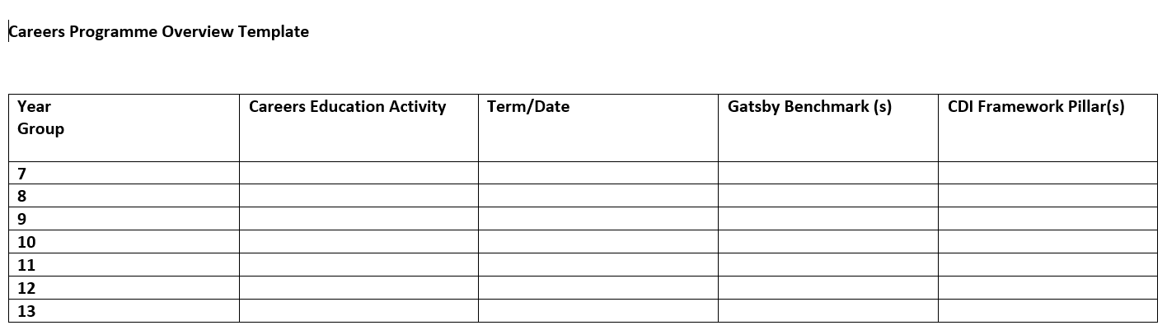
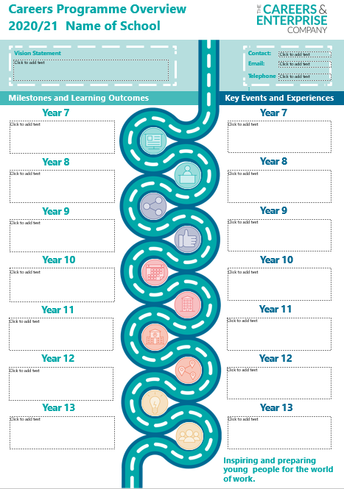
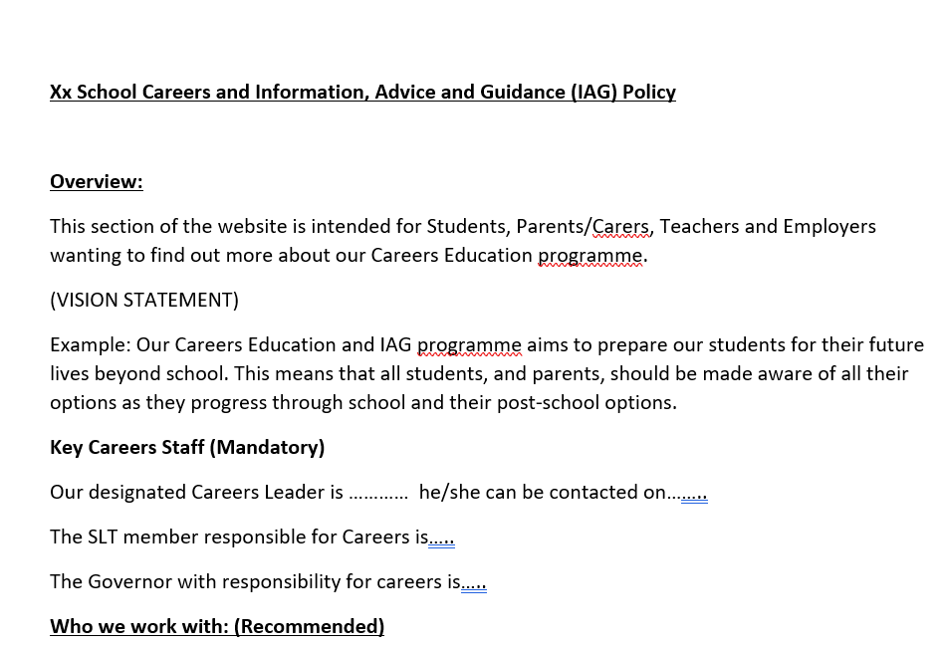
A stable (and progressive) careers programme –templates in our Gatsby Benchmark section on HOP
Use our Hertfordshire Careers Hub website template including access statement/Baker Clause
https://www.hopinto.co.uk/explore-careers/new-gatsby-benchmark-resources/

Slide 19

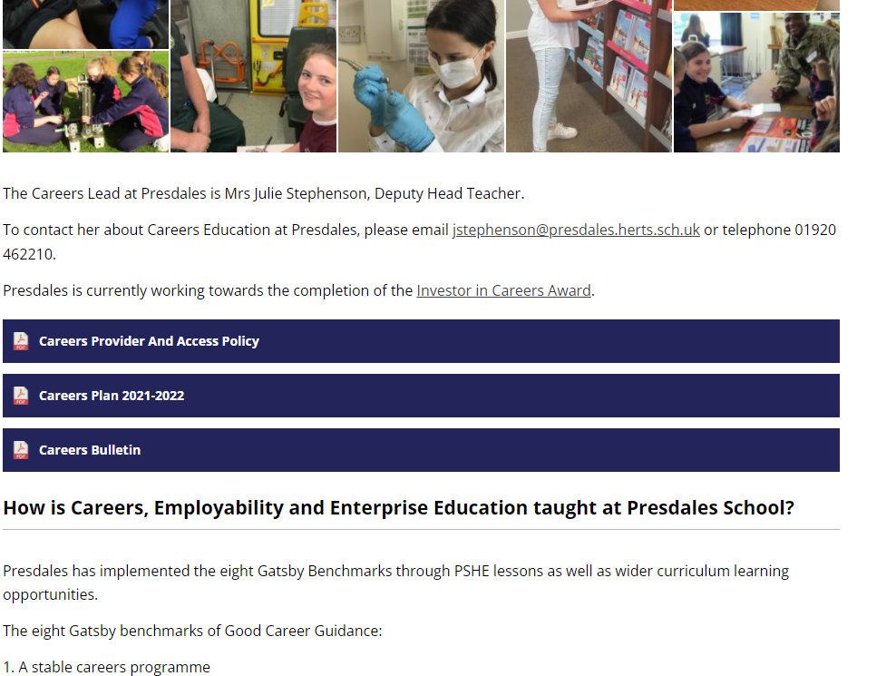
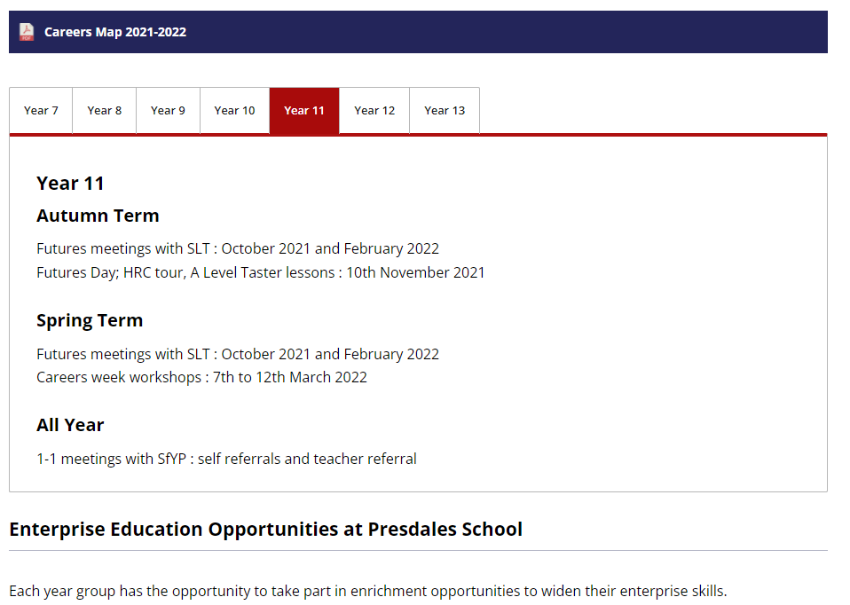
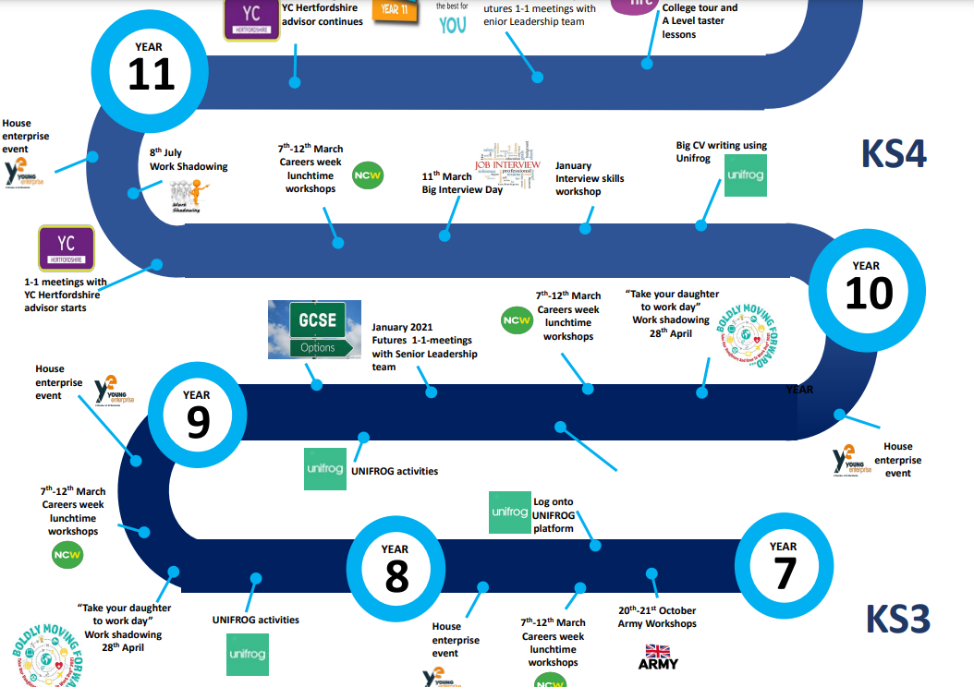
Useful websites
Presdales website
https://presdales.herts.sch.uk/careers/

Slide 20
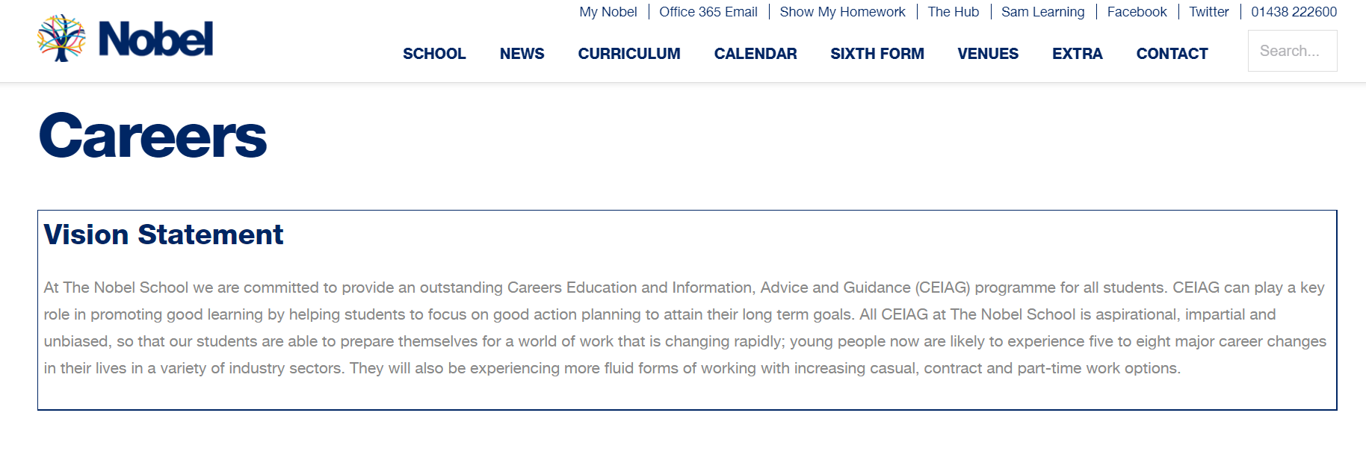
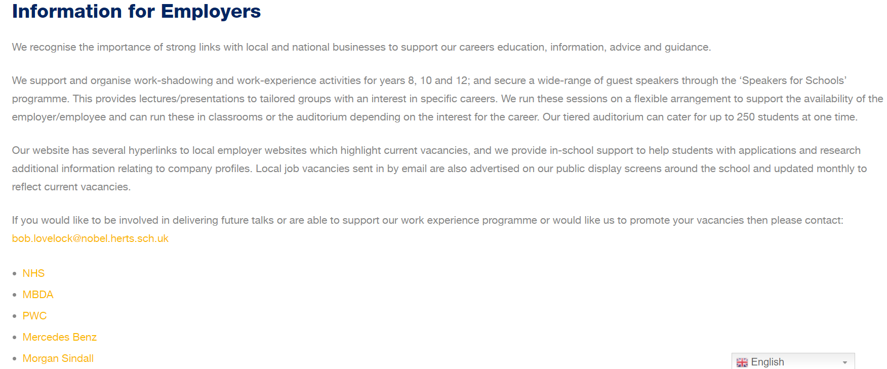
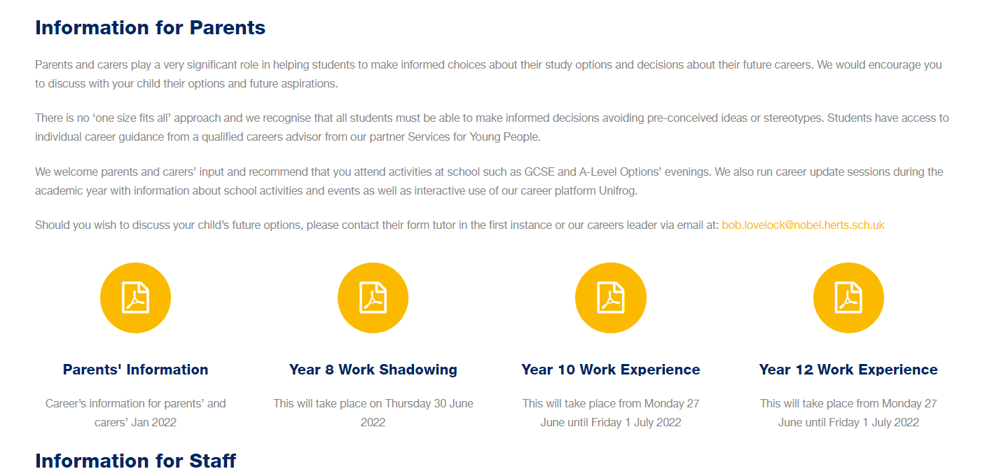
Useful websites https://thenobelschool.org/careers/

Slide 21
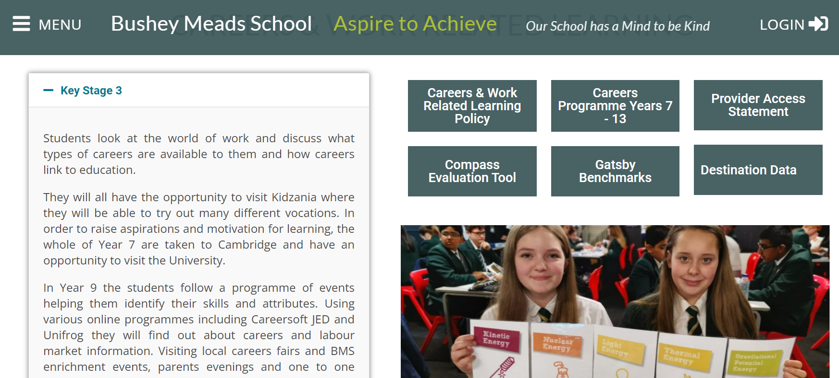
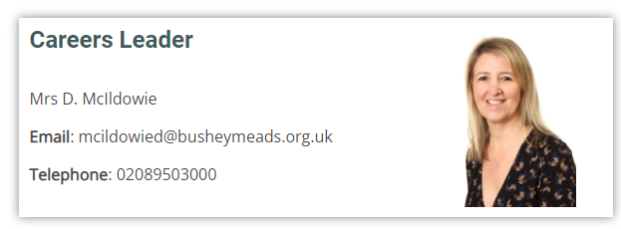
Useful websites
https://busheymeads.org.uk/careers-work-related-learning-2/

Slide 22
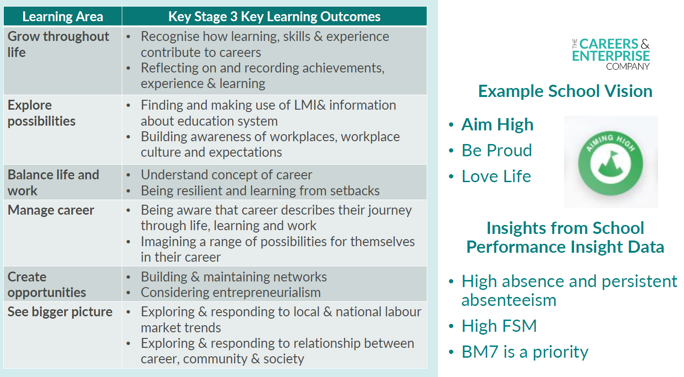

Slide 23
Features of a Careers Strategic Plan:
Key strategic objectives
How- The Careers Programme, how it is evaluated and monitored, who is responsible for each bit, timescales
Why – The vision
What-Case studies from the programme, WEX, events and alumni stories-different destinations/key groups
IMPACT

Slide 24

Evaluation
How do your schools/colleges currently evaluate their careers programmes?
CONSIDER-COMPASS/COMPASS + RESULTS, DESTINATIONS DATA, KEY GROUPS (SEND/PP/FSM/CLA)
Students
Surveys after careers guidance/ WEX
Surveys after events e.g. mock interviews/careers fairs
Focus group led by EA on school careers programme
Herts Skills Framework/Skills Builder audits before/after careers events to see improvement
Future skills questionnaire (Compass Plus)
Intended and actual destinations (Gb1 & GB3)
Parents
Careers Survey at parents evenings
Surveys after guidance/wex
Surveys after events
Focus group led by EA on school careers programme
Parents Apprenticeship Survey
Teachers
Promote/launch careers programme and gain feedback
INSET day careers focuses GB4 and audit careers in the curriculum
Focus group led by EA on school careers programme
Teacher Apprenticeship Survey
Employers
Post wex surveys
Post work related learning surveys –mock interviews, careers fairs etc
EA support/feedback on school careers website and programme/compass scores
ANNUAL CAREERS REVIEW
Website/Programme up to date
Policy approved
Post event evaluations from different voices/stakeholders
Staff development/CPD/INSET sessions
Fed back to SLT termly
Compass scores for the year/progress
Strengths
Areas for development
Destinations data review
Extra support for key groups
Pre-event prep, reflect, evaluate

Slide 25
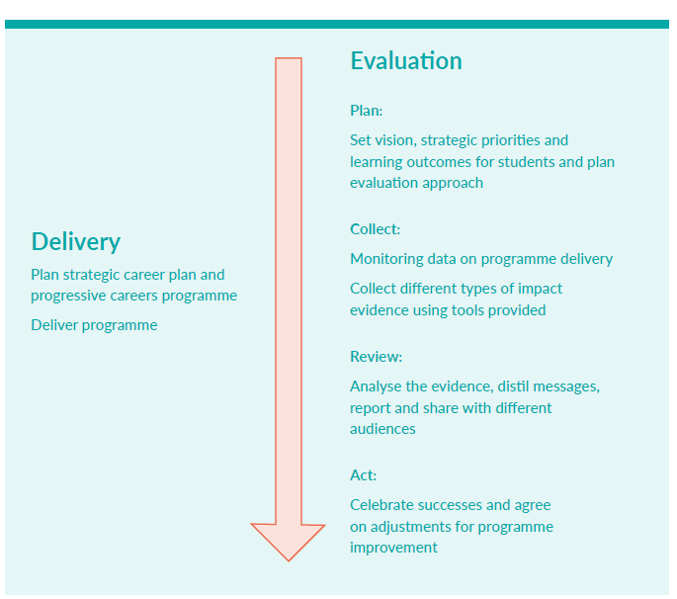
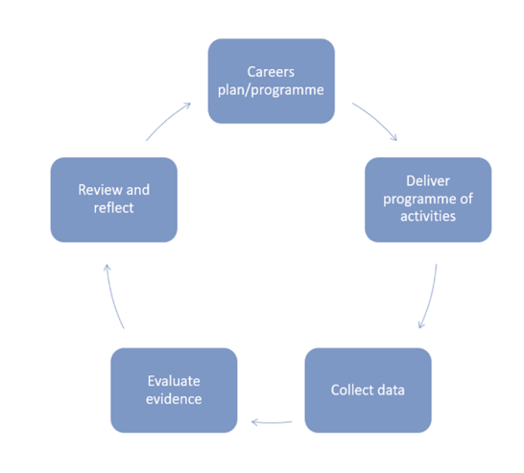

Slide 26
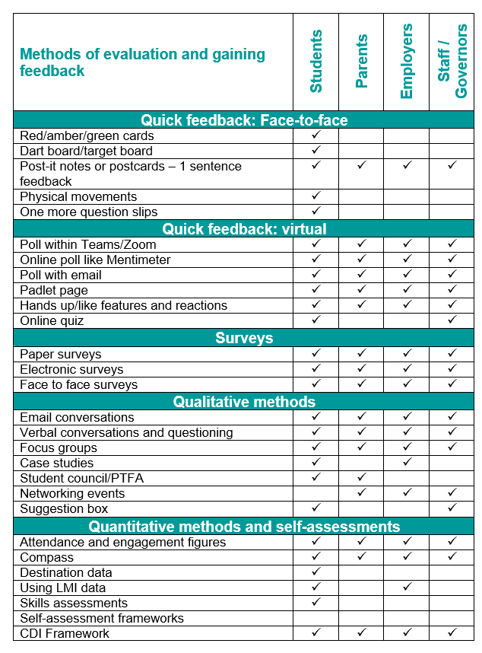

Slide 27
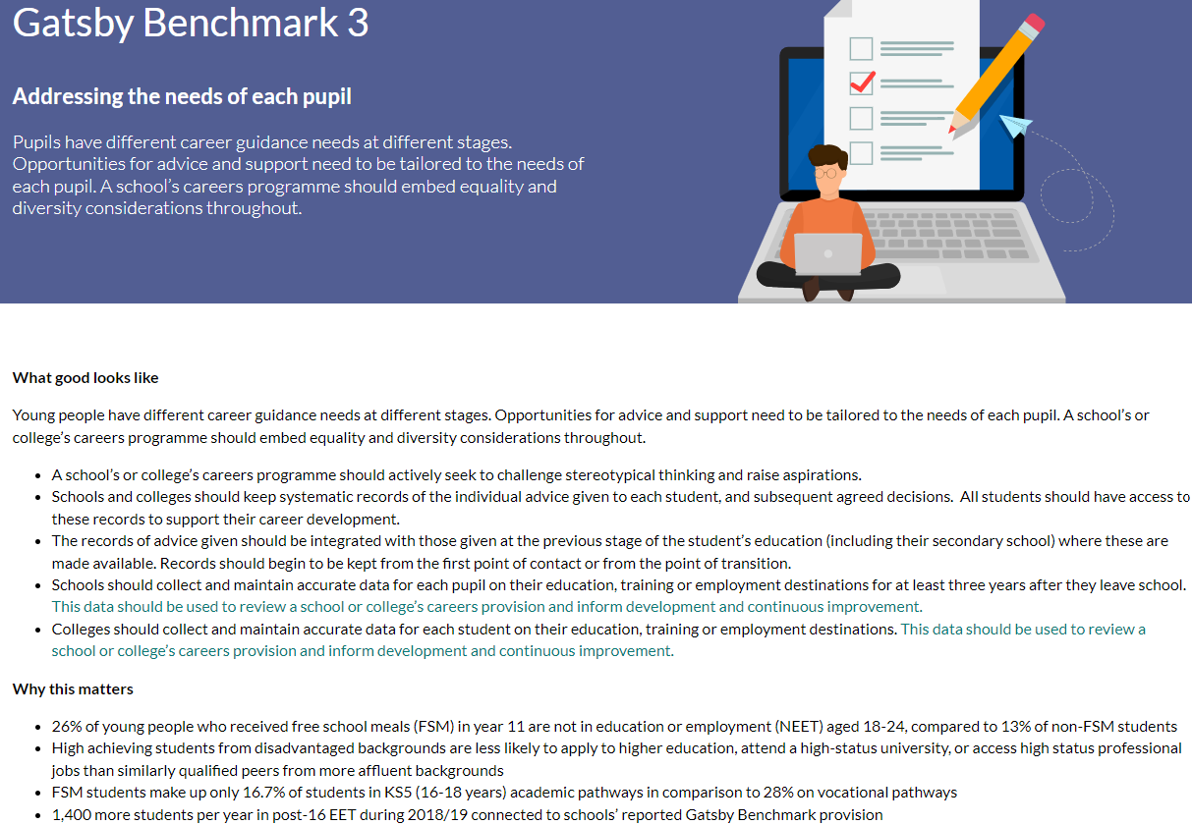
What is looked for to meet the benchmark?

Slide 28
BENCHMARK 3 – SUB BENCHMARK ANALYSIS
Sub Benchmark | % schools to achieve (based on most recent Compass updates)
Raises aspirations | 95%
Challenges typical stereotypes | 90%
Systematically records students experiences | 76%
Pupils can access information about experiences | 64%
Collects and maintains data for up to 3 years…. | 60%
Shares data with Local Authority | 97%
Provides bespoke provision for all students, including those with SEN | 96%

Slide 29
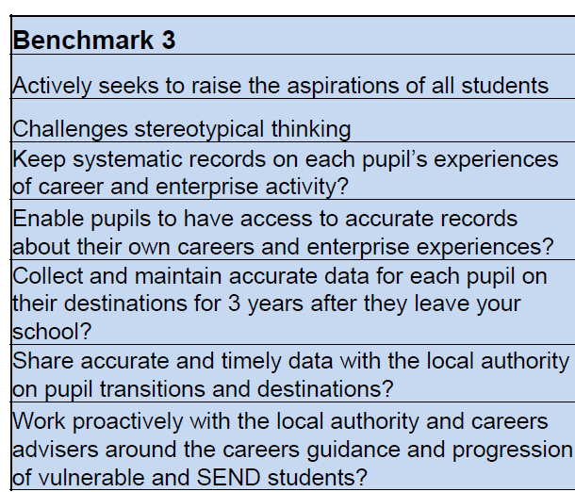
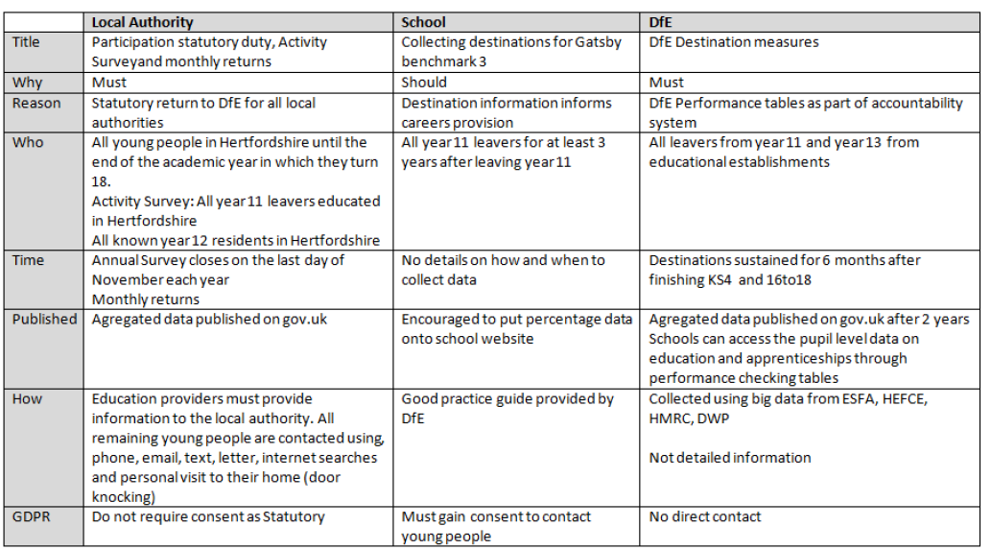

https://www.hopinto.co.uk/explore-careers/webinars/virtual-employer-encounters/
Notes:
Thursdays – 4:30pm

Slide 30
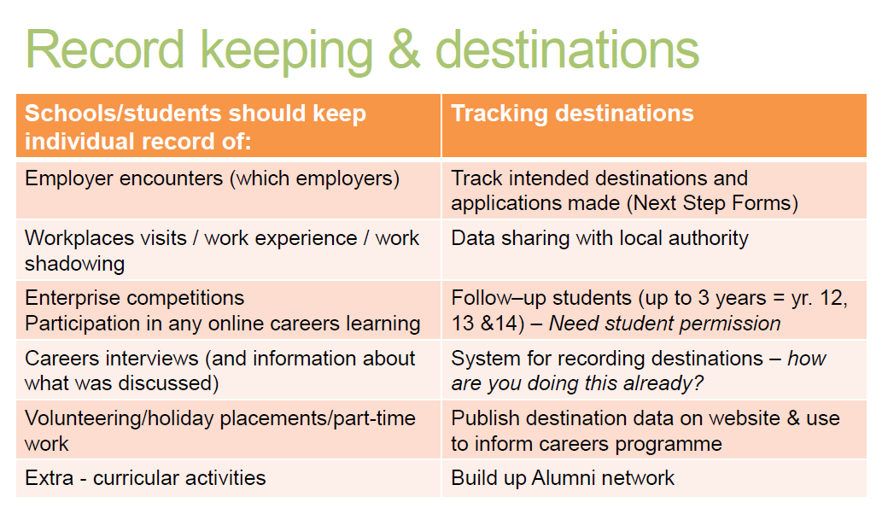
https://www.hopinto.co.uk/explore-careers/webinars/virtual-employer-encounters/
Notes:
Thursdays – 4:30pm

Slide 31
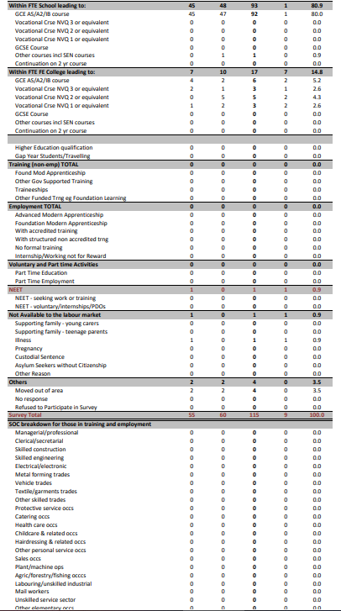
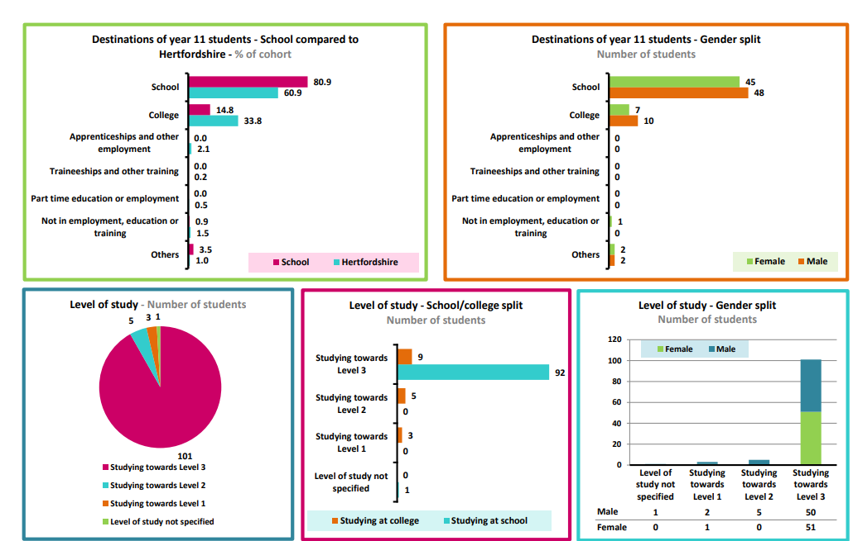
Services for Young People Destinations Reports

Slide 32
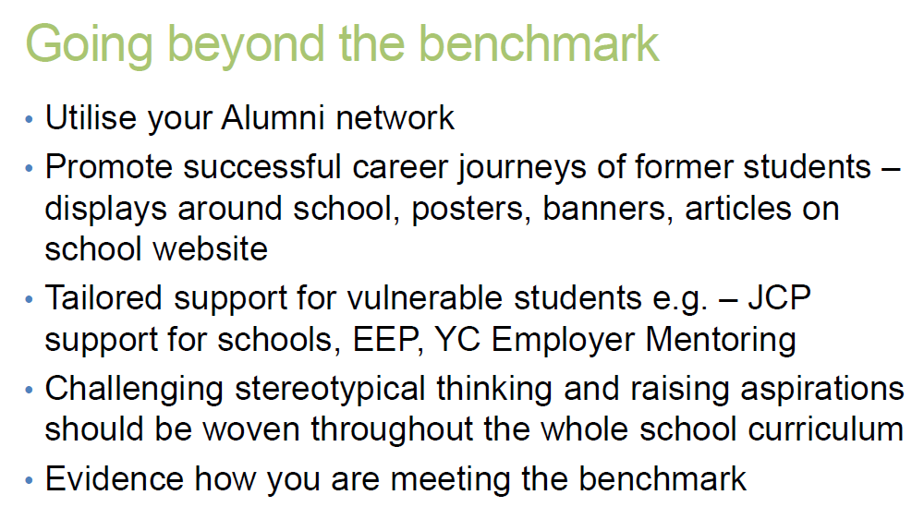
https://www.hopinto.co.uk/explore-careers/webinars/virtual-employer-encounters/
Notes:
Thursdays – 4:30pm

Slide 33
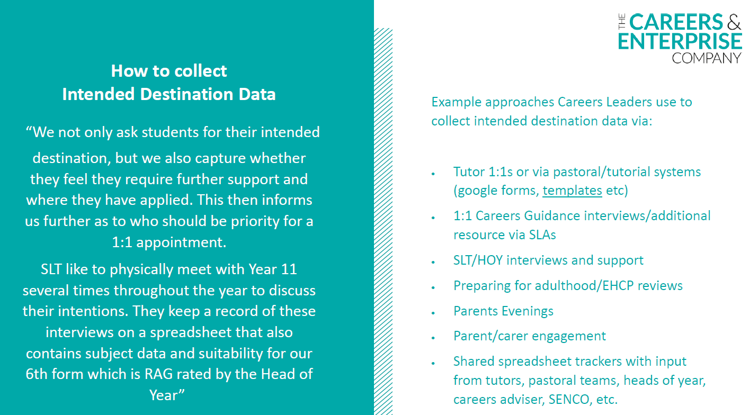

https://resources.careersandenterprise.co.uk/my-learning-my-future
Gatsby Benchmark 3- Destinations Data

Slide 34
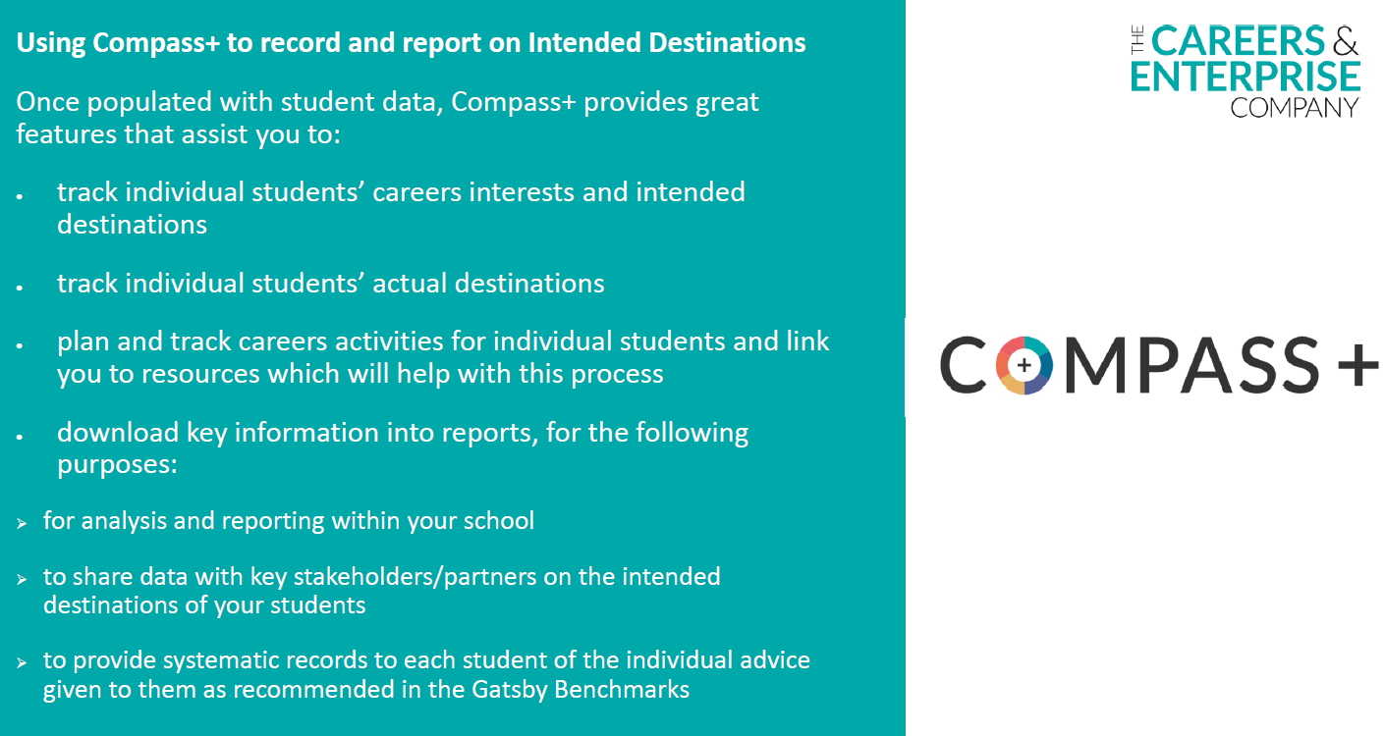
Using Compass Plus and or Unifrog for intended/actual destinations

Slide 35
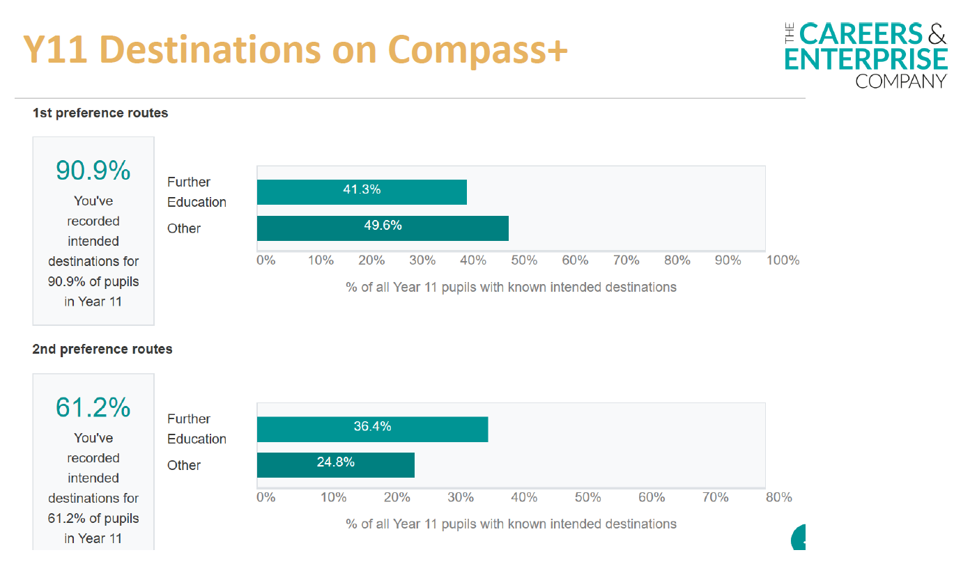
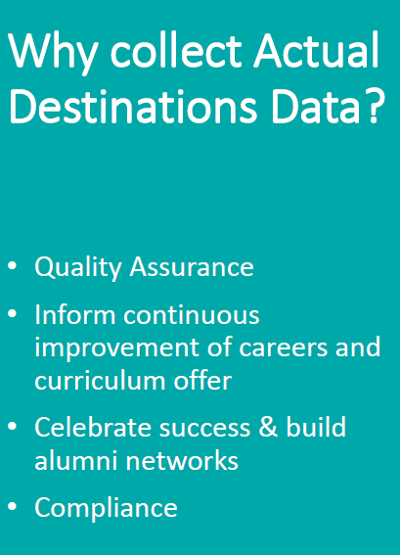
Using Compass Plus and or Unifrog for intended/actual destinations

Slide 36

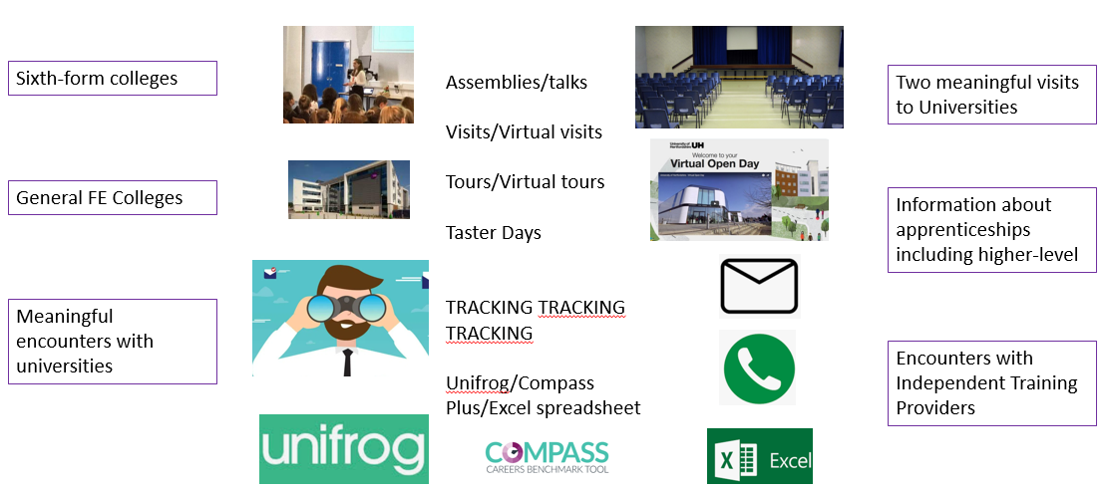




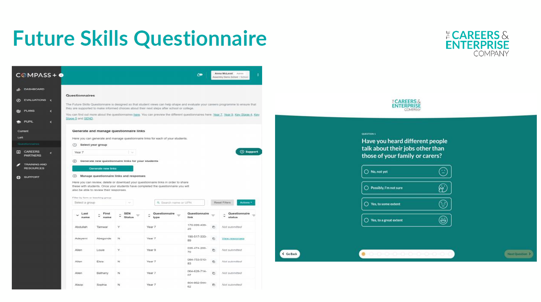

Inspiration and all options
https://www.hopinto.co.uk/explore-careers/webinars/virtual-employer-encounters/
https://www.unitasterdays.com/
katie.doran@theaimgroup.co.uk; natalie.phillips@theaimgroup.co.uk
https://careersandenterprise.zendesk.com/hc/en-gb/articles/360018448820-How-to-upload-your-data-from-Unifrog
Notes:
Thursdays – 4:30pm

Slide 37

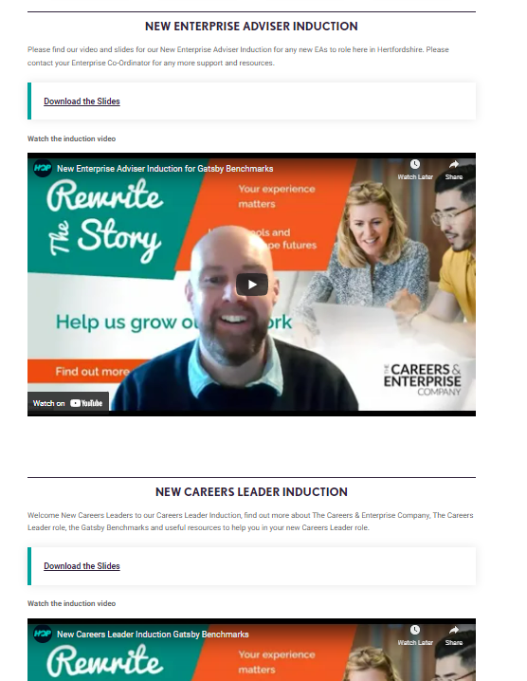
New Gatsby Benchmark resources section on HOP
New from this week we now have a Gatsby Benchmark section on HOP
Please send through good examples of GB resources to me
steve.trotter@hertfordshirelep.co.uk
Click here to register for a place at this online conference
For any new Careers Leaders or EAs who have missed an induction we also have Careers Leader and EA Induction videos on HOP too, plus over Zoom next EA Induction is Wed 4th May 9.30am ask your EC for an invite
.
https://www.hopinto.co.uk/explore-careers/new-gatsby-benchmark-resources/

Slide 38

Quality in Careers Standard Award and Career Mark
Jenny Longstaffe
Licensed Awarding Body for the Quality in Careers Standard

Slide 39

Session Content
  Exploring Quality Awards and their impact
  Introducing Career Mark to include:
        It’s features
        The process
        The standards
        The costs
  Comments and Questions

Slide 40
Why schools work towards the Quality in Careers Standard.
Recognition of the careers provision that they are proud of. – celebration
Using the process as an opportunity to develop the provision in the school and use external scrutiny to build an effective program – development.
To give a greater voice for improved resourcing within the school. – advocacy.

Slide 41
Department for Education
Schools and colleges can gain formal accreditation of their careers programme through the Quality in Careers Standard - the single national quality award for careers education, information, advice and guidance. The Standard is owned by the Quality in Careers Consortium which involves the major professional associations of school and college leaders alongside the Career Development Institute and Careers England. The Standard is fully aligned to the Gatsby Benchmarks and incorporates Compass and Compass+ into its processes.
The Standard seeks additional evidence of outcomes for students from the school or college careers programme. As the Standard is externally assessed by one of the Licensed Awarding Bodies, appointed by the Consortium, student voice is a key part of assessors evidence gathering on the impact the careers programme has had on students’ career-related learning. We strongly recommend that all schools and colleges work towards the single national Quality in Careers Standard to support the development of their careers programme.
– DFE guidance, updated 2021

Slide 42
Ofsted
Thomas Keble School
  ‘The school has an outstanding programme of careers guidance which begins in Year 7 and has recently been awarded Career Mark.’
Blackheath School
  ‘Careers guidance is excellent and students are very positive about the assistance offered. The school has attained the Career Mark award and promotes effective work related learning.’

Slide 43
What is the likely impact of working towards a Quality in Careers Standard Award?

Slide 44
What is Career Mark?
Career Mark was first established in 1994
Career Mark is a nationally available CEIAG Licensed Awarding Body for The Quality in Careers Standard
Career Mark is a comprehensive development framework for CEIAG. It supports legislation, national standards and best practice in careers.
One of 12 awarding bodies of The Quality in Careers Standard in the UK
Notes:
Career Mark has delivery partners across the country, all management and administration is carried out by Futures.
Delivery partners tend to operate in their own geographical area, many of which are local authorities.

Slide 45
Assessment
There are two stages to assessment:
Stage 1
Portfolio assessment - the portfolio is assessed against the 4 delivery standards and the evidence supplied. This is a desk top exercise by one of our assessors. Successful completion leads on to stage 2.
Stage 2
Onsite assessment - The assessor will visit the institution and assess the learner’s knowledge based on the evidence in a school’s portfolio. This is usually done by seeing a selection of students from each year group.

Slide 46
Structure
4 delivery measures
Management : measures the effectiveness of systems for planning, managing and integrating CEIAG
Advice and Guidance: measures the effectiveness of an integrated programme of advice, guidance and support
Information : measures the accessibility, relevance, importance and effectiveness of information, the acquisition of skills to research and evaluate to be able to make well informed and realistic career decisions
Curriculum : measures how effectively the curriculum supports the development of learners’ knowledge, skills, understanding and attitudes
Notes:
Advisers role – to support organisations in going through the award (should they want it)
Assessors role – to assess evidence and carry out onsite visit.

Slide 47
Structure (Ctd)
1 'output' measure
Learner Outcomes : evaluates learners’ knowledge, competence and attitudes towards career planning

Slide 48
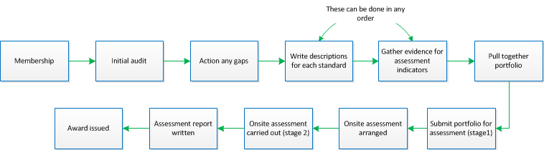
The Process
Notes:
CONFIDENTIAL – Username: careermarkassessor
Password: @$$3$$0R

Slide 49
Process (ctd)
The time the process takes will depend entirely on how much work is required following the audit.
The portfolio requires key evidence examples not everything you have, less is more.
Our members website provides a breadth of support in gathering evidence, writing descriptions etc.

Slide 50
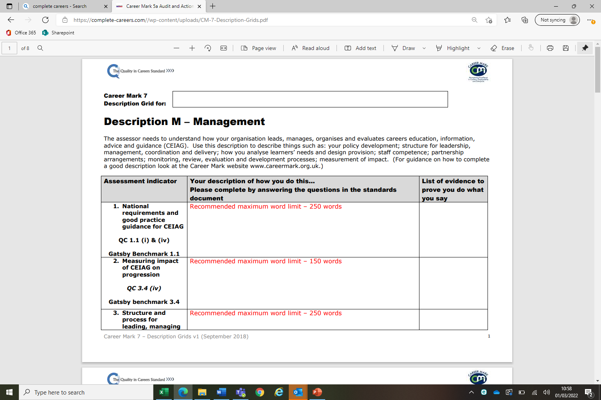

Slide 51
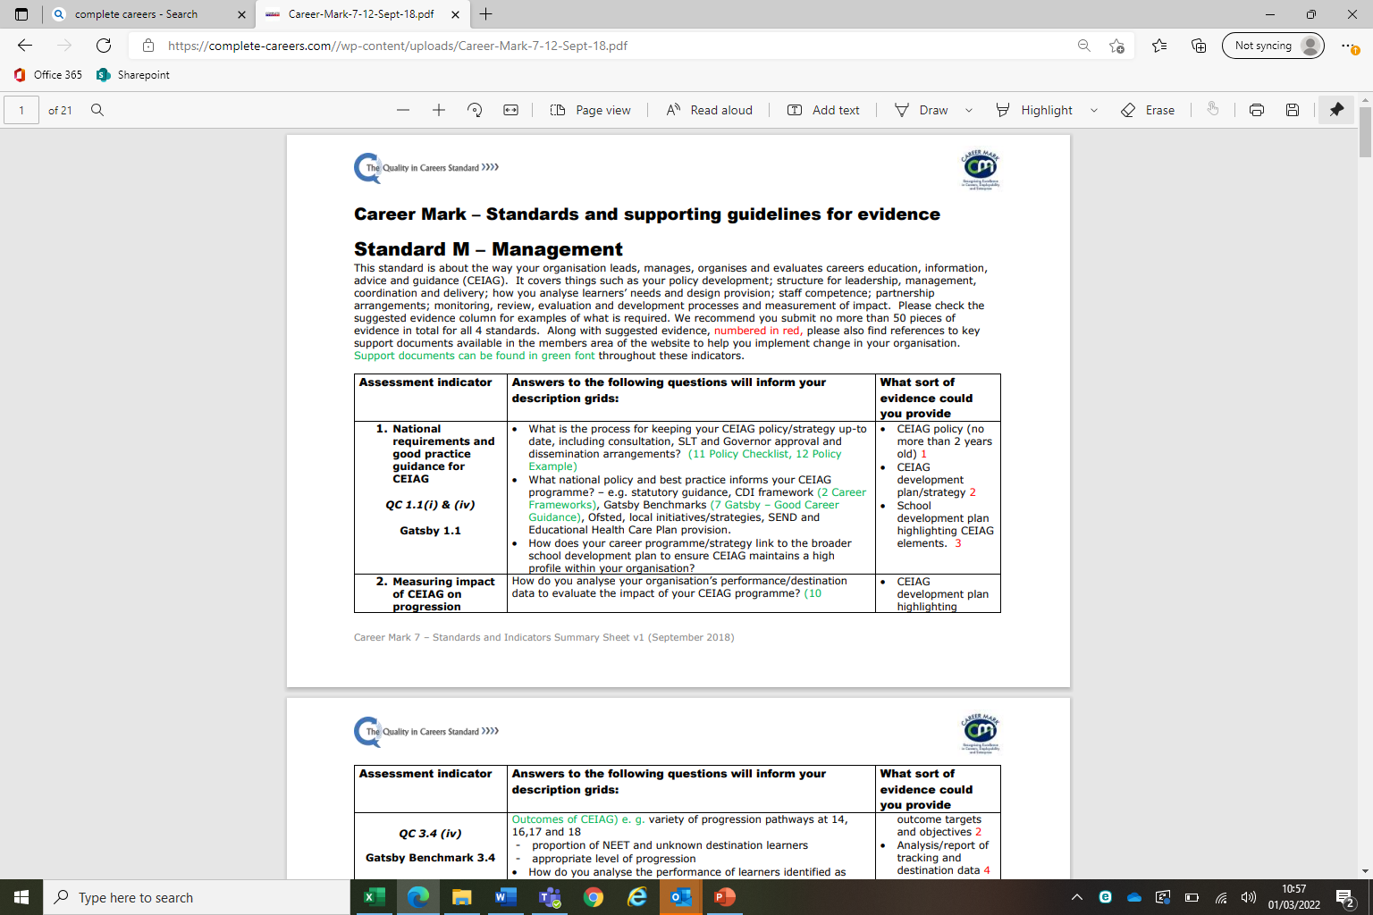

Slide 52
Award
A successful organisation will receive a plaque, certificate, full report and a copy of the career mark and Quality in Careers logo to use to communicate the quality of their provision.
The awards has a two year revalidation period
This creates a structure of continuous improvement, rather that ‘stop, start’. Process is both simpler and cheaper than the initial assessment.
Revalidation:
Offers a lot better value,
Less work in putting together a portfolio
Provides a stronger structure for continuous organisation improvement
Following two consecutive revalidations you will receive a gold plaque demonstrating further your commitment to quality CEIAG

Slide 53
Career Mark Costs
First assessment £1275 (membership and first award)
Membership £160 for 2 years
Revalidation £750
Career Mark Primary £750

Slide 54
Am I ready?
Have I got the time?

Slide 55
If you wish to find out more
Find out more on the website: https://complete-careers.com/career-mark and sign up for membership.
Contact enquiries@complete-careers.com to ask further questions or arrange a 1:1 discussion.
Use the Quality in Careers website to learn more about other awarding bodies: www.qualityincareers.org.uk.

Slide 56

Any Questions?
‘Doing a Careers award does make a difference.’ – Education Select Committee
‘We undertook Career Mark because we want to be recognised for preparing our students and we want our students to be recognised for being well prepared.’- headteacher – Oakfield School
It shows the school cares about the pupils and not just their grades. It really cares about our futures.’ – Student
Thank you for all your help over the last year. I have found Career Mark a very useful tool and it has really enabled me to review what we offer at Oakham and plan for the future – Careers Coordinator – Oakham School
‘It made a real difference that we can see every day’ – Careers Coordinator Thomas Keble School

Slide 57

DEVELOPING Gatsby Benchmarks 1 & 3
Quality in Careers Standard
Sarita Mistry Herts & Essex
Judith Crimes Birchwood
Gatsby Benchmark 1 & 3 how are you doing this well?
Julie Stephenson Presdales
Kate Robinson North Herts ESC
Sophie Antwi Chancellors

Slide 58


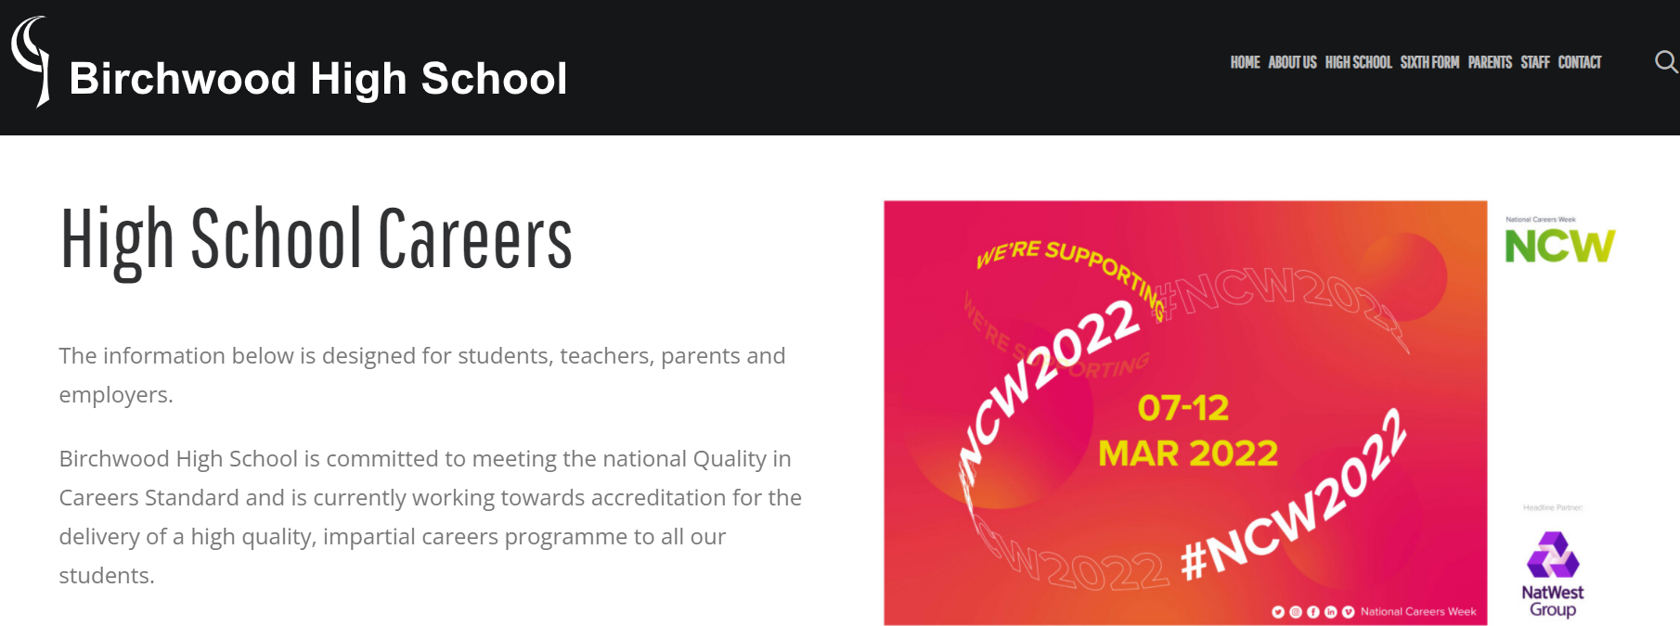
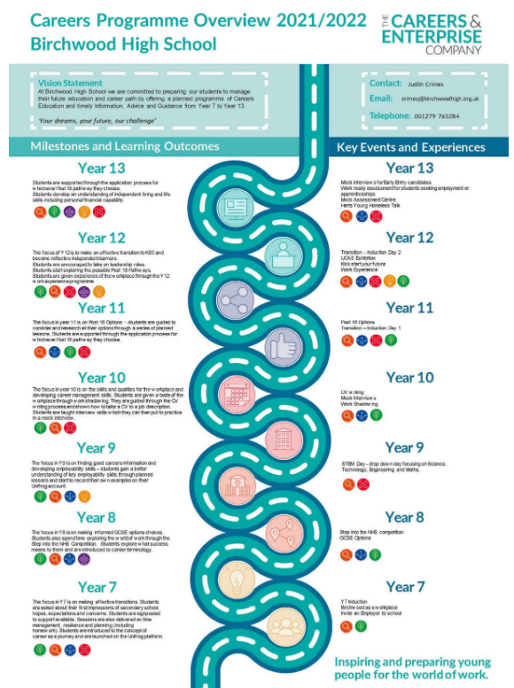
Investor in Careers Award through CSW
Assessed in September 2020 (via Teams!)
Achieved a grading of ‘Making good progress’
The evidence we were required to produce ensured that we were meeting GB1

Slide 59

Gatsby benchmark 1 – a stable careers programme
Every school and college should have an embedded programme of career education and guidance that is known and understood by pupils, parents, teachers and employers.
Website with all key information https://presdales.herts.sch.uk/careers/
Student facing google site for KS5 click here
Unifrog form time sessions for all year groups
Alumni/parent support in key events
  i.e. Careers week, Work shadowing
Strong SLT/Governor support
Alumni displays in subject areas
INVESTin partner school and Future First Alumni… can support social mobility
Using Unifrog to record interactions for each student and evaluate impact/evaluation
Year group focused communication with parents/carers
QiC award very useful as audit of good practise.
⬥
Ambition
⬥
Equality
⬥
Creativity
⬥
Integrity
⬥
Resilience
⬥
Kindness
⬥

Slide 60
Gatsby benchmark 3 – addressing the need of each pupil
Young people have different career guidance needs at different stages. Opportunities for advice and support need to be tailored to the needs of each pupil. A school’s or college’s careers programme should embed equality and diversity considerations throughout.
Teacher TLR holder responsible for development of STEM
Unifrog records all interactions for each student
  IAG action plan upload
  CV writing with application letter “Dream Job” in English lessons
  Personal statement for KS5
  Work experience “Placement” moduleon Unifrog
Use “Options” conversations with SLT for a further opportunity to discuss careers options
Lunchtime careers week sessions by Alumni open to all years selected by google form
SENCo/AHT inclusion involvement with SEND and PP students prioritised in year 8/9 for IAG meeting
⬥
Ambition
⬥
Equality
⬥
Creativity
⬥
Integrity
⬥
Resilience
⬥
Kindness
⬥

Slide 61
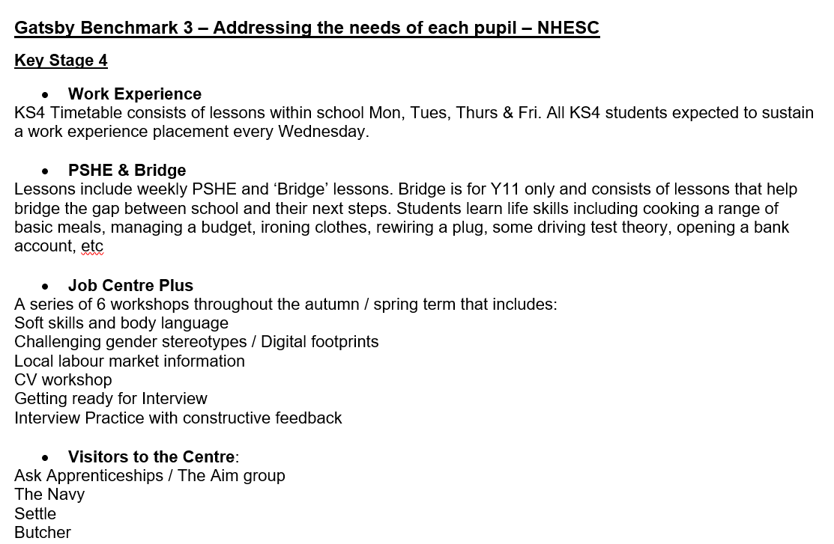
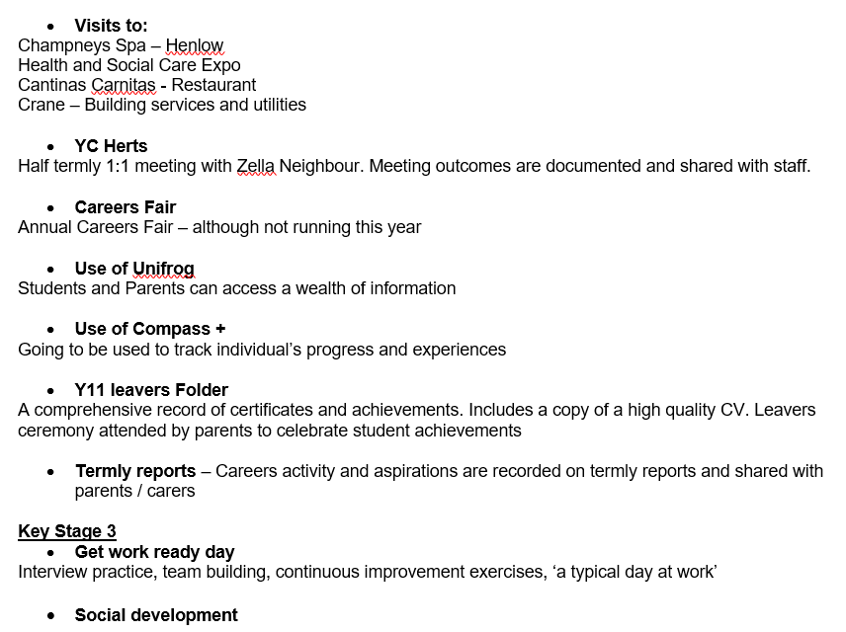

North Herts ESC
Click here to register for a place at this online conference

Slide 62

Chancellor’s Careers Day
Year 7 | Year 8 | Year 9 | Year 10 | Year 11 | Year 12 | Year 13
Work Shadowing Off Site | In School Workshops | NHS Talk | STEM Talk | ELSA |  | Work Experience
 | Unifrog Introduction | Herts Skills Framework Session | LMI & HOP Session
 | Social Media Footprint | Bring Your Friend to Work Day
 | Body Language

Slide 63
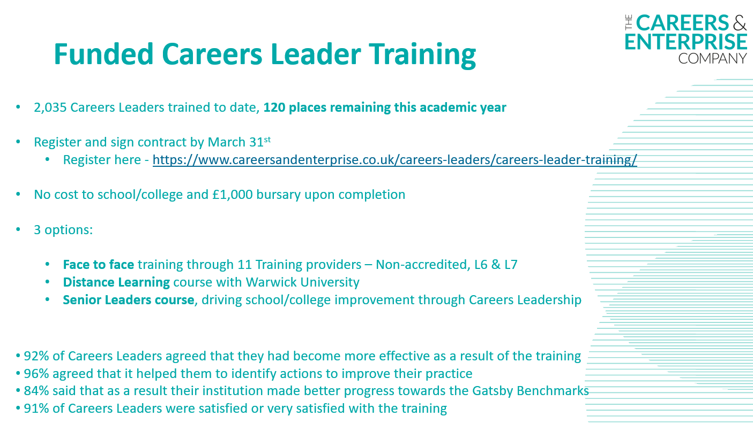
FREE Careers Leader Training & £1000 Bursary
Registration CLOSES 31st MARCH
Click here to register for a place at this online conference
In Herts schools where Careers Leader has participated in CEC Careers Leader training achieve average of 6.0 benchmarks – compared to 4.39 for those that haven’t.
https://www.careersandenterprise.co.uk/careers-leaders/careers-leader-training/

Slide 64



Upgrade to Compass Plus-School College Compass Completion due before Easter holidays
Click here to register for a place at this online conference
https://resources.careersandenterprise.co.uk/resources/compass
https://auth.careersandenterprise.co.uk/compassplus
Also has a future careers survey for each year group to complete annually to help inform your programme and GB1 evaluation

Slide 65

Would you rather be –Careers platform
Would You Rather Be is an Artificial Intelligence (AI) powered careers tool that helps young people find and get into a future-proofed career they’ll love.
Our award-winning software is part-funded by DfE and is specifically designed to be used in the classroom on whatever device pupils have available, in however long you have to talk about careers - whether that's a dedicated careers session in an IT lab, or short tutor sessions on smartphones.
Whatever the case, Would You Rather Be is designed to inspire our next generation and directly help Career Leaders tick Gatsby Benchmarks.
How it works:
Pupils answer 10 minutes of quick-fire 'would you rather be...' questions and our platform calculates the careers they’d be happiest in, based on their interests, skills and qualifications - and takes the future of work and job availability into account
We then generate every step that pupil will personally need to take to get into every career they are interested in, from where they individually are now, along with the time, cost and available funding, enabling pupils to make informed decisions
Phil Hewinson phil@wouldyouratherbe.com
*Herts special introductory offer £300+ VAT before 1st April*

Slide 66
New Gatsby Benchmark resources section on HOP
New from this week we now have a Gatsby Benchmark section on HOP
Please send through good examples of GB resources to me
steve.trotter@hertfordshirelep.co.uk
Click here to register for a place at this online conference
For any new Careers Leaders or EAs who have missed an induction we also have Careers Leader and EA Induction videos on HOP too, plus over Zoom next EA Induction is Wed 4th May 9.30am ask your EC for an invite
.
https://www.hopinto.co.uk/explore-careers/new-gatsby-benchmark-resources/

Slide 67



Key dates & events
Wednesday 15th June 2pm-3.30pm Gatsby Benchmark 5 & 6 workshop over Zoom
Invites to come out over Easter
Networking sessions in June tbc too

