Slide 1
Experiences of the Workplace Project 2023-24
Additional Funding from Careers and Enterprise Company to increase Gatsby Benchmark 6 attainment and ensure that ALL students gain impactful experience of the workplace opportunities.
Hertfordshire one of 6 High achieving Gatsby Benchmark 6 Hubs to be approached to deliver strand 1 ‘the final third’ pilot projects.
Project to run in 2023-24 academic year
Objectives – to test new models that will break down barriers
for schools, employers and providers to ensure that EVERY
young person can gain impactful experience of workplace
visits.
Partnership between:
Amazing Apprenticeships (Research)
Services for Young People (Main Delivery)
Schools
Employers

Slide 2
Gatsby Benchmark 6

Slide 3
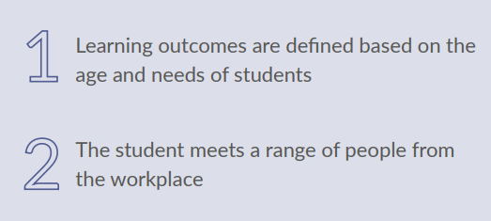
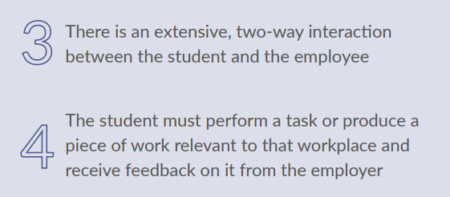
Gatsby Benchmark 6
Types of activities for Gatsby Benchmark 6 at employer premises:
Work experience/shadowing 1, 2 or 3 days.
Extended placement (1 day a week).
Workplace visits can be for 10-15 students to meet a few employees and have a short tour.
Inspiration/alumni activities.
Mock assessment centres-skills/teamwork development.
Careers speed dating/networking.
Application prep, hints and tips employer from an employers’ perspective, LinkedIn profile work, employability skills.
Work based project work e.g. a Marketing Challenge for your organisation
Preparation and reflection workshops for students on experience of the workplace.
To include an activity under Benchmark 6, it must meet the following minimum requirements:

Slide 4
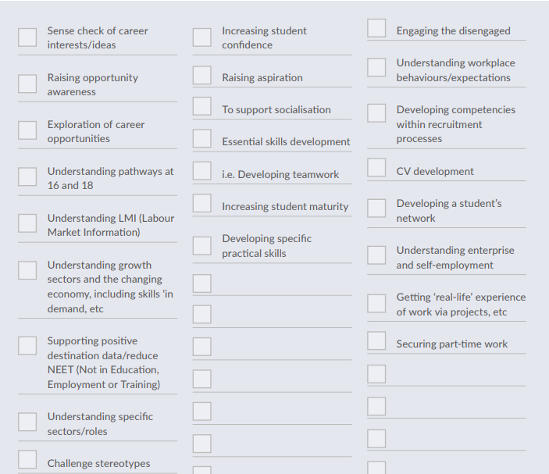
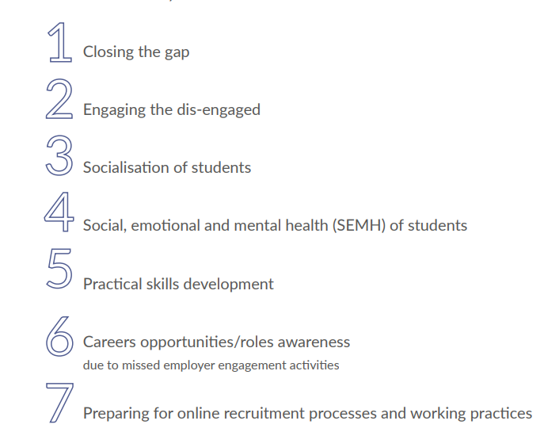
Gatsby Benchmark 6 Aims

Slide 5
Employer Standards –Consider using these as part of your Experience of the workplace
https://resources.careersandenterprise.co.uk/employer-standards-resource-directory
From Thurs 8th Nov 23 we will would love Hertfordshire employers to complete the Employer Standards (like Compass/Gatsby for employers)
https://www.careersandenterprise.co.uk/employers/employer-standards/

Slide 6
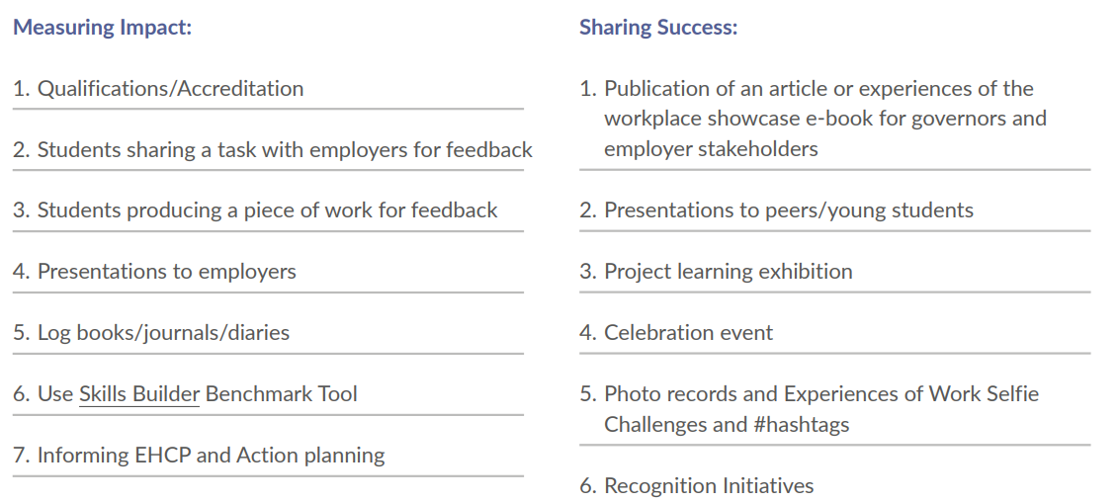
Gatsby Benchmark 6 –Impact & Share Success
Prepare and Reflect-What skills did the young person develop?
What are the next steps? Part-time job, LinkedIn profile etc.

Slide 7
Executive Summary
1. The perceived value of work experience and the positive impact it can have on a young person's aspirations.
There is no doubt that work experience is valued by schools and by employers in Hertfordshire. The interviews and surveys conducted with employers showed that each year, significant numbers of students in Years 10 and 12 undertake placements with local businesses. Businesses value being able to support their local schools and make significant investment in both time and resources to offer a variety of placements. For businesses that don’t yet offer placements, the majority stated that they had never been asked.
Both schools and employers are clear on the many benefits that work experience can bring to a young person in preparing them for the world of work, raising aspirations, increasing their confidence and communication skills, exposing them to a variety of job roles, helping them to gain new skills and potentially connecting them with future vacancies.

Slide 8
Executive Summary
1. The perceived value of work experience and the positive impact it can have on a young person's aspirations.
The research showed that systems for measuring the impact of the placement are less developed. The focus is often on the co-ordination, rather than the impact. Centralised evaluation activities that track and measure the impact for all parties are not consistently applied, yet all interviewed could see that increased reflection activities to review the placement and seek improvements would be useful.
The planning and selection of self-sourced placements seem to be primarily driven by the interests of the student combined with the connections of the family.
There were very few examples from schools or employers of how students can identify skills that they need to develop and how this could feed into the activities that they undertake in the workplace.

Slide 9
Executive Summary
2. Models of work experience that work best for schools and employers.
The traditional model of 5-day placements is still the preferred model by schools in Hertfordshire. There will be flexibility for students that are unable to sustain a placement for the full duration, with additional activities such as work-related projects being used.
Both schools and employers voiced concerns over this model as the move to hybrid working is now impacting the resource and capacity within the workplace to host students on placement. Both schools and employers could see the benefit of offering shorter placements for students e.g. 1 – 3 days. However, there was a strong sense that for schools, the 5-day placement works well. It means that the activity is contained, it causes less disruption to the school timetable and staff can support with monitoring activities.

Slide 10
Executive Summary
2. Models of work experience that work best for schools and employers.
Not all schools are following the traditional model of placements happening in the summer months. Some schools have moved their work experience weeks to earlier in the year (Feb/Mar/Apr) instead of the summer months and shared that this is working well.
Reasons for this included:
Prioritising work experience within the core timetable so that students realise how important it is.
Reducing competition with other schools for placements with local businesses.
Some employers will select and set their own dates for work experience based on business need and capacity.

Slide 11
Executive Summary
3. Identification of barriers that might prevent schools, young people and employers from being able to provide the most impactful work experience programmes.
The majority of schools use a self-source model for work experience, where students use their own personal networks or reach out to employers to find a placement. Schools shared concerns that students with working parents and professional contacts often benefit from more exciting and meaningful placements, and as parents can often support travel costs, they can broaden their search to include London and even overseas.
Less advantaged students can struggle to find high quality placements. In situations where parents do not work, do not have the personal connections and/or cannot afford the travel costs, the schools will support these students to find a placement. Some will use services such as SfYP Link+ however this has budget implications. Many schools also try to keep a list of local employers with placements.
Sourcing high-quality placements for students with additional needs is a challenge that all schools share. It is felt that placements are not as well-structured or meaningful as they would like them to be and the majority are often in retail, primary schools, care homes etc.

Slide 12
Executive Summary
3. Identification of barriers that might prevent schools, young people and employers from being able to provide the most impactful work experience programmes.
The interviews with employers also raised the issue of student preparation for placement. Employers would like students to be better prepared by the school/college so that placements can be more impactful. They would like a more consistent approach through schools to increase preparation activities across three main areas: - Research about the organisation – the services and products, the different job roles and sites/locations. - Taking an interest – thinking about the different functions of the business and coming prepared with activities that encourage questions to ask and information to source. - Employability skills – expectations of the workplace, what to wear, punctuality, behaviour and communication skills.
The ways that schools prepare students depends largely on the resource within the school. Some schools implement detailed plans involving parents and carers, form tutors and advice from previous students. Other schools may only be able to deliver a couple of assemblies, and communication is mostly via email.

Slide 13
Executive Summary
4. Suggestions for alternatives or new approaches to the delivery of meaningful work experiences.
There are a number of ideas that have emerged from this research. These fall into two themes:
Practical ways to boost experiences of the workplace for young people in Hertfordshire:
Trialling different methods and models of work experience e.g. shorter placements / group visits / rotations.
A focus on students that do not have access to meaningful placements e.g. students with additional needs and personal/social barriers.
Support for schools to implement work shadowing and/or ‘take your child to work’ days for younger year groups.
An employer campaign to source placements for 1-3 days and ½ day visits for 10-15 students.
Ideas for collaborative working within the county:
Facilitated best practice sessions to enable sharing of ‘what works’ for both schools and employers.
Training and guidance for those co-ordinating work experience within schools and employers to look at the structure and purpose of work experience placements, covering new ideas and emerging trends.
Planning and reflection sessions for students to better prepare for and reflect upon the placement and how it links to future goals.
Training for schools looking to implement a work shadowing or ‘take your child to work’ day for younger year groups.

Slide 14
Ideas for core delivery & support
Trialling different methods and models e.g. 1-3 days, ½ day visits for groups and rotational models.
Focus on creating meaningful placements for disadvantaged students
Growth in work shadowing and/or ‘take your child to work’ for younger year groups.
An employer campaign to source placements for 1-3 days and ½ day visits for 10-15 students,
The development of meaningful work-related tasks that support students to develop new skills.
Facilitated best practice sessions to share ‘what works’ for schools and employers.
Training and guidance for schools and employers focussed on the purpose and benefits.
Training for schools looking to implement work shadowing for younger year groups.
Training and guidance for schools on building lasting relationships with local employers.
Delivery of enhanced ‘planning and reflection’ sessions for students to assist with impact of placement.

Slide 15
Introduction
Services for Young People (SfYP) is part of Hertfordshire County Council and provides youth work projects, information, advice, guidance, work-related learning and wider support for young people in Hertfordshire
SfYP work with schools and students across Hertfordshire to facilitate block, bespoke and extended work experience, mock interviews, CV workshops, Careers carousels and fairs, employer visits and more
We manage several projects working with young people and employers across Hertfordshire including the ASK programme, the employer liaison element of Hertfordshire Opportunities, Hop into your future and many more
Details of the SfYP offer can be found here: Employers (servicesforyoungpeople.org)

Slide 16
Project survey / next steps
You will shortly be receiving a short project survey which will ask for information that will help us establish the best ways we can support you to engage with schools and students. It will include questions around
your current school engagement
capability and capacity to support this project – including information on the type of support that may be required
confirming your existing health and safety policies, procedures, risk assessments & insurances are in place to be able to support students in the workplace

Slide 17
SfYP Support / facilitation
co-ordination / planning of activities to ensure they are effective and engaging
school/student liaison as required by each employer
provide templates for activities
sharing best practice
guidance in relation to best practice when working with groups of students (where required)

