Slide 1


INTRODUCING…
PUBLIC AND EMERGENCY SERVICES
LMI CONFERENCE
JAN 2025

Slide 2
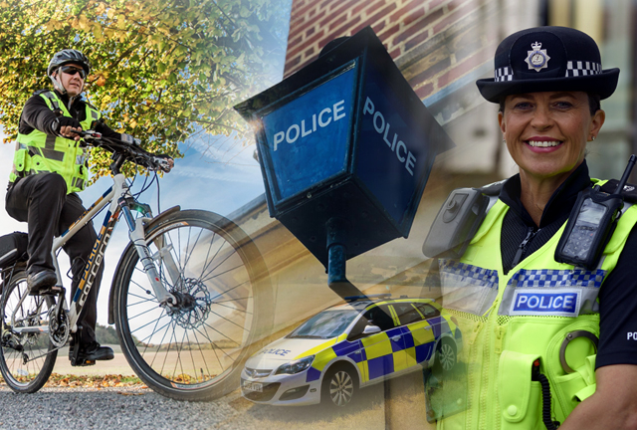




INTRODUCING…
HERTFORDSHIRE CONSTABULARY
Who are we?
Hertfordshire Constabulary is the territorial police force responsible for policing the county of Hertfordshire in England. The force consists of over1, 1,900 police officers, 235 PCSOs, over 1500 police staff, as well as being supported by more than 410 special constables.
Why join us?
We’re recruiting for all kinds of roles here at Hertfordshire Constabulary. We need police officers and detectives, and our training schemes combine work-based and off-the-job learning, giving a direct route into an exciting career like no other. You’ll be a police officer from day one, earning £32,007 (including regional allowance) which will rise to £51,231 within a few years. We’re also taking applications for Police Community Support Officers (PCSOs) and all kinds of police staff jobs, everything from communications operators.

Slide 3
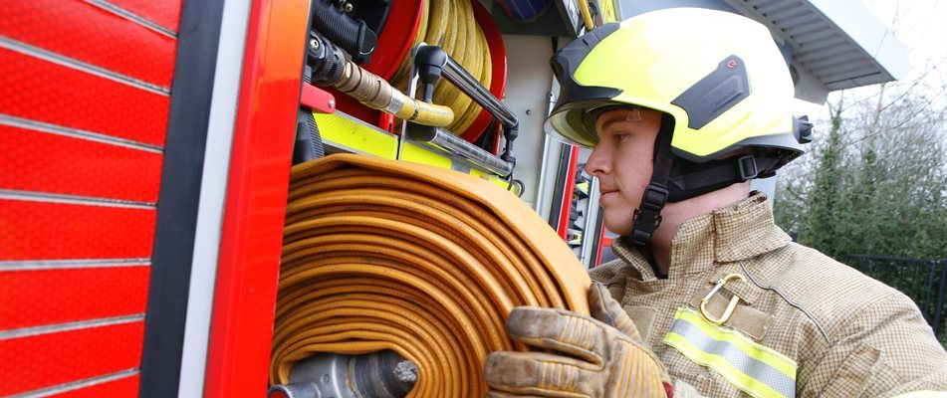

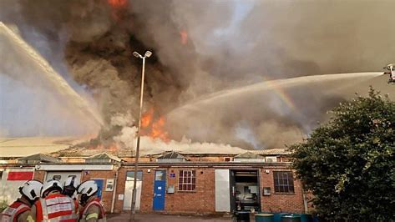
HERTFORDSHIRE FIRE & RESCUE SERVICE
365 days a year 24 hours a day
1000+ staff
29 fire stations
Full-time (75%) and part-time (25%) personnel
Cover 634 square miles / 1.20 million people
Statutory duty to attend emergency incidents
Legislative duty to enforce the law
Targeted community fire safety initiatives
Part of the Community Protection Directorate
“WORKING TO PROTECT, ACTING TO SAVE”

Slide 4


ICEBREAKER…ARE THESE STATEMENTS TRUE OR FALSE?
Detectives hold a higher rank than Police Constables.
You need a degree to become a Police Officer.
A Police Constable and a Police Officer are two different ranks.
Police officers eat a lot of donuts.
Fitness tests are vigorous and it’s extremely hard to pass.
The job is extremely dangerous.
Police officers are NOT allowed tattoos.
You cannot join the police if you have a criminal record.
There is a minimum height requirement to join the police.
Police officers don’t work nights, bank holidays or special occasions.

Slide 5
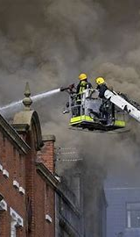
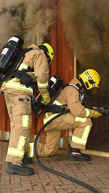
ICEBREAKER…ARE THESE STATEMENTS TRUE OR FALSE?
Firefighters sleep during night shifts
Firefighters go in the gym all day while waiting for calls
Firefighters don’t get paid much
Firefighters need to be super fit
Firefighters get a lot of time off including Christmas
Firefighters only work part-time and have second jobs
Firefighters must be over 6 feet tall
Firefighters are not allowed tattoos and piercings
Firefighters are all brave and have no fear
Fire stations have cooks that make all their food
Firefighters don’t really climb ladders and work at height
Firefighters can see their route clearly in a fire
Firefighting is not that dangerous

Slide 6
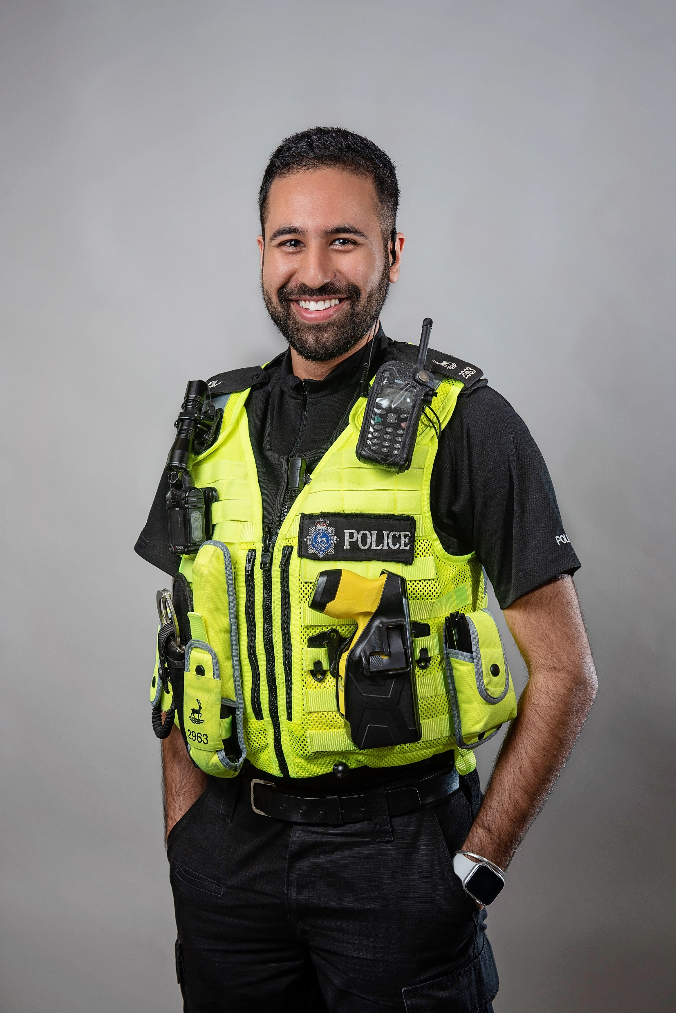
OUR MOST IN-DEMAND
ROLES…
Intervention/ Response Police Officers – 999
Detective Constable – Investigatory Units
Neighbourhood Policing Team
Force Control Room – 999/ 101 Call Handlers
Police Community Support Officers
After completing your probation on any of these units, you can then aspire to specialise depending on our internal vacancies. These may include jobs such as; firearms, dog unit, traffic, plain clothes proactive units, safeguarding investigation teams etc.

Slide 7
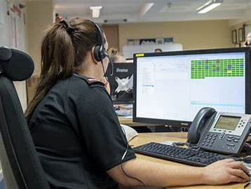
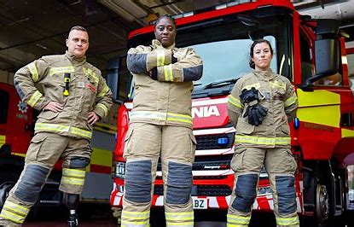
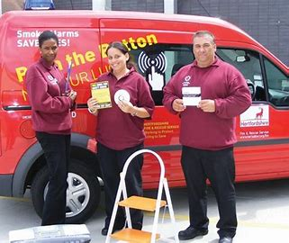
OUR MAIN ROLES
Operational (Wholetime / On-Call)
Fire Control Operators
Service Support Roles
Community Volunteers Task Force
HHSS: Herts Home Safety Service

Slide 8
PATHWAYS INTO POLICING – subject to change…
PCDA | PCEP
3 Year Probation | 2 Year Probation
32 UCAS Points | At least one year work experience or studying with comparable skills to policing. or A level qualifications. or Work experience within Policing roles or armed forces
BSC Prof. Policing | Level 5 equivalent qualification
PCEP - D
3 Year Probation
The same as PCEP
Level 5 equivalent qualification and PIP 2 detective
Starting salary for all pathways is £32,907 which includes £3,000 South East Allowance
All officers are required to work shift patterns according to the department they are on. This will initially include weekends, bank holidays, earlies, lates and nights.

Slide 9
PATHWAY TO JOINING FIRE & RESCUE
PRE-SELECTION
HOME OFFICE STANDARD TESTS
PHASE 1
RECRUIT SQUAD – BASIC TRAINING
PHASE 2
CONTINUOUS PROFESSIONAL DEVELOPMENT
PHYSICAL APTITUDE TESTS
PHYSICAL FITNESS TESTS
WRITTEN TESTS & APPLICATION
INTERVIEWS & MEDICAL
START OF APPRENTICESHIP
PROBATIONARY PERIOD
ANNUAL COMPETENCY ASSESSMENTS & PERIODIC FITNESS ASSESSMENT
SPECIALISM / PROMOTION

Slide 10

SKILLS AND QUALITIES REQUIRED
Fairness
Objectivity
Openminded
Leadership
Selflessness
Honesty
Accountability
Integrity
Respect

Slide 11
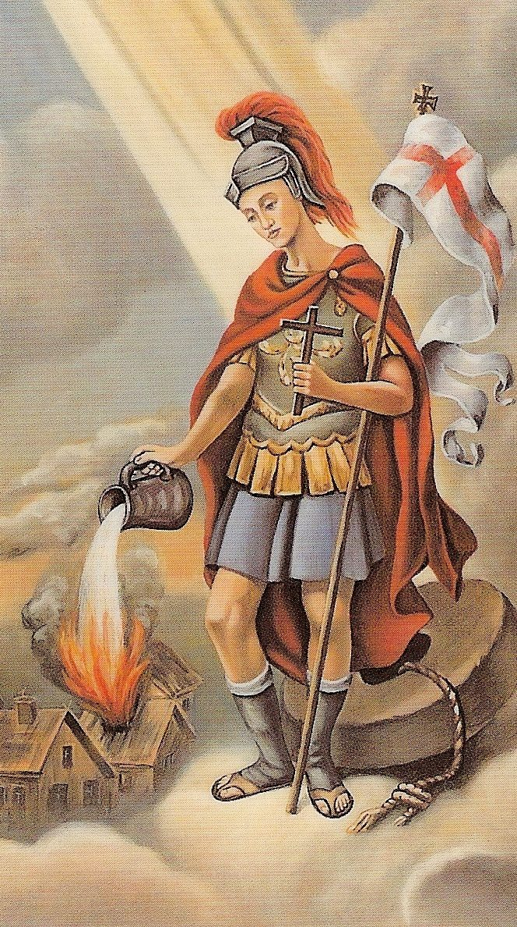


SKILLS AND QUALITIES REQUIRED
PHYSICAL FITNESS
WILLPOWER
CALMNESS
COURAGE
DISCIPLINE
POWERS OF OBSERVATION
SITUATIONAL AWARENESS
INTELLIGENCE
INITIATIVE
PATIENCE WITH THE PUBLIC
ENQUIRING MIND
PRIDE IN APPEARANCE

Slide 12
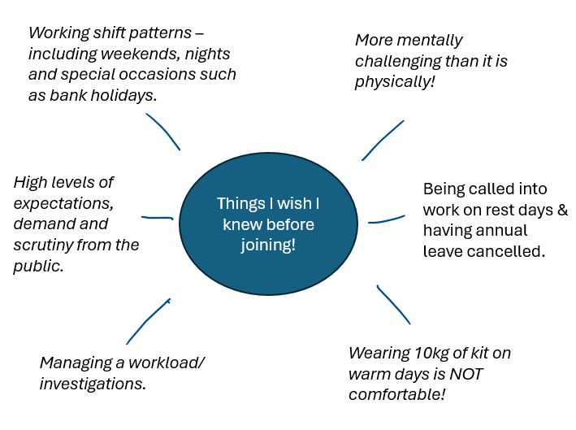
MANAGING EXPECTATIONS…
WHAT JOBS WILL YOU DEAL WITH?
Know what they are getting into/ applying for.
Have a realistic expectation of what the job entails.
Deaths- decaying bodies, hangings, other suicides.
Mental health – crisis, ABD, self-harm, drug overdose.
Violence – stabbings, murders, assaults – against members of public and towards you as an officer.
Missing people – elderly, learning disabilities, suicidal people.
Prisoner guards/ scene guards.
Domestic incidents.
Burglaries/ thefts.
Investigations – crime reports, lines of enquiry, suspect interviews & case files – taking them to court.
Gang related violence & drug use/ drug dealing.
Suspects in possession of weapons.
Road traffic collisions/ traffic management.
Vehicle related crime.
Sexual assaults – both over 16 and under 16 years of age.
Fraud.
Driving on blue lights & carrying a taser.

Slide 13
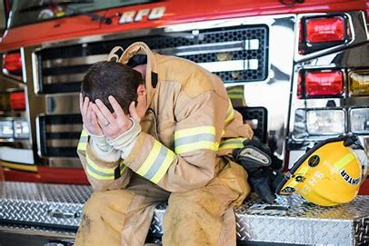
I WISH I’D KNOWN THAT BEFORE JOINING…..
TIRING SHIFT WORK
MENTALLY DRAINING
HIGH PRESSURE DYNAMIC SITUATIONS
WORKING AT HEIGHT
WORKING IN CONFINED SPACES
WORKING IN HEAT & HUMIDITY
DEALING WITH DEATH
PERSONS IN CRISIS
PEOPLE WHO HAVE LOST EVERYTHING
VIOLENCE & ABUSE
PUBLIC SECTOR BUDGET RESTRAINTS
UPSETTING SCENES
DISCIPLINE & CHAIN OF COMMAND
PROBATIONARY PERIOD
WORKLOAD & TARGETS
HIGH EXPECTATIONS OF PUBLIC

Slide 14

Where to access more information…
Here is how:
Head over to our website
Hertfordshire Police - Police Officer (hertspoliceofficer.co.uk)
Click on the tile “Register your interest” and fill in requested details
Check your junk/spam folder for emails from us!

Slide 15
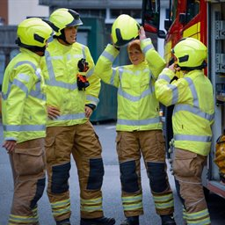
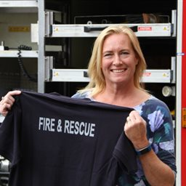

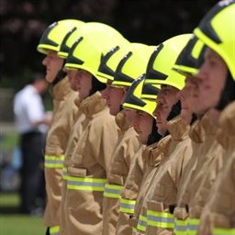
Jobs at Hertfordshire Fire and Rescue Service | Hertfordshire County Council
Jobs at Hertfordshire Fire and Rescue Service
Feel rewarded, respected and valued.
Improve your community whilst progressing your career.
When you're ready for your next challenge, Hertfordshire Fire and Rescue is here.

Slide 16
ANY QUESTIONS?
Herts Police Recruitment Inbox:
Recruitment@bch.police.uk
Positive Action Inbox:
positiveaction@bch.police.uk

