Slide 1
INTRODUCING… DIGITAL & TECHNOLOGY
LMI CONFERENCE
JAN 2025

Slide 2
INTRODUCING…
225,000 jobs available in Digital Sector in the UK
Average wage in this industry is approximately £32,000
There are over 8,200 digital businesses in UK
20,000 jobs available in the Tech Sector in Hertfordshire
Average wage in the technology industry is approximately £47,411
There are over 5,000 tech businesses in Hertfordshire

Slide 3
ICEBREAKER…ARE THESE STATEMENTS TRUE OR FALSE?
You need to be skilled in Maths and Science at A-levels or degree level
Almost all tech jobs are going to be replaced by robots in the future
The tech industry is still heavily male-dominated
Students do not need to have studied IT or Computer Science to work in technology
The average attention span of internet users is around 20 seconds
Students need to have a degree qualification in media/marketing to get into digital

Slide 4
OUR MOST IN-DEMAND ROLES
Cloud Engineer
Data Science Manager
Site Reliability Engineer
Data Engineer
Security Operations Centre Analyst
Machine Learning Engineer
Software Engineer
Product Analyst
Social Media Manager
SEO Specialist
Content Marketing Specialist
PPC Specialist
Email Marketing Specialist
Web Developer
Video Content Creator
Account Manager

Slide 5
SKILLS AND QUALITIES REQUIRED OR RECOMMENDED
Communication skills
Leadership skills
People skills
Presentation skills
Problem-solving skills
Critical thinking and analytical skills
Coding skills (if required for technical roles)
Project management skills
Computer Science
Maths
Business Studies
Languages
History
Geography
Art/Design/Media
Project Management
Data Analyst
English language/literature

Slide 6
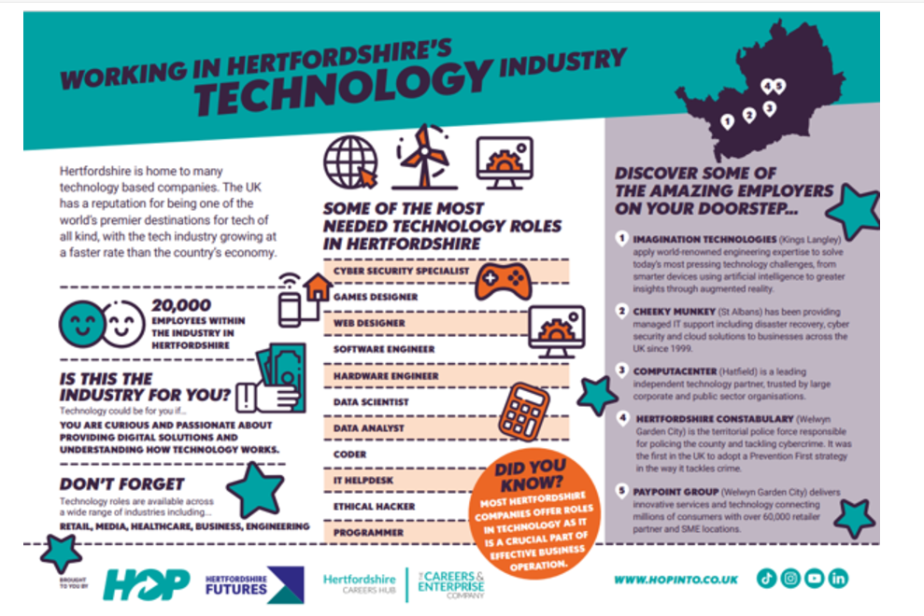

Slide 7
ANY QUESTIONS?
Renée Ramsay-Nicol: Early Careers CSR Specialist at Computacenter
ricca-renee.ramsay-nicol@computacenter.com
Emma Ellis: Managing Director at Amber Mountain
emma@ambermountain.co.uk
Key Links:
https://www.computacenter.com/en-gb/careers/future-talent
www.ambermountain.co.uk

