Slide 1
HERTFORDSHIRE SKILLS FRAMEWORK GET….WORK….READY

Slide 2
KEY EMPLOYABILITY SKILLS
What characteristics are most valued by Hertfordshire employers?
Think about
Personal skills
People skills
Technical skills
Practical skills
Why do you think these qualities are so important?
Hertfordshire Skills Framework (hopinto.co.uk)

Slide 3
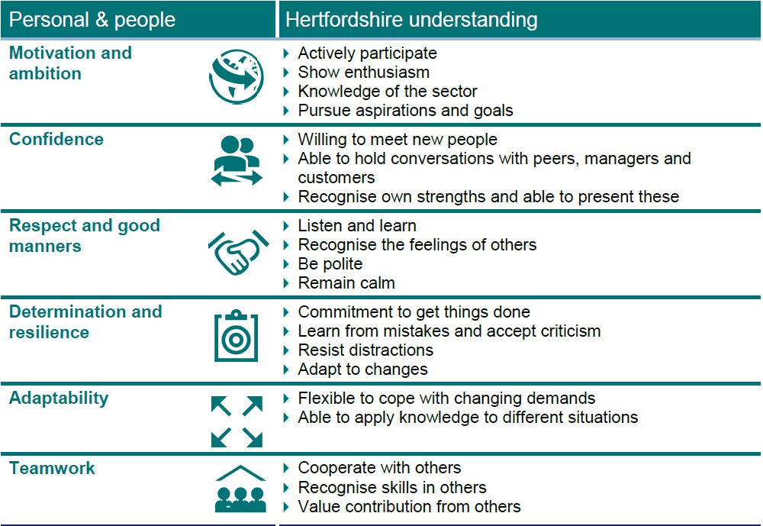

Slide 5
HOW DO YOU SCORE? (Mark yourself out of 10)
Personal and people
Motivation and ambition
Confidence
Respect and good manners
Determination and resilience
Adaptability
Teamwork
Technical and practical skills
Numeracy
Literacy
Business and customer awareness
Analytical and problem-solving skills
Digital technology
Qualifications

Slide 6
KEY EMPLOYABILITY SKILLS
How do you demonstrate them in school?
How do you demonstrate them out of school?
At home
In the community
In clubs or events
How would you demonstrate them at interview?
How would you demonstrate them in your first job?

Slide 7
MY EMPLOYABILITY SKILLS
Which are your best skills?
How have you demonstrated them?
Think about what you have done during your lessons, during activities and outside of school.

Slide 8
MY EMPLOYABILITY SKILLS
Which skills do you need to improve?
How will you develop these skills in the future?
Think about what you may learn in future lessons.
Can you do any personal development activities in or outside of school?
Are you doing work experience or attending a careers fair?

Slide 9
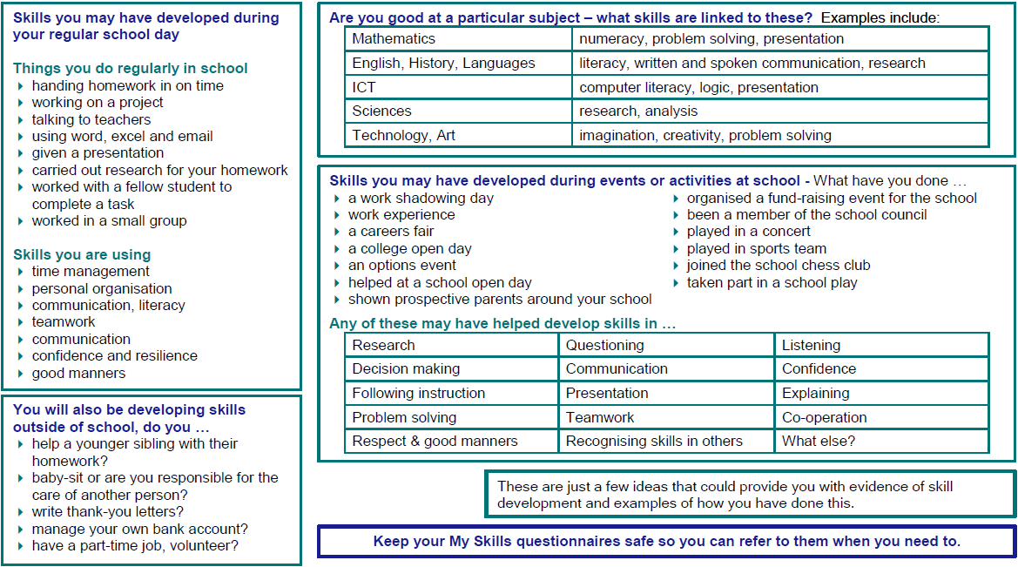

Slide 13
CONTACT SLIDE
Material produced in conjunction with
Herts for Learning

