Slide 1



INTRODUCING…
HOSPITALITY & TOURISM
LMI CONFERENCE
JAN 2025

Slide 2
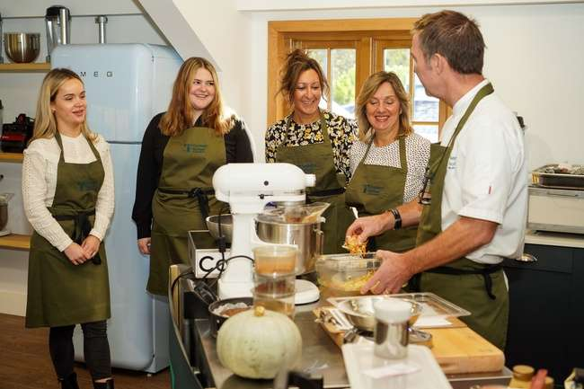

INTRODUCING…
321,000 businesses in the UK tourism industry, generating over £150 billion every year
3.6 million people employed by the UK tourism industry
42,973 estimated actual jobs in Hertfordshire supported by tourism and hospitality
Notes:
A core component of domestic tourism in the UK is people holidaying at the beach or in the countryside. This moves £25bn per annum from urban to rural and seaside economies (£50bn per annum if expenditure in small towns and by overseas visitors is included) and represents the largest non-governmental redistribution of wealth in the UK, making tourism a key mechanism for levelling-up.

Slide 3

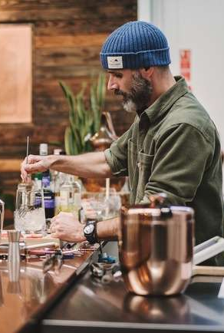
TRUE OR FALSE?
Tourism and hospitality is the UK’s 3rd largest employer
Jobs in tourism and hospitality account for 6% of all jobs in Hertfordshire
The VAT paid by international visitors on each Boeing 777 landing at Heathrow is the same as the annual salary for two NHS nurses.
Notes:
Bigger than telecoms and computer services, construction and engineering and agriculture and fisheries.

Slide 4
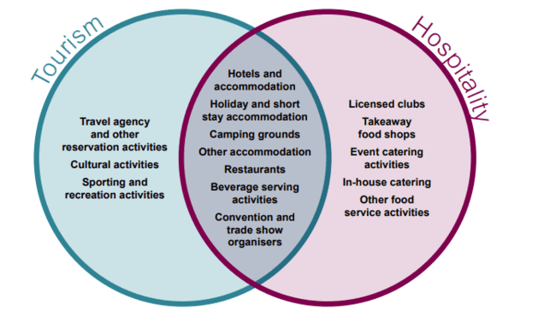
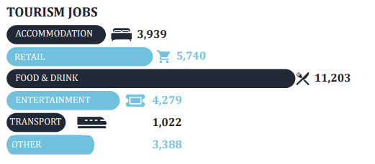
OUR MOST IN-DEMAND ROLES
3 key skills challenges
Staff retention, employee turnover and churn
Brexit and the shortages of EU workers
Recruitment and perceptions of the sector

Slide 5

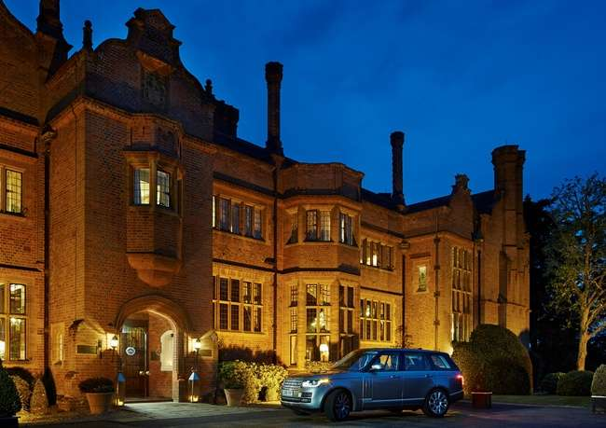
SKILLS AND QUALITIES REQUIRED
Hanbury Manor Marriott Hotel & Country Club
We recruit talent not skills
For most entry level jobs, no specific qualifications are required
Good customer service/people skills
Teamwork
Communication – written and verbal
Commitment
Opportunities to work in different brands, locations, sizes of hotels plus area/corporate offices
Development and training
Good benefits and work culture

Slide 6

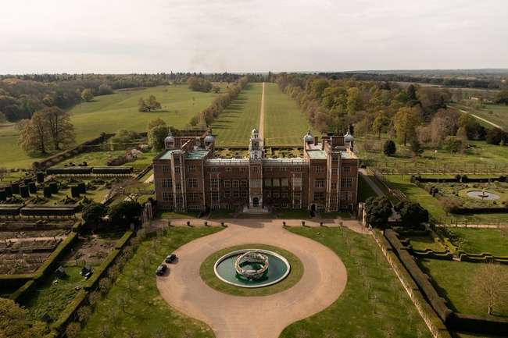
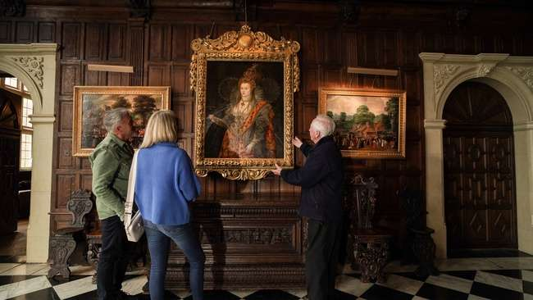
ROLES AND SKILLS REQUIRED

Slide 7

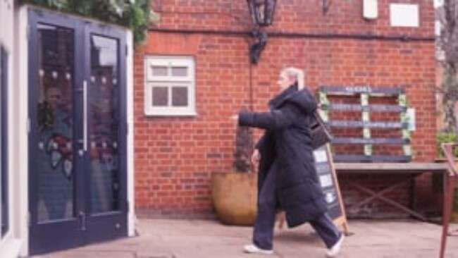

Slide 8



Slide 9
ANY QUESTIONS?
Alanna Kite
Head of Partnerships
alanna.kite@visitherts.co.uk
UK Hospitality
Career Scope
UKinbound
Hospitality Jobs UK
HIT Training

