Slide 1












preparing for workplace experience

Slide 2
what impresses employers during workplace experience?

Slide 3
what impresses employers on workplace experience?
Watch this film featuring several employers who work with people on workplace experience.
You’re going to be asked some questions after the film, but you don’t know what they are yet, so watch and listen carefully!

Slide 4

Watch carefully as there are some questions after!
Click this link to launch video

Slide 5
what impresses employers on workplace experience?
Now you’ve watched the film, can you answer these questions?
What advice does the film give if your workplace experiences ISN’T something you’re interested in doing in the future?
Why should you try to impress on your workplace experience?
What impresses employers? Can you name five things?
What can you do to prepare for workplace experience?

Slide 6
what impresses employers on workplace experience?
1. What advice does the film give if your workplace experience ISN’T something you’re interested in doing in the future?
Don’t waste it! Even if it’s not what you want to do, you could still gain some useful skills and valuable experiences.
2. Why should you try to impress on your workplace experience?
It could lead to something amazing – more experience, an apprenticeship or a job. Or the employer may connect you with other employers who could offer you more relevant workplace experience, a job or an apprenticeship in the future.
3. What impresses employers? Can you name five things?
Being on time
Dressing appropriately for the workplace
Taking the initiative
Researching the employer
Having a positive attitude
Listening
Collaborating
Asking questions
Bringing the best version of yourself
Positive body language
Looking interested and engaged
Interest and knowledge of the business
Being polite, well mannered, reliable and personable
Putting ideas forward

Slide 7
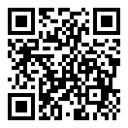
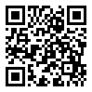
preparing for workplace experience
Before you go on workplace experience, you’re going to complete some activities to help you prepare so you get the best out of the experience.
To understand if these activities are helpful for you, we’d like you to complete an anonymous survey, which asks some questions about you, your careers knowledge and skills.
We are asking you to complete this survey now (before you complete any activities) and would like you to complete it again at the end of the year if possible.
Year 7-11
Year 12 & 13
https://tinyurl.com/mr4eydje
https://tinyurl.com/3t3ua936

Slide 8
evaluating your skills

Slide 9
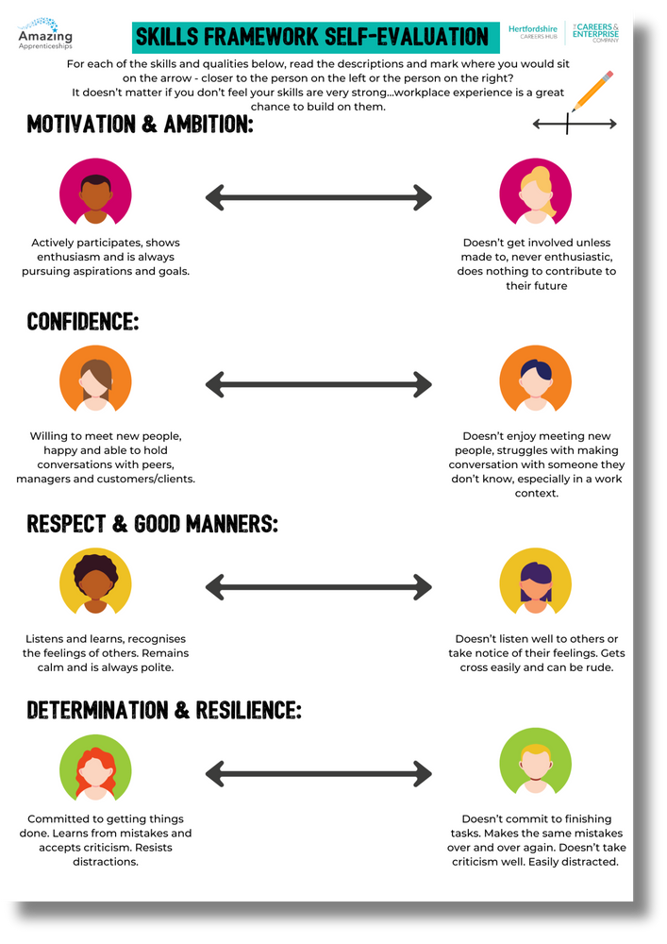


self-evaluation
For each of the skills and qualities below, read the descriptions and mark where you would sit on the arrow - closer to the person on the left or the person on the right?
It doesn’t matter if you don’t feel your skills are very strong...workplace experience is a great chance to build on them.

Slide 10
which skills do you most want to improve?
Now that you’ve evaluated where you feel you sit on the skills’ scales, let’s think about which skills you want to improve.
Think about...
  Which skills are most important to you to improve.
  Is there anything that feels impossible?
  Is there anything you feel confident you can develop on your own BEFORE your workplace experience?
  Is there anything you think you’d need to be on the placement to develop?

Slide 11
developing your skills

Slide 12
developing your skills
Now that you have identified your strengths and what you could improve, how do you do it? A great opportunity to do this is during your workplace experience.
There are some things it will be important you think about BEFORE workplace experience, so you have the best chance of impressing the employer in the way we saw in the film.
There are other things you could build on DURING your workplace experience placement.
Let’s have a look at some of them now...

Slide 13



how to develop your skills before or during
workplace experience
confidence:
Willing to meet new people, happy and able to hold conversations with peers, managers and customers/clients.
Doesn’t enjoy meeting new people, struggles with making conversation with someone they don’t know, especially in a work context.
before? during? or both?
What can you do before your workplace experience?
What can you do during your workplace experience?

Slide 14

how to ask employers to help you develop your skills
Everyone at this organisation is great at talking to customers! I’ve often felt nervous about talking to new people. Would it be okay to sit in a couple of meetings and get some ideas?
I don’t think I’m very good at talking to new people. Can I practise on one of your customers?
which might get the best response?
Why?
confidence

Slide 15


how to develop your skills before or during
workplace experience
Motivation & ambition:
Actively participates, shows enthusiasm and is always pursuing aspirations and goals.
Doesn’t get involved unless made to, never enthusiastic, does nothing to contribute to their future
before? during? or both?
What can you do before your workplace experience?
What can you do during your workplace experience?

Slide 16

how to ask employers to help you develop your skills
One of my goals is to present at a meeting by the end of this year - is this something I could do while I’m here, with what I’m presenting checked before, of course?
I don’t really have any goals, is there anything you can think of that I should try and achieve? What have other work experience people done?
which might get the best response?
Why?
Motivation & ambition

Slide 17
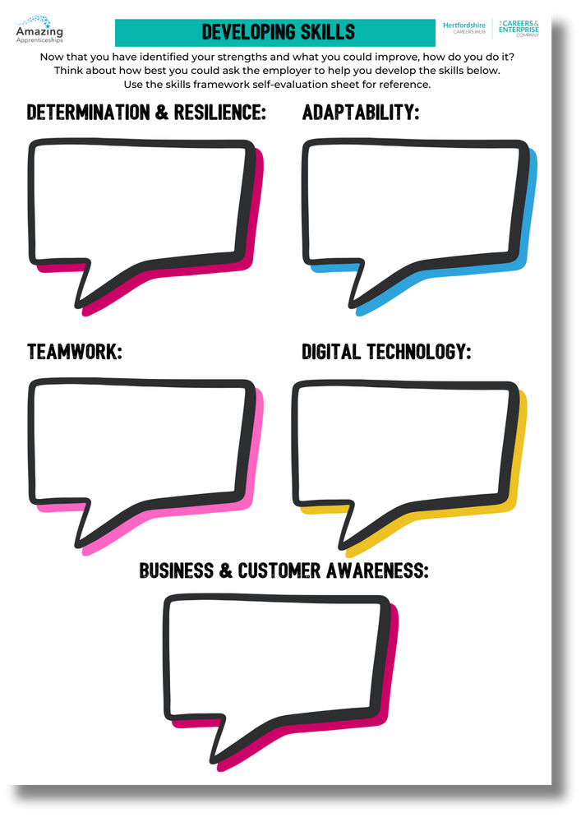
how to ask employers to help you develop your skills
Now think about how you could ask your employer to improve your skills in the areas on the worksheet:

Slide 18
preparing for workplace experience

Slide 19

how to prepare for your workplace experience
Make sure you have taken on board all of the instructions and information you’ve been given by your school or college. Lots of the information below may have been organised for you. But if not:
  Get in touch with the organisation before your placement.
  See if you can attend a pre-placement meeting.
  Research the organisation.
  Find out what you should wear and get prepared.
  Find out what you might need to bring, for example would they like you to bring in a CV?
  Plan your journey.
  Find out who to ask for when you arrive.
  Think about positive body language.
  Be ready to share any skills you’d like to develop.

Slide 20
post workplace experience
survey

Slide 21
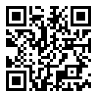
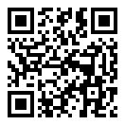
reflecting on your workplace experience
We’d like you to complete this anonymous survey, which asks some questions about you, your careers knowledge and skills now that you’ve completed your workplace experience.
The survey takes about 5 minutes to complete. Please read through each question carefully. There are no right or wrong answers so please answer the questions as honestly as you can.
It also asks some questions about yourself at the end of the survey, these questions are optional.
Year 7-11
Year 12 & 13
https://tinyurl.com/yc447fzp
https://tinyurl.com/466vukht

